Slide 1

Using anti-racism lens in quality improvement
Dr Nandi Simpson
Director of Implementation
Sarindi Aryasinghe
Head of Implementation
Notes:
Sam

Slide 2
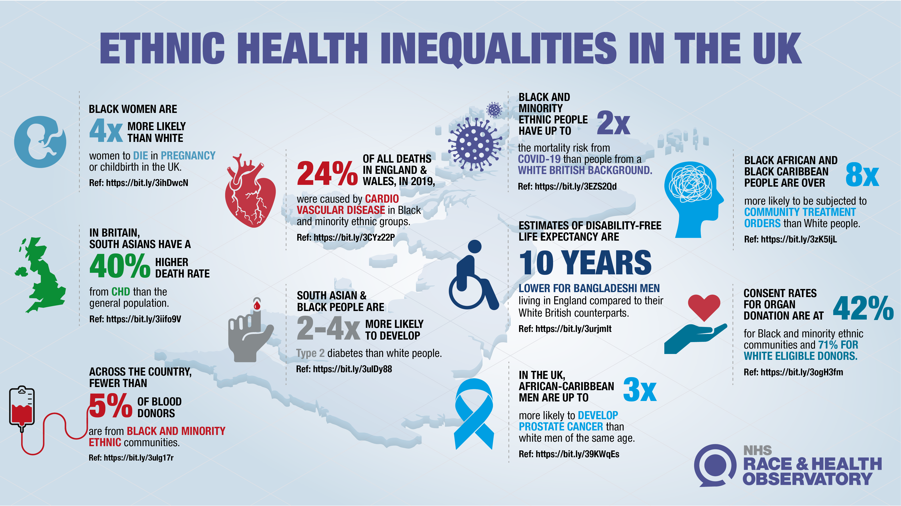

Slide 3



NHS Race and Health Observatory
The NHS RHO defines racism in health as:
the process by which members of a racial or ethnic group have unequal access to services and resources, differential experiences within the healthcare system, and diverging health outcomes when compared with the White majority group. As such, racism harms individuals and undermines the full potential of the whole of society.
1
    EVIDENCE – We produce evidence about racial and ethnic inequality in health;
      commissioning original research to fill knowledge gaps
      synthesise and mobilise existing evidence
2
INFLUENCE- We use the evidence we commission and mobilise to influence leaders through practical recommendations for policy and practice
3
IMPLEMENT- On the basis of our recommendations, and in response to the needs of the communities we work with, we work to support the implementation of new policies and practice at the grassroots.

Slide 4
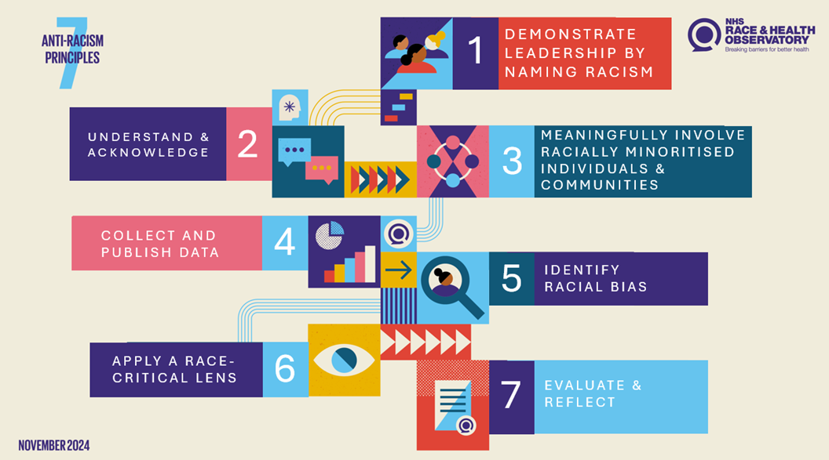


Slide 5
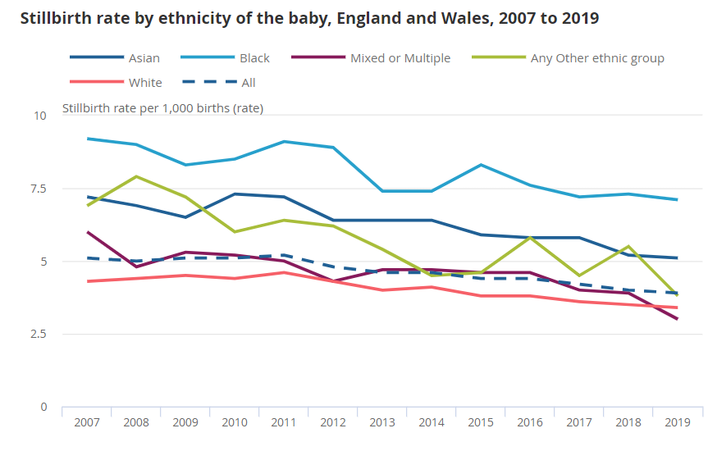
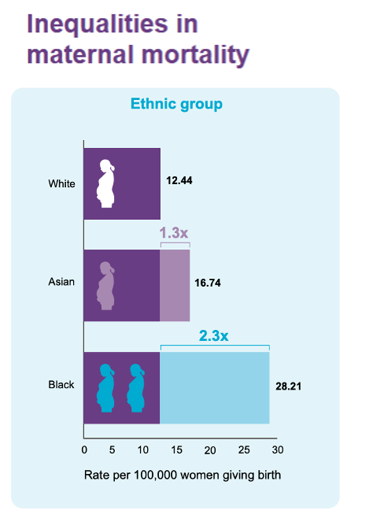
Maternal & neonatal ethnic health inequalities in the UK
Overall, if all infants in England had the same risk of death as White infants, 12.0% of deaths would be avoided (>200 infants per year)
Births and infant mortality by ethnicity in England and Wales - Office for National Statistics (ons.gov.uk)

Slide 6
RHO Learning and Action Network: purpose
WHY?
No large scale maternal and neonatal improvement programme has focused specifically on racial/ ethnic inequalities and there are evidence gaps around translatable interventions to reduce maternal and neonatal ethnic health inequalities
Racism is one of the factors that underlies the persistence of the maternal & neonatal ethnic health inequalities
We aim, through this programme, to:
develop an anti-racism focused QI approach, that supports practitioners to identify and address racism within maternity services;
Identify, scale and spread improvement approaches that embed anti-racism into services and improve maternal and neonatal health outcomes
WHAT?
HOW?
Notes:
Commissioned by NHS RHO in 2022
Aim: to map existing policy interventions designed to tackle ethnic health inequalities in England

Slide 7
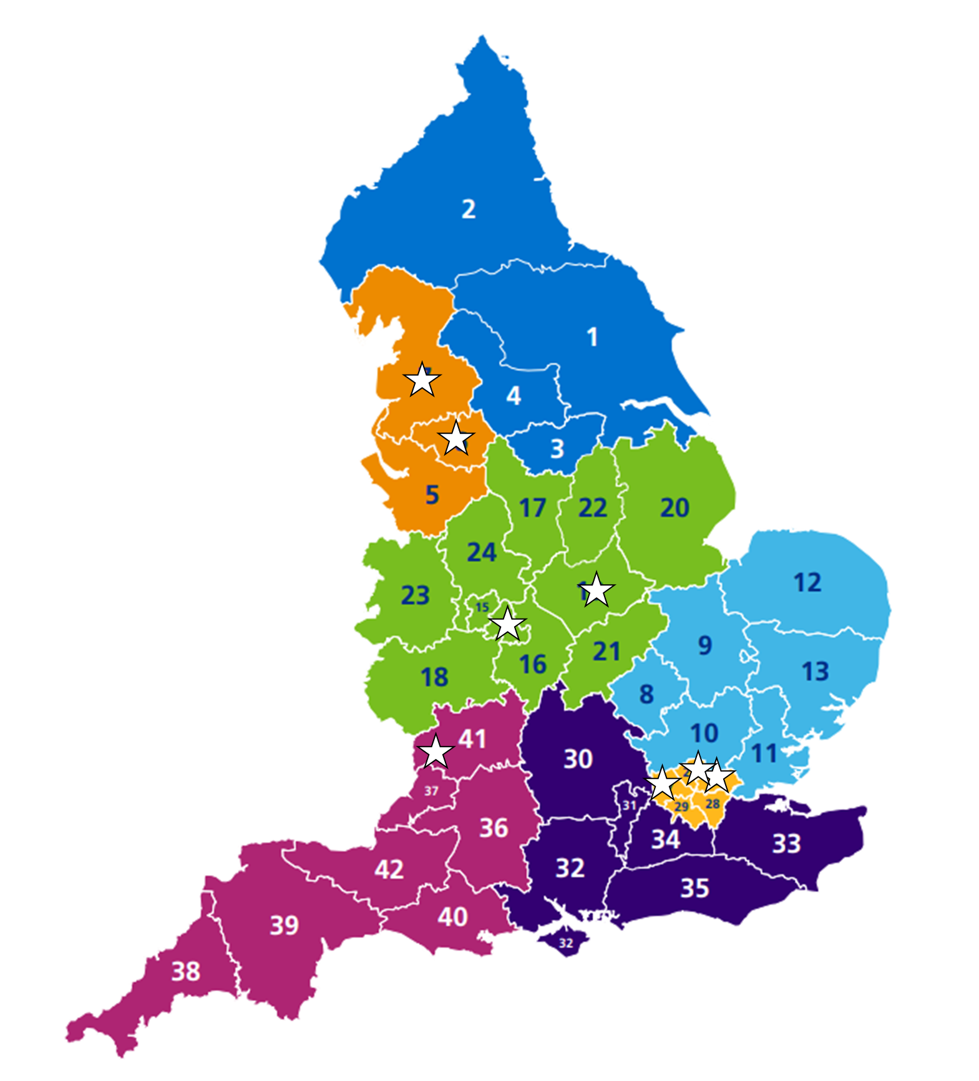

RHO Learning and Action Network: overview
  10 NHS organisations across 4 regions in England
  4 conditions:
    Post-partum Haemorrhage
    Gestational Diabetes
    Perinatal Mental Health
    Preterm Birth
  14 months Jan 2024 – Dec 2025
1 aim: To reduce clinically avoidable severe maternal morbidity, perinatal mortality and neonatal morbidity while improving the experience of care for pregnant women and people from Black, Asian and minority ethnic groups.

Slide 8




Imperial College Healthcare NHS Trust : Risk Assessment Awareness Don’t Miss the Signs
Pale lips
Pale conjunctivae
Pale palms
Pale nail beds

Slide 9
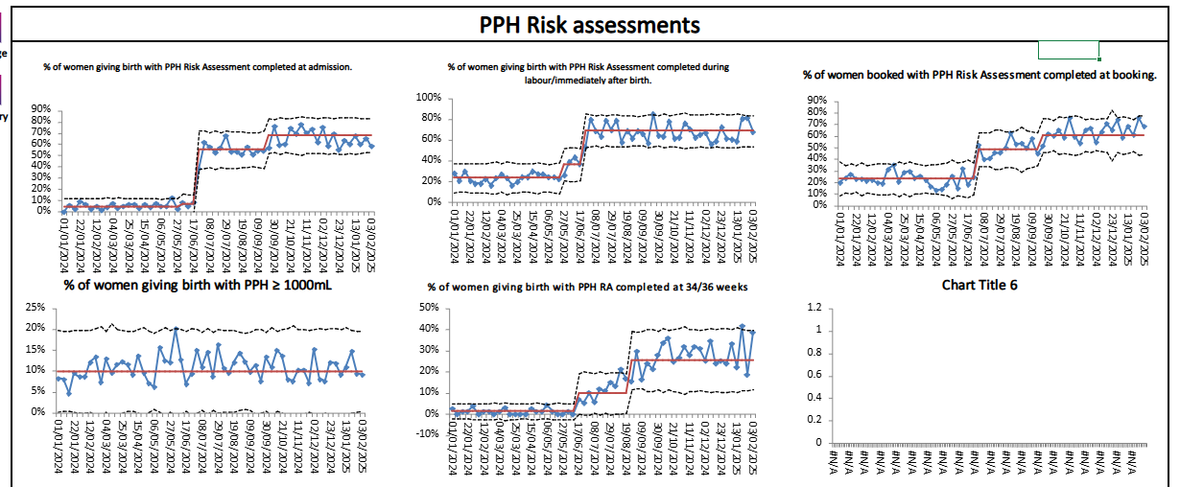
Lancashire Teaching Hospitals NHS Trust : Increasing process reliability in postpartum haemorrhage

Slide 10
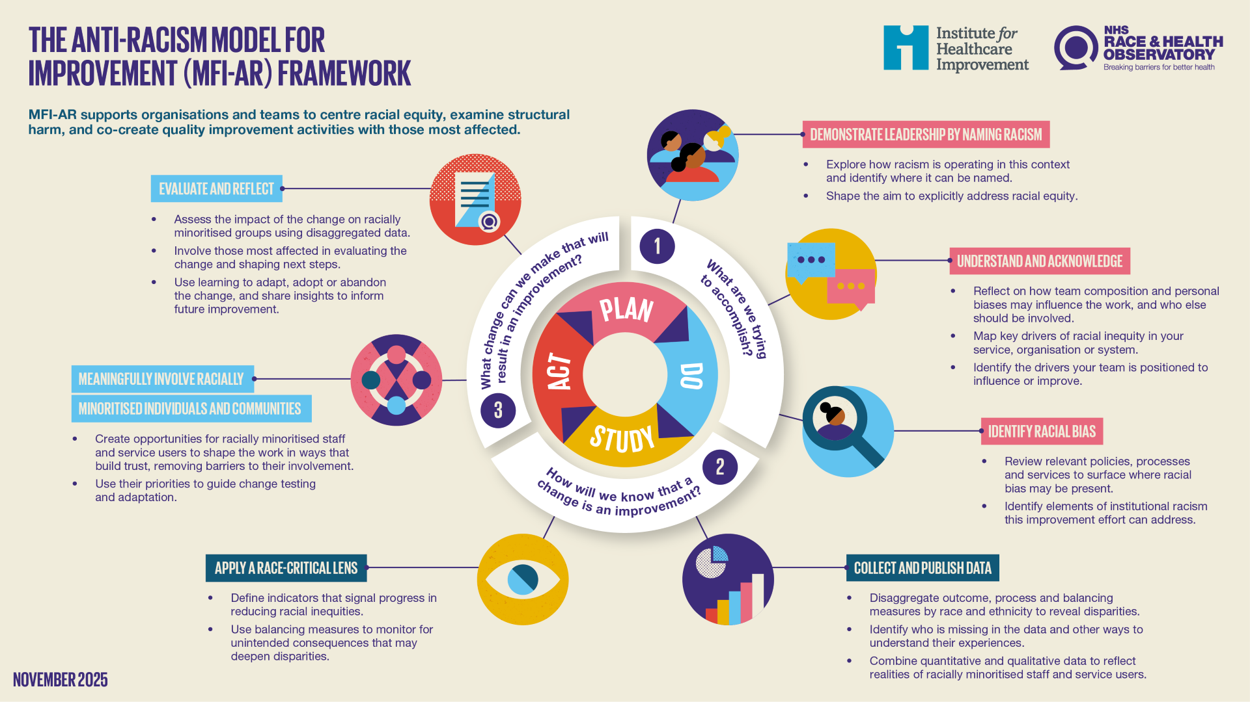


Slide 11
Understanding needs and assets through three-part data review
Needs and assets
Quantitative Data
Qualitative data - Care Providers in Health System / Service Providers in Community
Qualitative data – Service users / patients

Slide 12

Why engage in a deep dive of this nature?
Deeply understanding community experiences is essential to advancing population health, equity, and dismantling racism and other systems of oppression
Asset-based inquiry surfaces not only needs and opportunities, but reveals how systems have discarded or undervalued the strengths of individuals and communities
Ensures everyone has a role in dismantling inequities and advancing population health and well-being

Slide 13
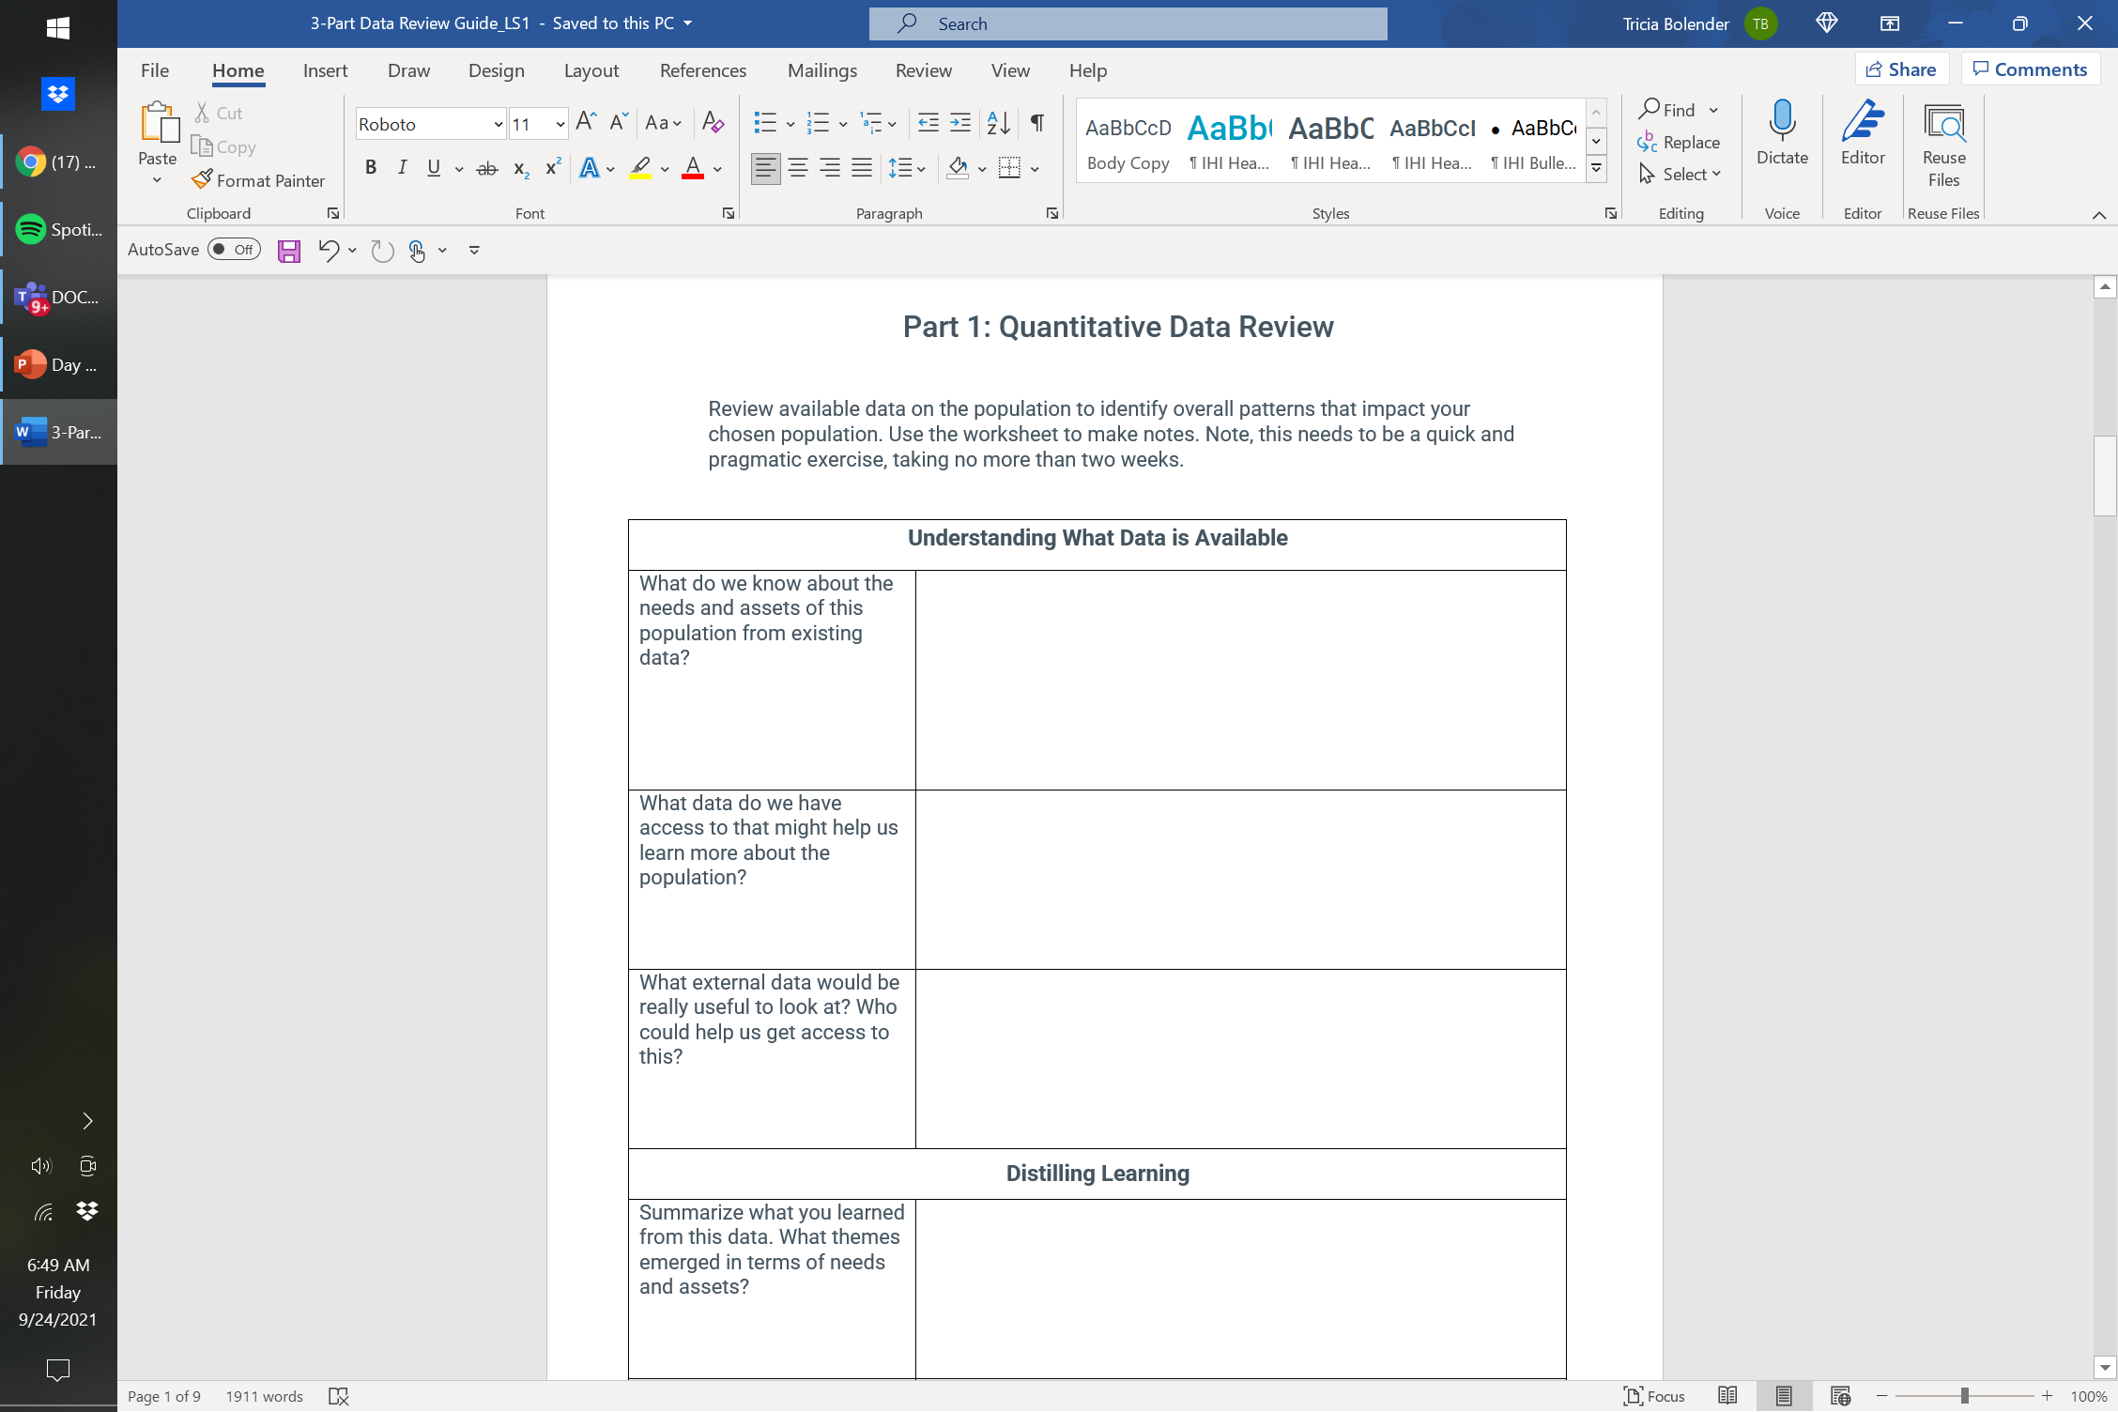
Three-part data review
Review available data on the chosen sub-population of pregnant women and babies
Interview 2-5 care teams/professionals providing care and external collaborators/partners/service agencies supporting the population
Interview 5-10 individuals/clients/patients in the chosen sub-population

Slide 14
Psychological safety when collecting qualitative data
BEFORE
DURING
AFTER
Co-design the approach with lived experience
Offer flexible formats
Consider power imbalances
Consider timing and environment
Create support plan
Remuneration for communities
Build rapport before asking difficult questions
Follow participant’s lead – let them tell their story in their own way
Use accessible language
Being clear participants can pause, skip, or withdraw at anytime
Being honest about what can and can’t be done
Close with a grounding or settling moment – don’t end abruptly.
Offer chance to amend or withdraw contributions
Share how their feedback will be used to improve services (and close the feedback loop).

Slide 15
Case study activity

Slide 16

Case study activity
At your tables:
Review the case study on the right, and talk through:
How would you implement the MFI-AR in your context/organization to address the case study?
What are the facilitators/barriers?
What support would you need?
We will ask you to feedback at the end!
Case Study Scenario :
A 32-year-old Black British woman reports severe abdominal pain during late pregnancy. Despite multiple visits to her GP and hospital triage, her symptoms are dismissed as “normal pregnancy discomfort.” She later suffers a life-threatening complication.

Slide 17
Before we finish…
Take 30 seconds to pause & reflect: Why does addressing racism in healthcare matter?
Your key learning: What will you take away from today into your own area of practice?
Your commitment: What is one action you will commit to taking next week?

Slide 18
Thank you

