Slide 2
Welcome session
Quality Coach Development Programme

Slide 3
Funding Acknowledgement
The Quality Coach Development Programme was partially funded through Q Exchange by the Health Foundation and NHS England and NHS Improvement
  For additional information contact
  clcht.continuous.improvement@nhs.net or the Q Community
This slide deck and all associated materials of the Quality Coach Development Programme are available under the Creative Commons Attribution-ShareAlike Licence 4.0
  This licence permits others to remix, adapt, and build upon this piece of work even for commercial purposes, as long as you credit us and license any and all new creations under the identical terms. (CC-BY-SA)
Notes:
All materials associated with this programme are copyrighted. CC-BY-SA allows anyone to use this slide deck for free, as long as the authors and contributors are credited.
You should not add your own logos to these materials without the express permission of all authors, as this would be a direct infringement on the copyright. We want to ensure all materials associated with this programme remain free-to-access for everyone.
The legal code for CC-BY-SA can be found here: https://creativecommons.org/licenses/by-sa/4.0/legalcode

Slide 4
Welcome session
Cohort A
Notes:
Hello faculty of the Quality Coach Development Programme.
This is the welcome session of the Quality Coach Development Programme. Please refer to the Trainer Guide for more detailed information on the day.
In advance of delivering this day you should work through the slides with any co-presenters and tailor the content to suit your local context. This may include swapping slides out for your own slides, adding different visuals, changing icebreakers or adapting activities to suit the target audience.
Notes in bold are instructions for the faculty. Notes in regular text are notes for delegates, and can be read out during the session or adapted as required.
Please do not delete large sections of content – if significant changes are made to the content then it may no longer meet the learning outcomes. See further explanation in the Programme Leader Guide.
All content is copyrighted by the authors. Please do not remove the © mark from any materials and ensure content is correctly attributed. We have made all materials available for free to the public and just ask that you attribute the content fairly.

Slide 5
Making the most of our virtual environment
We are happy to take questions – raise your hand at any point or ask in your breakout room sessions
When you see this symbol, we recommend you take a photo or screenshot of the task for the breakout room
Indicates page in handbook
Feel free to use the chat box during the session
Making the most of our virtual environment
Indicates activity
We will be using breakout rooms a lot
Top tip: don’t touch anything when you are
being moved to rooms
Indicates an independent task for you to complete later
Notes:
You should edit this slide if delivering the content in person. You will only need the icons shown in the right hand box. However you may still wish to explain that you encourage people to ask questions or chat in the breaks, and that the session includes many activities.
If you are using an online whiteboard, ask delegates to open your preferred internet browser. If you are using Mural, we find it works best with Google Chrome.

Slide 6
Agenda for today
9.00
      Introduction and housekeeping
      QI coaching
      Getting to know one another
      The programme
      Close
9.20
9.40
Agenda for today
10.15
10.30

Slide 7
Housekeeping
Housekeeping
Notes:
Suggested housekeeping – adapt to suit your environment
Technology
Where possible, please turn off emails, websites, mute phones
Mute yourself when you’re not speaking
Use emojis and reactions
Keep cameras on
Movement
Stretch if you need to, move around as desired
Feel free to fidget and doodle
Excuse yourself when you need to (sign off and re-sign on)
Fun
Have fun
Lean in with curiosity

Slide 8
Poll
Poll
Yes
No
Maybe
Notes:
Add an icebreaker poll or other icebreaker activity

Slide 9


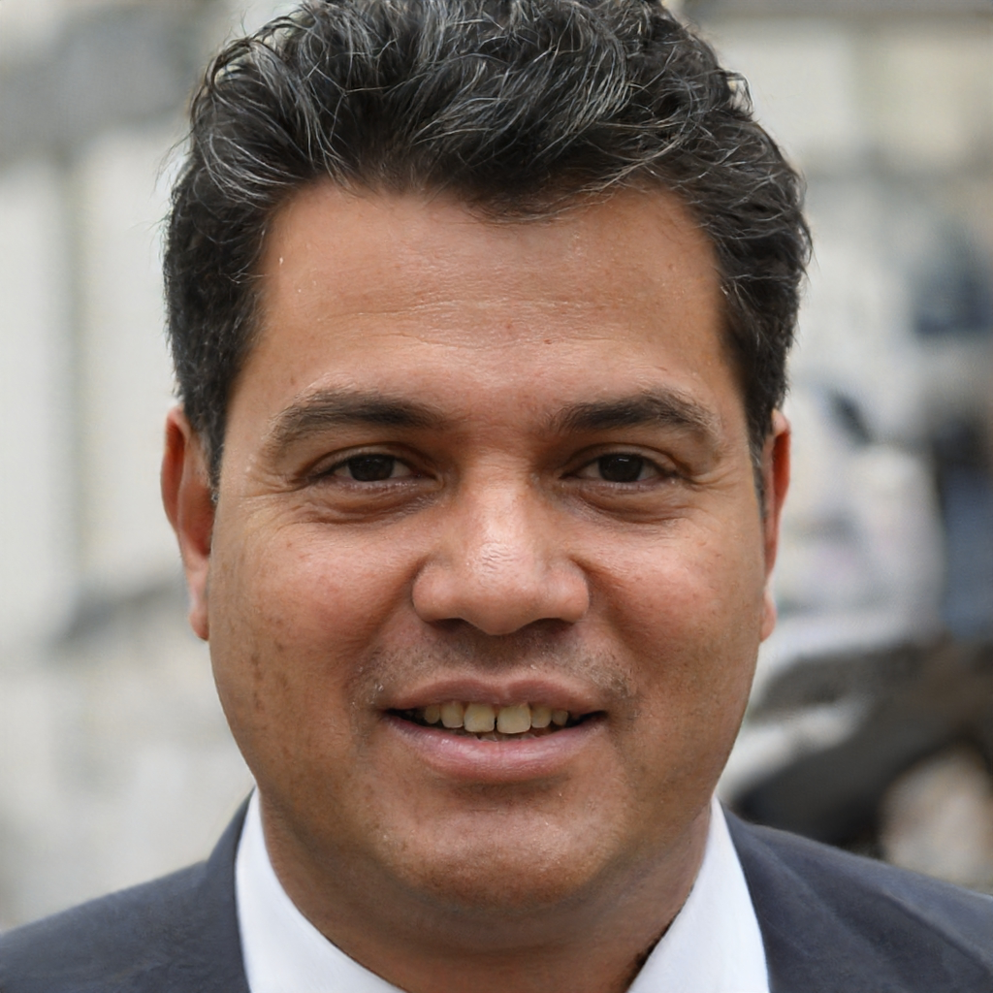
Programme faculty
To tint photos:
Format picture > Picture >
Picture colour >
recolour
Person name
  Job title
  Email
  Mobile
Person name
  Job title
  Email
  Mobile
Person name
  Job title
  Email
  Mobile
Programme faculty
Notes:
*Notes for faculty – please add in your own images and contact details here*
This is a good point to properly introduce yourselves and explain your background and experience in QI and coaching improvement.

Slide 10
Programme aim
The aim of this eight week programme is to…
Support individuals to develop the skills
and knowledge required to independently
and confidently coach a team through improvement work.
Programme aim

Slide 11
Ten learning outcomes of the programme
      By the end of the programme delegates will be able to independently:
Coach an improvement team ensuring robust application of QI methods and principles
Help teams to explore barriers and enablers relating to their QI work, in support of the sustainability of interventions
1
6
Understand the concepts of coaching improvement and the difference between coaching and advising
Advocate for meaningful involvement in
QI work and advise teams on methods for involvement
2
7
Ten learning outcomes of the programme
Explain their role as a Quality Coach to different stakeholders
Coach a team to identify, collect and interpret data in support of their improvement work
3
8
Promote an environment that encourages team members to contribute equally to the development of improvement work
Apply creative problem-solving methods and behaviour change concepts to support teams to revive a stalled effort
4
9
Assimilate QI knowledge and facilitation skills that support teams to progress through the different stages of QI work
Critically analyse their own limitations and the limitations of coaching
5
10

Slide 12
The handbook
The handbook covers:
What QI is
Key concepts of
QI coaching
The handbook
Coaching & the Foundations
of Improvement
Working with People
Coaching Measurement
Human Side of Change
Notes:
Everyone should have a copy of the handbook either printed or virtually. If you don’t have it just let me know or speak to your mentor and we will get it over to you.
The handbook is a key resource for you as budding Quality Coaches, as it provides comprehensive guidance and learning on the key concepts of improvement coaching
The handbook has been written to reflect the structure of the programme – so it starts off with what QI is and what coaching is through to working with people, coaching measurement and finally the human side of change.
You should ensure you have the handbook with you for all sessions as you may wish to make notes or look up the content as it is being taught
The content of the handbook can be read as part of independent study both during and after the programme so please keep it nearby!

Slide 13
What is a ‘Quality Coach’?
A person with a passion for QI, who has experience of running a project | Has dedicated time to support QI | Teaches and explains the use of QI tools
Works to engage people and teams in QI | Develops and nurtures relationships based on trust and support | Observes QI work of team – provides guidance, support and encouragement
What is a ’Quality Coach’?
Notes:
By the end of this programme, you will have the experience and know-how to support and coach improvement within your service and organisation.
The definition of a Quality Coach is shown on the screen
You have passion for improvement. We often speak about getting the ‘QI bug’ – you understand its value in the NHS and are committed to endorsing QI and supporting QI. You have experience of leading a project. This experience is valuable in being able to empathise with project teams
You have the support of your local service or your organisation to be a Quality Coach. This means you will have some ‘ring-fenced’ time to be a Quality Coach
You are knowledgeable with QI and feel comfortable teaching and explaining simple QI tools and concepts. A lot of a coach’s role is in-the-room teaching, as the opportunity arises.
You are a champion of QI and work across your organisation (not just in your team) to engage people in QI
Coaching is in the name – you develop people, nurture and grow relationships based on trust and support
You will be the ‘go-to’ person for QI as a coach. You will provide a blend of coaching (helping them find the solutions they need) and improvement advice (using your expertise to co-design the solution). You will be a positive force for good – encouraging the teams, consoling the teams and keeping the momentum going.

Slide 14
Why do we need
Quality Coaches?
Why do we need Quality Coaches?
Notes:
NHS Improvement published this report in 2017.
In the paper, they advocate for Quality Coaches (also called Improvement Coaches). This is the first time it was mentioned in a report of this kind and inspired the development of this programme. In the report they outline the dosing model as the strategy for building capacity and capability for improvement. Coaches serve both roles – they have some ‘ring-fenced’ capacity within their day-job to help QI at the frontlines, and develop capability by coaching and teaching teams in QI.
Reference:
NHS Improvement (2017). Building capacity and capability for improvement: embedding quality improvement skills in NHS providers.
https://qi.elft.nhs.uk/wp-content/uploads/2017/09/01-NHS107-Dosing_Document-010917_K_1-1.pdf

Slide 15
Why we need Quality Coaches
People doing improvement work
Numerous in size: NHS ambition is that everyone does improvement, every day
Often only basic QI knowledge
Training up everyone in advanced improvement methods and skills isn’t the answer
Coach
Coach
Central Improvement team
Improvement experts
Often small in number (WTE)
Large and broad remit
Support organisational priorities (e.g. waiting times, flow etc.)
Support ‘bottom-up’ improvement by provide training in improvement methods and facilitation of project work
Why we need Quality Coaches
QI Team
Coach
Quality Coach
Frontline staff who have been trained in how to coach and support teams through QI work
Championing the importance of improvement at a local level
Coach
Coach
Notes:
Every healthcare provider strives to improve the care they provide. Using quality improvement methods as an approach to improve care is a well-recognised approach and is established to varying degrees in most healthcare providers.
The ambition in health and care is simple – we want everyone to do improvement every day.
To support this, most providers have established a central QI team who have the broad responsibility for embedding QI within their organisation or system. This is by no means a simple task!
These teams use their improvement expertise to support the delivery of key organisational priorities and build improvement knowledge and skills by providing training and support to teams who want to use QI.
There are however challenges to this approach. The most apparent is that as interest in QI grows in the NHS, the QI team needs to respond to this by providing additional support to teams with their QI work. We know that training alone is not enough to bring about sustainable improvements – support from an experienced improver is key to navigating the often complex task of improvement.
The QI team cannot be everywhere, all at once – this would dilute the resource to a point where they no longer add value. Recruiting more staff to a QI team may be hard to justify, at least beyond a certain point.
Organisations are highly complex – like the network on the screen but many times over. How do we reach everyone, build trust in QI across services whilst at the same time supporting them to improve?
For years this has left us with a gap – between the frontline and central team - a challenge that many organisations throughout the UK face.
‘Quality coaches’ are arguably the best method of tackling this challenge. As you will know, Quality Coaches are frontline staff (clinical and non-clinical) who are passionate about QI and have been trained on how to coach and support teams through QI work – and the human side of change. Within their role, they should receive ring-fenced time in their day jobs (2-4 hrs a week) to perform this role.
The principle is excellent – we are distributing QI knowledge and skill across organisations and systems and with that the power and agency for change.
By developing coaches – we expand our network of QI support far beyond the central team. Now when someone seeks guidance on improvement they can speak with a friendly and familiar face instead of seeking out the central team.
Within Quality Coaches in place, the focus of the central QI team shifts – away from supporting bottom up improvement work – towards tackling organisational priority work and system work instead.

Slide 16
Why we need Quality Coaches
Faculty of people with advanced expertise who promote improvement sciene, provide advice and train others
QI Team & QI Faculty
Why we need Quality Coaches
Individuals who have a passion for, and experience in, improvement and the human side of change. They apply coaching and improvement skills to support others with their improvement work.
Wider resources and networks provide insight from elsewhere
Quality Coach
Capability realised when people have energy, time and skills to work on particular things
All Staff
Wider workforce understand and are able
to engage in improvement in their area
Adapted from Health Foundation (2014)
Notes:
Please change the content of this slide to reflect your organisation’s approach to QI training (e.g. bronze, silver, gold model or levels of training).
So let’s frame this in terms of improvement capability across an organisation.
Many healthcare providers use a ‘dosing approach’ to improvement capability and QI training. Using a dosing approach, organisations deliver an educational programme that builds knowledge in improvement science at different levels based on role and position within the organisation. This means people have just right amount of QI knowledge needed to effect change locally.
In this model, we can see that towards the bottom, all staff should have an understanding of improvement and are able to engage in it in their area. For example, they may have undertaken training that introduces the Model for Improvement and may know some of the fundamental tools for QI such as driver diagrams, PDSA and run charts. Some may have more training (such as QSIR Practitioner or similar), however they may not be confident or competent enough to independently do improvement work.
Looking at the top of this model we have the QI team and/or faculty. These individuals have a broad role to build an improvement culture in their organisation. In practice this means that they apply advanced improvement knowledge and skills to tackle the most complex and systemic issues. In addition to this they often train others in QI and promote and advocate for QI at all levels. These individuals often have years of experience doing and support improvement, and at times they may have more formal training in QI, such as this programme.
You may realise that this leaves a gap between the top and the bottom of the triangle – i.e. that we have advanced knowledge in the QI Faculty and often many thousands of people in an organisation with only a fundamental knowledge of QI. As we just discussed on the previous slide, Quality Coaches bridge this gap. In your role you will bring your passion and expertise in improvement to those who need it most. You will use a blend of coaching skills and improvement techniques to support teams to successfully test and implement improvement work. Over the coming programme we will teach you how to do this.
Reference:
Image adapted from the Health Foundation (2014). Building capability to improve safety. https://www.health.org.uk/publications/building-capability-to-improve-safety

Slide 17
Styles of learning
      Active blended
      learning
      Experiential
      learning
Styles of learning
      Project-based
      learning
Notes:
The best way to learn is by ‘doing’. In this programme, we will give you many opportunities to put learning into practice both in and out of the classroom.
We will use active blended learning to deliver the taught content of the programme. Active learning means using activities, discussion, debate to facilitate learning in a meaningful way. You will be heavily involved in each session – just as a warning! Blended learning means we will use different forums and platforms to provide learning opportunities. Some of this will be in the ‘classroom’ either virtually or in person. Some will be in coaching circles (more on this later), as a forum to discuss challenges, successes, reflect in smaller groups. Some will be with your assigned coach. We will use electronic resources to strengthen your knowledge on key topics – through videos, articles, blogs etc. You have been asked in the pre-programme content to keep a reflective diary throughout the programme.
As part of the programme, you will coach an improvement project team. Project-based learning will provide you with the best opportunity to put your learning to the test. You should aim to have regular contact with the project(s) you are coaching.
You won’t necessarily get everything right the first time when putting your learning into practice. This is normal and expected. You therefore should reflect on what went well, what could have been better as part of the project-based learning. You can then bring this experiential learning to the group and discuss your success, challenges, get clarity etc in the coaching circles. Your peers will often have good suggestions for what you could do and can help with knowledge-based questions. We will also give you the chance to simulate tasks and conversations in the classroom, as a safe space to test out your approach and reflect and revise.

Slide 18
Getting to know one another
My QI journey so far
    A chance for you to share your QI experiences to date
    Small group discussion
Getting to know one another
Notes:
Invite delegates to share their journeys so far in QI – five mins each
Over the coming sessions you will be practising coaching on each other, so it's important to spend some time to build relationships in the group and to get to know one another. We thought it would be nice for you to hear each other’s journeys in improvement so far. It’s OK to say you don’t have a lot of experience in QI – we’re sure you are bringing a lot of other life experience and experience around change in healthcare anyway – so just talk to that!
Group work (in threes) for 15 mins
You will be in groups of three or four and you will have 15 minutes in total – so around five minutes each including time to quickly introduce yourselves. Some points to consider:
How did you come across QI?
What interests you in QI and improvement?
What roles have you undertaken?
What QI work have you done so far?
When you are not speaking you should listen and reflect at the end:
What struck you about your own journey?
What struck you about the journeys of others?

Slide 19
How you will be supported
Named mentor
from QI team
Buddy system
Coaching circles
How you will be supported
Notes:
You will be supported in the classroom, with plenty of space for questions/answers, discussion and room to go over materials again, if needed. However, in order to get the most out of the programme, to touch base on your project progress, and to provide opportunity to practise coaching we have three other ways to support you.
You should have been assigned a mentor by now. Their role is to help you with your personal development as a coach. You should have set objectives with them aligned to your new coaching role. They will use these as a foundation for your conversations with them. You can have a confidential conversation with them about your experiences as a coach and seek support on how to further improve. As a rough guide, we suggest meeting with them three times throughout this programme – at the start, middle and end of the programme. You should continue contact with them upon completion of the programme, as the main person for your continued development.
Buddy system. You have been assigned (or identified yourself) a buddy. Their role is to be the first person you speak with about your questions, challenges, to see if you can find a solution together. You should reflect with them and help one another with your coaching development. You can use them as a sounding board for planned conversations or approaches. If you miss a session, go to them for a re-cap and materials.
Coaching circles, which we cover in more detail shortly.

Slide 20
List of mentors from the QI team
To tint photos:
Format picture > Picture >
Picture colour >
recolour
Person name
  Job title
  Email
  Mobile
Person name
  Job title
  Email
  Mobile
Person name
  Job title
  Email
  Mobile
List of mentors from the QI team

Slide 21
Coaching circles
p12
Peer-to-peer coaching in small groups (5–7 people)
Safe space to discuss recent experiences, challenges, approaches, reflections etc.
‘A problem shared is a problem halved’
Opportunity to gain insights from others
others’ experiences
Good practice for coaching conversations
Space for micro-learning.
    Peer-to-peer coaching in small groups
    (5–7 people)
    Safe space to discuss recent experiences, challenges, approaches, reflections etc.
    ‘A problem shared is a problem halved’
    Opportunity to gain insights from others
    others’ experiences
    Good practice for coaching conversations
    Space for micro-learning.
Coaching circles
Notes:
We will have four coaching circles throughout this programme. It is important to familiarise yourself with the structure and ground rules of these, in order to make the most of your time together.
These are for your benefit – to support you, help you reflect as you go through the programme and for you to practise QI coaching with your peers. These make up a vital part of the programme. The more you put into these, the more you will get out of them.

Slide 22
Structure of the programme
Mentoring and support from the QI team
Coaching and the Foundations of QI |  | Working with People |  |  | Coaching Measurement | Human Side of Change
Date of Session 1 | Date of Session 2 | Date of Session 3 | Date of Session 4 | Date of Session 5 | Date of Session 6 | Date of Session 7 | Date of Session 8
QI vs. other types of change GROW coaching Using coaching questions Active listening | Coaching practice Contracting with teams as a Quality Coach The pitfalls of coaching Coaching circle | Just-in-time teaching practice (teachback) Facilitation and working with groups Methods to build psychological safety | Coaching circle The role of context in QI Reflecting as a coach Measuring sustainable change | Involving patient in QI Qualitative data Coaching best practice PDSA All teach, all learn | Coaching measuring Using creative methods in QI Working with resistance to change Human factors in QI | Using SPC charts in QI Creative thinking (cont.) Designing sustainable change | Behaviour change in QI Creative thinking (cont.) What’s next for you as a coach
QI coaching assessment
Poster presentation:
[date]
Reflective log submission:
[date]
Project coaching
Structure of the programme
Coach
graduation
[date]
Notes:
Explain the structure of the programme.

Slide 23
End of programme assessment
Presentation | Reflective log
10 minute poster presentation discussing your experiences and learning as a Quality Coach Successes Challenges Learning | Short reflection at key stages of programme, e.g. Start When you begin coaching End of each module When the team begin applying the Model for Improvement End of the programme
Poster template is provided | Evidence is required of application of learning by coaching QI work outside of the sessions – reflection and debrief with mentor
Q&A from panel | Reflective log template is provided
End of programme assessment
Notes:
You should amend this slide to reflect your approach to delegate assessment. Please see the Evaluation Guide for more detail on this.
As a recommendation, we have suggested the use of a presentation and reflective log.
Explain the delegate assessment process and requirements.

Slide 24
Tasks for you to complete
Meet with
your mentor
Set your objectives
Read the introduction and
top up your QI knowledge
Tasks for you to complete
Meet with your buddy
Let us know if you have identified a project or want one allocated to you
Complete the
pre-programme module

Slide 25
Questions
Questions

Slide 26
References and links
NHS Improvement (2017). Building capacity and capability for improvement: embedding quality improvement skills in NHS providers.
  https://qi.elft.nhs.uk/wp-content/uploads/2017/09/01-NHS107-Dosing_Document-010917_K_1-1.pdf
The Health Foundation (2014). Building capability
to improve safety.
  https://www.health.org.uk/publications/building-capability-to-improve-safety
References and links

Slide 27
Authors
Bridget Browne
Sidney Beech
Robin Davis
Contributors
All contributors to the programme helped to define the role of the coach, and so contributed to these slides. A full list of contributors can be found in the handbook.
Slide design and layout by Studio Quercus

Slide 28
Authors
Bridget Browne
Sidney Beech
Robin Davis
Contributors
All contributors to the programme helped to define the role of the coach, and so contributed to these slides. A full list of contributors can be found in the handbook.
Slide design and layout by Studio Quercus

