Slide 2
Human Side of Change
Session 8
Quality Coach Development Programme

Slide 3
Funding Acknowledgement
The Quality Coach Development Programme was partially funded through Q Exchange by the Health Foundation and NHS England and NHS Improvement
  For additional information contact
  clcht.continuous.improvement@nhs.net or the Q Community
This slide deck and all associated materials of the Quality Coach Development Programme are available under the Creative Commons Attribution-ShareAlike Licence 4.0
  This licence permits others to remix, adapt, and build upon this piece of work even for commercial purposes, as long as you credit us and license any and all new creations under the identical terms. (CC-BY-SA)
Notes:
All materials associated with this programme are copyrighted. CC-BY-SA allows anyone to use this slide deck for free, as long as the authors and contributors are credited.
You should not add your own logos to these materials without the express permission of all authors, as this would be a direct infringement on the copyright. We want to ensure all materials associated with this programme remain free-to-access for everyone.
The legal code for CC-BY-SA can be found here: https://creativecommons.org/licenses/by-sa/4.0/legalcode

Slide 4
Human Side of Change
Session 8
Cohort A
Notes:
Hello faculty of the Quality Coach Development Programme.
Welcome to Session 8 of the Quality Coach Development Programme. Please refer to the Trainer Guide for more detailed information on the day, including activity templates for the breakout rooms.
In advance of delivering this day you should work through the slides with any co-presenters and tailor the content to suit your local context. This may include swapping slides out for your own slides, adding different visuals, changing icebreakers or adapting activities to suit the target audience.
Notes in bold are instructions for the faculty. Notes in regular text are notes for delegates, and can be read out during the session or adapted as required.
Please do not delete large sections of content – if significant changes are made to the content then it may no longer meet the learning outcomes. See further explanation in the Programme Leader Guide
All content is copyrighted by the authors. Please do not remove the © mark from any materials and ensure content is correctly attributed. We have made all materials available for free to the public and just ask that you attribute the content fairly.

Slide 5
Making the most of our virtual environment
We are happy to take questions – raise your hand at any point or ask in your breakout room sessions
When you see this symbol, we recommend you take a photo or screenshot of the task for the breakout room
Indicates page in handbook
Feel free to use the chat box during the session
Making the most of our virtual environment
Indicates activity
We will be using breakout rooms a lot
Top tip: don’t touch anything when you are
being moved to rooms
Indicates an independent task for you to complete later
Notes:
You should edit this slide if delivering the content in person. You will only need the icons shown in the right hand box. However you may still wish to explain that you encourage people to ask questions or chat in the breaks, and that the session includes many activities.
If you are using an online whiteboard, ask delegates to open your preferred internet browser. If you are using Mural, we find it works best with Google Chrome.

Slide 6
Housekeeping
Housekeeping
Notes:
Suggested housekeeping – adapt to suit your environment
Technology
Where possible, please turn off emails, websites, mute phones
Mute yourself when you’re not speaking
Use emojis and reactions
Keep cameras on
Movement
Stretch if you need to, move around as desired
Feel free to fidget and doodle
Excuse yourself when you need to (sign off and re-sign on)
Fun
Have fun
Lean in with curiosity

Slide 7
Agenda for today
9.00
      Introduction and housekeeping
      Teachback
      Comfort break
      COM-B and the behaviour change wheel
      Coffee break
      COM-B activity
      Lunch
      Graduation drawings
      IHI change concepts
      Comfort break
      Reverse brainstorming
      Convergent thinking
      What’s next?
      Close
9.15
10.00
10.05
11.00
11.15
Agenda for today
12.00
12.45
1.15
1.45
1.55
2.45
3.30
4.00

Slide 8


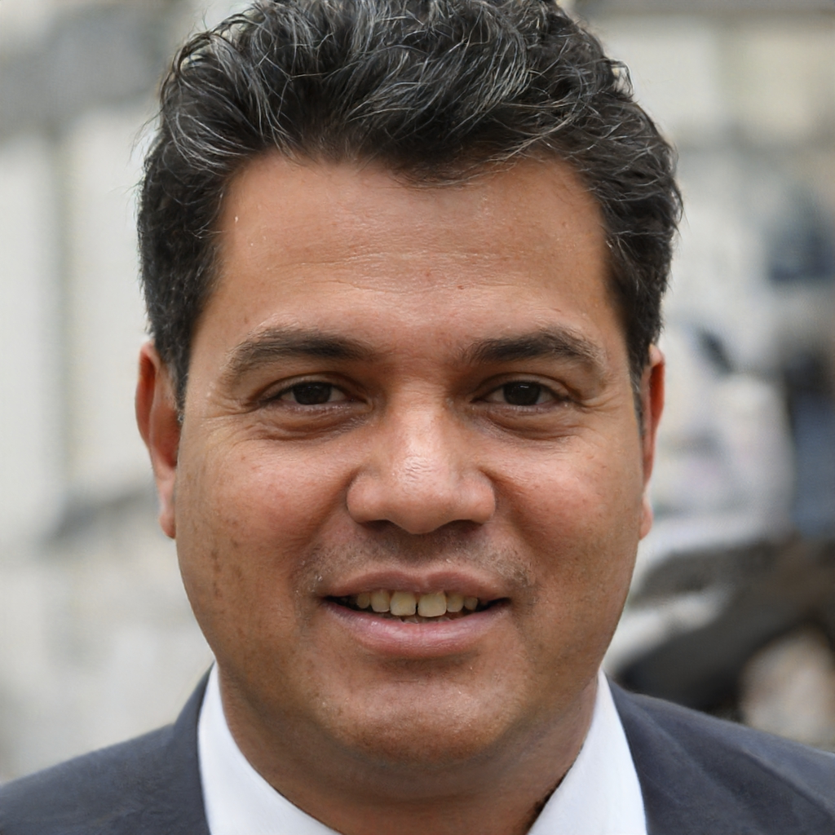
Today’s facilitators
To tint photos:
Format picture > Picture >
Picture colour >
recolour
Person name
  Job title
  Email
  Mobile
Person name
  Job title
  Email
  Mobile
Person name
  Job title
  Email
  Mobile
Today’s facilitators
Notes:
*Notes for faculty – please add in your own images and contact details here*
This is a good point to properly introduce yourselves and explain your background and experience in QI and coaching improvement.

Slide 9
Programme aim
The aim of this eight week programme is to…
Support individuals to develop the skills
and knowledge required to independently
and confidently coach a team through improvement work.
Programme aim

Slide 10
Ten learning outcomes of the programme
      By the end of the programme delegates will be able to independently:
Coach an improvement team ensuring robust application of QI methods and principles
Help teams to explore barriers and enablers relating to their QI work, in support of the sustainability of interventions
1
6
Understand the concepts of coaching improvement and the difference between coaching and advising
Advocate for meaningful involvement in
QI work and advise teams on methods for involvement
2
7
Ten learning outcomes of the programme
Explain their role as a Quality Coach to different stakeholders
Coach a team to identify, collect and interpret data in support of their improvement work
3
8
Promote an environment that encourages team members to contribute equally to the development of improvement work
Apply creative problem-solving methods and behaviour change concepts to support teams to revive a stalled effort
4
9
Assimilate QI knowledge and facilitation skills that support teams to progress through the different stages of QI work
Critically analyse their own limitations and the limitations of coaching
5
10
Notes:
Each session has its own learning outcomes. Today’s focus on the human side of change.
As delegates on the programme, we encourage you to reflect on the learning outcomes at the end of each session. Ask yourself: can I meet the outcomes shown on the screen without guidance from a member of the QI team? If not, then think about what you need to meet these learning outcomes.

Slide 11
Human Side
of Change
  Quality Coach Development Programme
Notes:
Today we will be looking at the human side of change.

Slide 12
Today’s learning outcomes
  By the end of the session, you will be able to…
    Be able to apply creative problem-solving methods and behaviour change concepts to support teams to revive
    a stalled effort
    Understand and be able to apply COM-B and the behaviour change wheel to support QI work
    Be able to use convergent thinking tools to facilitate improvement
    Understand the IHI change concepts and how they can be used to inspire improvement work
Today’s learning outcomes
Notes:
Each session has its own learning outcomes. Today’s focus on the human side of change.
As delegates on the programme, we encourage you to reflect on the learning outcomes at the end of each session. Ask yourself: can I meet the outcomes shown on the screen without guidance from a member of the QI team? If not, then think about what you need to meet these learning outcomes.

Slide 13
Teachback – over to you!
Teachback

Slide 14
Teachback – over to you!
    Groups of three to five people
    You have ten minutes to create
    a short teaching sessions on
    a given topic
    Each group will present for
    three to five minutes plus
    two minutes of questions
    Your target audience are beginners in QI
    You can use slides but you
    don’t have to.
Today’s topics:
Teachback
[add topic]
[add topic]
[add topic]
[add topic]
[add topic]
[add topic]
Notes:
See activity 8.1 in the Trainer Guide
45 mins (breakout rooms).
You should identify topics based on formative assessment and other key priorities for your organisation.
We have suggested six common concepts/tools and will give you 10 minutes in small groups to collate some info and teach it back.

Slide 15
Comfort break
Notes:
5 mins

Slide 16
COM-B
COM-B

Slide 17
Let’s start with the elephant in the room
Change can be complex.
Let’s start with the elephant in the room
Notes:
This session is a starter for your journey in recognising the role behaviour plays in leading change.

Slide 18
Behaviour Change
Behaviour Change
Notes:
As we’re all well aware, the world isn’t perfect and by nature humans don’t always do the ‘right’ thing.
We all engage in behaviours that are ‘bad’. Sometimes we drive too fast, sometimes we drink too much despite knowing the consequences.
At work the same rules apply – we don’t always do the ‘right’ thing and it isn’t just because we don’t know what is best – not washing our hands as often as we should, not documenting patient observations as frequently as needed. I’m sure most of us intend to do what’s right, we just forget or we get distracted by stress and other things.
Everything we do in healthcare relies on people, so it’s obvious that whenever we need to change something – or do some QI work – that we need people to work differently and help us.
The challenge is how can we actually change people’s behaviour… it’s not always easy!

Slide 19
Behaviour Change
Behaviour Change
Notes:
The more we do something, the more it becomes routine… the more we go on ‘autopilot’.
When we make a change (like doing QI work), we will be asking people to stop doing what has become a habit and start doing something new – and importantly make new habits.
This may require us to stop and think, and make deliberate decisions about the new change – but it can be hard to break the cycle, especially when people don’t feel motivated to do so or are feeling change fatigue…
An example – let’s say I recently decided to stop taking sugar in my tea and wanted to swap it for sweetener. For a week, I find myself still putting sugar in my tea, despite not wanting to. It’s just a force of habit. In this example I have the motivation or will to change – it’s just about breaking the cycle…

Slide 20
Behaviour Change
What influences a lack of desire to change?
Benefits
Other people
Skills
And more!
Behaviour Change
Notes:
So what happens when somebody doesn’t have the desire to change, or if a team is experiencing change fatigue?
They may think ‘stuff it, I’m just going to continue working in the same way I always have’, thinking there’s no real consequence to it.
Ask the question on screen.
So people don’t always have the desire to change. There are many things that will influence this:
Their beliefs about the benefits of the change
If they don’t see the worth in the change then of course they won’t commit to it
What others do and think related to the change
If no one else is endorsing it then it can be much easier to go with the group
If people are openly criticising it then likewise…
Whether we think we have the skills
If you don’t know how to do the change or are unsure about it then you are unlikely to do it.
Any suggestions on how to overcome these problems?

Slide 21
Use a behaviour change theory
  Provide a framework to help:
    Understand the problem
    Unpick the process of behaviour change
    Design, improve and evaluate change ideas
    Communicate what works and why
  Can help identify:
    Specific behaviours to target
    Potential barriers and facilitators
Use a behaviour change theory
Notes:
Using a behaviour change theory to structure our thinking around some of our common problems can help us to address some of those other factors that help people to change their behaviour and in doing so get us thinking about things in a different way from how we usually would
There are many reasons why using behaviour change theory can help… (read off slide)

Slide 22
COM-B
Capability
C
Motivation
Behaviour
COM-B
C
Opportunity
Notes:
This model is the COM-B Model. It’s a behaviour change model. As can be seen in the diagram, capability and opportunity influence motivation, and all three influence behaviour change but are also influenced by the change which occurs.
So an example of this might be that you target the opportunity component to try to encourage somebody who is inactive to be more active
A change idea might be to provide social and physical opportunity through free group exercise sessions
Because the model is interactional – if this individual initially thought that they did not have the appropriate skills to take part in an activity (which would be their capability) but were still provided with the opportunities to attend a class, then by going to this class they might reinforce the idea that they do have the capabilities required
This interaction between the components can be effective at facilitating long-term behaviour change due to some of the knock-on effects that targeting just one area has.

Slide 23
COM-B
Capability
Physical and psychological capability to engage in the behaviour
C
Motivation
Behaviour
COM-B
All brain processes that energise and direct behaviour
C
Opportunity
All factors lying outside the individual that make the performance of the behaviour possible or prompt it
Notes:
The COM-B model proposes that there are three components to any behaviour (B): Capability (C), Opportunity (O) and Motivation (M). And those three areas are the key drivers of behaviour.
Capability refers to whether we have the knowledge, skills and abilities required to engage in a particular behaviour. Its two components are:
• Psychological capability: our knowledge/psychological strength, skills or stamina
• Physical capability: our physical strength, skill or stamina.
In the context of this model, opportunity refers to the external factors which make the execution of a particular behaviour possible. Its two components are:
• Physical opportunity: opportunities provided by the environment, such as time, location and resource
• Social opportunity: opportunities as a result of social factors, such as cultural norms and social cues.
Motivation refers to the internal processes which influence our decision making and behaviours. Its two components are:
• Reflective motivation: reflective processes, such as making plans and evaluating things that have already happened
• Automatic motivation: automatic processes, such as our desires, impulses and inhibitions.

Slide 24
COM-B
COM-B
© Quality Coach Design Group
Notes:
Taking into account that the COM-B model states that in order to change or influence behaviour we need the underpinning Capability, Opportunity, Motivation:
For example if we wanted to start riding our bike to work. Firstly we need the capability – we need to be able to ride a bike, be able to confidently ride, know the way and have the fitness level to ride that distance.
Then we need the opportunity. The physical opportunity – i.e. having a bike to ride, having the time to be able to ride it to work, somewhere to store the bike when you get there, etc. There may also be social opportunity like social norms. Do lots of people ride bikes? Is it a very car-dominant part of the world with highways and no cycle lanes? Is it safe?
Lastly we need the motivation – wanting to ride the bike to work, understanding the benefits and drawbacks of riding the bike to work.

Slide 25
Identifying the Current Behaviour
      Problem
  Graham does not follow a healthy and balanced diet.
  GP said he must improve diet to avoid health complications.
Doing the telephone calls at 4.45 and therefore not having time to record at the end of the day
Not calling IT
or escalating challenges to management
Not bringing mobile device with them to visit patients
Multi-tasking when speaking to patients on the phone
Not attending training to use IT systems
Taking phone calls whilst not at the desk
Not believing that this is an important task
Identifying the Current Behaviour
Not taking breaks
Notes:
Here’s an example.

Slide 26
Identifying the Current Behaviour
Routinely eating ready meals
Skipping breakfast
Drinking lots of beer
      Problem
  Graham does not follow a healthy and balanced diet.
  GP said he must improve diet to avoid health complications.
Not routinely buying fresh fruits or vegetables
Identifying the Current Behaviour
Driving for most journeys – even short ones
Eating lots of sugary treats
Drinking fizzy drinks
Not believing healthy eating is important
Notes:
These are the behaviours which are causing Graham problems.
Read through some examples on slide.

Slide 27
COM-B
Capability
Knowing what healthy eating is and being able to cook healthy meals
C
Motivation
Behaviour
COM-B
Understanding why it’s important and what is the impact if it doesn’t happen
C
Opportunity
Having the facilities and space to cook e.g. having a fridge, having an oven, time to cook and space
Notes:
If we consider this problem from a behaviour angle:
Do they have the capability?
Do they have the motivation?
Do they have the opportunity?

Slide 28
Behaviour Change Wheel
Capability
C
Motivation
Behaviour
C
Opportunity
Behaviour Change Wheel
Adapted from Michie, S et al. (2011)
Sources of behaviour Intervention functions Policy categories
Notes:
This is where the behaviour change wheel comes into play.
The purple section in the middle of the wheel is the COM-B model, which you already know.
The bit we’ll be focusing on now is the turquoise section, which outlines the different types of intervention functions you could consider.
Just a side note, the outer bit of the wheel in pink is more at an organisation or policy level, and focuses on the bigger influences of behaviour such as legislation and regulation. We won’t go into that today, but you can read more about it in Professor Michie’s paper, referenced on this slide.
Reference:
Michie, S. et al. (2011). The behaviour change wheel: a new method for characterising and designing behaviour change interventions. Implementation science. https://implementationscience.biomedcentral.com/articles/10.1186/1748-5908-6-42

Slide 29
Intervention Functions
Intervention function | Definition | Example
Education | Increasing knowledge or understanding | Providing information to promote healthy eating
Modelling | Providing an example for people to aspire to or to imitate | Using people of key influence to demonstrate the joys of cooking and healthy eating
Persuasion | Using communication to induce positive or negative feelings or to stimulate action | Using imagery to motivate healthier eating
Incentivisation | Creating expectation of reward | Giving vouchers when buying a healthy food option
Coercion | Creating expectation of punishment or cost | Putting a taxation on unhealthy foods
Training | Imparting skills | Providing a healthy eating cooking class
Restriction | Using rules to reduce opportunity to engage in behaviour or reduce opportunity to engage in competing behaviours | Prohibiting high fat and sugar content meals in schools
Environmental restructuring | Changing the physical or social context | Putting healthier option snacks instead of junk food snacks near the queues in shopping centres
Enablement | Increasing means/reducing barriers to increase capability or opportunity | Providing medication that makes it difficult to eat fatty foods
Intervention Functions
Notes:
This slide is just for your information, and gives a definition and an example of all nine intervention functions (you can go back and read this in your own time).

Slide 30
Behaviour Change Wheel
COM-B component | Education | Persuasion | Incentivisation | Coercion | Training | Restriction | Environmental restructuring | Modelling | Enablement
Physical capability The skills to eat healthily (cook, being able to go to the shop) |  |  |  |  | ⬤ |  |  |  | ⬤
Psychological capability The knowledge to eat healthily (what is/isn’t healthy etc) | ⬤ |  |  |  | ⬤ |  |  |  | ⬤
Automatic motivation Desires, impulses and inhibitions (not snacking) |  | ⬤ | ⬤ | ⬤ | ⬤ |  | ⬤ | ⬤ | ⬤
Reflective motivation Will to make plans, evaluate etc (wanting to meal prep) | ⬤ | ⬤ | ⬤ | ⬤
Physical opportunity The resources, environment (time, money, kitchen ) |  |  |  |  | ⬤ | ⬤ | ⬤ |  | ⬤
Social opportunity The cultural norms, setting (social life revolves around pubs) |  |  |  |  |  | ⬤ | ⬤ | ⬤ | ⬤
Behaviour Change Wheel
Notes:
Some of you may be wondering how exactly the COM-B model and the behaviour change wheel link up and how would you choose the most appropriate intervention functions.
This is where this matrix comes into play – so to help improvers choose the most appropriate intervention functions, Professor Michie and her team have done extensive research to identify evidence-based links between the components of COM-B and the functions of the wheel.
They’ve brought all that evidence together in this matrix – with the strongest links shown in green.
For example they’ve found that if you want to improve a person’s physical opportunity the most effective ways of doing that are through change ideas that involve an element of training, restriction, environmental restructuring or enablement.
So those would be the areas that you’d encourage teams to focus on if they wanted to improve physical opportunity.
The functions are purposely broad, as they give you the freedom to tailor your change ideas to what works in your individual situations.
There’s no right or wrong answer, it just depends on what you’ve identified as your COM-B influences and what makes most sense in your area.
The purple dots indicate what the evidence to date has shown are the most common and successful functions to address each area of COM-B.
Talk through verbal example of cycling to work.
This example relates to healthy eating.
Facilitate discussion in the main room.

Slide 31
Coffee break
Notes:
15 mins

Slide 32
Activity
Capability
      Target behaviour
  Reduce Cardiovascular Disease in Westminster by 10% by the end of 2025
Motivation
Activity 8.2
Opportunity
Notes:
See Activity 8.2 in the Trainer Guide
45 mins total for activity, 5 mins reflection
We’ll have 10 minutes to brainstorm and then 10 minutes to discuss back in the main room. No change ideas yet – just focus on the drivers.
As you will see, this will start to look very similar to a driver diagram and can be used with teams to think about potential drivers.
There is a template on Mural. For now we are focussed just on the secondary drivers – no change ideas.
For example: for me, a drive for personal wellbeing is a driver that would fit both capability and motivation. Where I shop may drive opportunity.

Slide 33
Developing Change Ideas Activity
  Primary drivers = capability, opportunity and motivation
  Secondary drivers = Identified in our last activity
Now…
Use the COM-B model and behaviour change wheel matrix to develop change ideas
Activity 8.2
Notes:
Now we’re going to do some more theory into action work over on Mural and start to use the behaviour change wheel and matrix to develop our own change ideas!
Earlier you brainstormed some of the drivers for change, for this exercise your primary drivers will be the three sections of the COM-B model, capability, opportunity and motivation and your secondary drivers will be the more specific areas that you brainstormed.
What we want to get you to do now is have a go at using the COM-B model and behaviour change wheel matrix to develop change ideas that will help you to achieve your target behaviour of increasing healthy eating in the borough.
We’ll have about 15 minutes to do this.

Slide 34
Testing behaviour change ideas through PDSAs
        What are we trying to accomplish?
        How will we know that a change is an improvement?
        What changes can we make that will result in improvement?
Testing behaviour change ideas through PDSAs
        Act
        Plan
    Adopt
    Adapt
    Abandon
        Study
        Do
Notes:
You will all be familiar with this: the trusty old PDSA cycle.
All change ideas developed through the behaviour change wheel can be tested in the traditional way using PDSA cycles.
And you’d be adapting, adopting or abandoning ideas based on the learning that comes from each cycle.

Slide 35
Useful references and further reading
  The behaviour change wheel: a new method for characterising and designing behaviour change interventions.
  Implementation science.
      Michie S. et al. (2011).
      https://implementationscience.biomedcentral.com/articles/10.1186/1748-5908-6-42
      Useful for more in-depth reading around the COM-B model and behavior change wheel
  The Behaviour Change Wheel: A guide to designing interventions
  Silverback publishing.
  Michie S. et al. (2014).
  www.behaviourchangewheel.com
      Useful if you want a step-by-step guide on how to use the behaviour change wheel
  Developing a theory-informed complex intervention to improve nurse–patient therapeutic engagement employing Experience-based Co-design and the Behaviour Change Wheel: an acute mental health ward case study
  BMJ Open.
      McAllister S. et al. (2021).
        https://pubmed.ncbi.nlm.nih.gov/33986066/
      Useful if you want to consider how to use the behaviour change wheel with service users and carers
Useful references and further reading
Notes:
References:
Michie, S., van Stralen, M.M. and West, R. (2011). The behaviour change wheel: A new method for characterising and designing behaviour change interventions. Implementation Science. https://implementationscience.biomedcentral.com/articles/10.1186/1748-5908-6-42
Michie, S., Atkins, L., West, R. (2014). The Behaviour Change Wheel: A Guide to Designing Interventions. Silverback Publishing. www.behaviourchangewheel.com
McAllister, S., Simpson, A., Tsianakas, V., Canham, N., De Meo, V., Stone, C., Robert, G. (2021). Developing a theory-informed complex intervention to improve nurse-patient therapeutic engagement employing Experience-based Co-design and the Behaviour Change Wheel: an acute mental health ward case study. BMJ Open. https://pubmed.ncbi.nlm.nih.gov/33986066/

Slide 36
Lunch break
Notes:
45 mins

Slide 37
IHI Change Concepts
IHI Change Concepts

Slide 38
Graduation Drawings
Activity 8.3
Notes:
See activity 8.3 in the Trainer Guide
15 mins
This activity asks each participant to ‘draw’ another person from the programme.

Slide 39
IHI Change Concepts
“A change concept is a general notion or approach to change that has been found to be useful in developing specific ideas for changes that lead to improvement.”
Institute for Healthcare Improvement
IHI Change Concepts
      List of 72 ‘Concepts’ which are categorised into the groups.
      Full List of Change Concepts
Notes:
Sometimes it can be hard for people to come up with change ideas. As a coach you will often hear lots of the same solutions – and in most cases doing more of the same isn’t what is going to solve the problem.
We need people to think differently.
References:
Institute for Healthcare Improvement. Using Change Concepts for Improvement. https://www.ihi.org/resources/Pages/Changes/UsingChangeConceptsforImprovement.aspx
Institute for Healthcare Improvement. Change Concepts Worksheet. https://www.ihi.org/resources/_layouts/download.aspx?SourceURL=%2fresources%2fKnowledge+Center+Assets%2fTools+-+QualityImprovementProjectChangeConceptsWorksheet_c8af5542-2cb3-467f-a7ac-11000709eed8%2fIHITool_QIProjectChangeConceptsWorksheet.pdf

Slide 40
IHI Change Concepts
Eliminate waste | What activities or resources don’t provide value to your patients or customers?
Improve workflow | How can you change the work flow so that the process is less reactive and more planned?
Optimise inventory | How can you reduce costs associated with the maintenance of inventory?
Change the work environment | What would make the environment better able to support improvement
Enhance the producer/customer relationship | How can you better understand and respond to the customers’ needs?
Manage time | How can you reduce the time to develop new products, waiting times for services, lead times for orders and deliveries, and cycle times for all functions in the organisation?
Manage variation | How can you reduce the frequency of poor results?
Design systems to avoid mistakes | How can you reduce the probability of making an error for a given opportunity?
Focus on the product or service | What improvements can you make to the design of the product or service?
IHI Change Concepts
Notes:
This is where the change concepts can help.
The list of change concepts has been developed by the IHI –
There are 72 concepts, categorised into the 9 groups that we can see here:
This list of change concepts helps people to consider changes which they may not have thought of before.
Also using the ‘concept’ can people to generate more than new ideas. You can use these concepts with teams to generate specific actionable ideas. Then we can use QI methodology to test which works the best!
For even more change concepts you can reference The Improvement Guide (2009) for a list of hundreds of change concepts, as well as examples of how they were applied in process improvement.
References:
Langley, G., Moen, R., Nolan, K. M., Nolan, T. W., Norman, C. L. and Provost, L. P. (2009). The Improvement Guide: A Practical Approach to Enhancing Organizational Performance. Jossey-Bass Publishers. https://www.ihi.org/resources/Pages/Publications/ImprovementGuidePracticalApproachEnhancingOrganizationalPerformance.aspx
Institute for Healthcare Improvement. Using Change Concepts for Improvement. https://www.ihi.org/resources/Pages/Changes/UsingChangeConceptsforImprovement.aspx

Slide 41
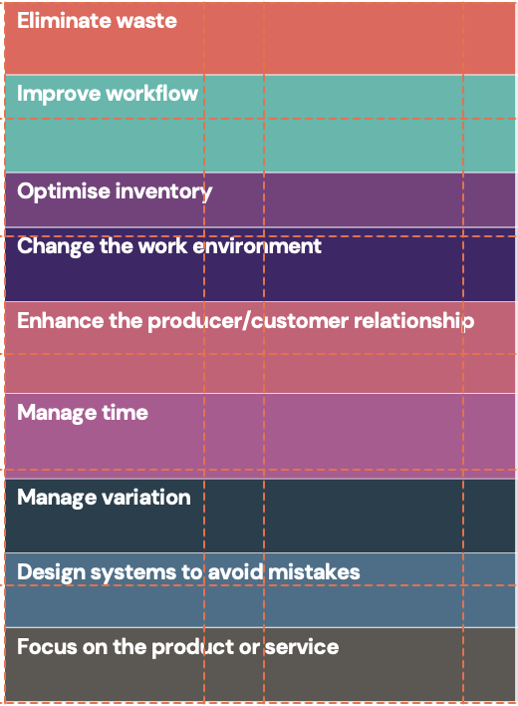
IHI Change Concepts
1
Eliminate things that
are not used
12
Synchronise
22
Adjust to peak demand
32
Implement crosstraining
42
Reach agreement
on expectations
53
Develop operation definitions
64
Offer product/service anytime
13
Schedule into multiple processes
23
Match inventory to predicted demand
33
Invest more resources in improvement
2
Eliminate multiple entries
43
Outsource for ‘free’
54
Improve predictions
65
Offer product/service anyplace
3
Reduce or eliminate overkill
14
Minimise handoffs
24
Use pull systems
34
Focus on core process and purpose
44
Optimise level
of inspection
55
Develop
contingency plans
66
Emphasise intangibles
15
Move steps in the process close together
25
Reduce choice of features
4
Reduce controls on
the system
35
Share risks
45
Work with suppliers
56
Sort product
into grades
67
Influence or take advantage of fashion trends
16
Find and remove bottlenecks
26
Reduce multiple brands of the same item
36
Emphasise natural and logical consequences
46
Reduce setup or startup time
5
Recycle or reuse
57
Desensitise
IHI Change Concepts
68
Reduce the number of components
6
Use substitution
17
Use automation
27
Give people access
to information
37
Develop alliances
and cooperative relationships
47
Set up timing to
use discounts
58
Exploit variation
7
Reduce classifications
59
Use reminders
69
Disguise defects
or problems
18
Smooth workflow
28
Use proper measurements
48
Optimise maintenance
8
Remove intermediaries
19
Do tasks in parallel
38
Listen to customers
60
Use differentiation
70
Differentiate product using quality dimensions
49
Extend specialist’s time
9
Match the amount to the need
20
Consider people as in the same system
29
Take care of basics
39
Coach the customer to use a product/service
61
Use constraints
50
Reduce wait time
71
Change the order of process steps
30
Reduce demotivating aspects of the pay system
62
Use affordances
10
Use sampling
21
Use multiple
processing units
40
Focus on the outcome to a customer
51
Standardisation (create a formal process)
63
Mass customise
72
Manage uncertainty – not tasks
11
Change targets or
set points
31
Conduct training
41
Use a coordinator
52
Stop tampering
Source: Langley et al (2009)
Notes:
Here are the 72 change concepts colour coded – I like to think of them as suggestions/things to consider when generating change ideas.
Eg taking a concept and asking yourself or the team –
Eliminate multiple entries (2) – Waste
Could automation be used (17) – Improve flow or
Have we agreed the expectations (42) Enhance the producer/customer relationship
What stands out for you?
References:
Langley, G., Moen, R., Nolan, K. M., Nolan, T. W., Norman, C. L. and Provost, L. P. (2009). The Improvement Guide: A Practical Approach to Enhancing Organizational Performance. Jossey-Bass Publishers. https://www.ihi.org/resources/Pages/Publications/ImprovementGuidePracticalApproachEnhancingOrganizationalPerformance.aspx
Institute for Healthcare Improvement. Using Change Concepts for Improvement. https://www.ihi.org/resources/Pages/Changes/UsingChangeConceptsforImprovement.aspx

Slide 42
Change Concept Activity
    Thinking of a project you’re coaching/have been involved with in your breakout room
    Choose some of the change concepts from the list of 72 and come up with some change ideas related to them
    Choose the one you think you would test first and explain why
Eliminate waste
Improve workflow
Optimise inventory
Change the work environment
Activity 8.4
Enhance the producer/customer relationship
Manage time
Manage variation
Design systems to
avoid mistakes
Focus on the product or service
Notes:
See activity 8.4 in the Trainer Guide
15 mins for activity, 5 mins group reflection
Thinking of a project you’re coaching/have been involved with in your breakout room.
I will give you a worksheet. Choose some of the change concepts from the list of 72 and come up with some change ideas related to them.
Choose the one you think you would test first and explain why – we will share these when we get back.
Struggling for ideas?
Coaching circle
Long waiting times
Here is the worksheet –
Change concepts worksheet exercise https://www.ihi.org/resources/_layouts/download.aspx?SourceURL=%2fresources%2fKnowledge+Center+Assets%2fTools+-+QualityImprovementProjectChangeConceptsWorksheet_c8af5542-2cb3-467f-a7ac-11000709eed8%2fIHITool_QIProjectChangeConceptsWorksheet.pdf

Slide 43
Coffee break
Notes:
10 mins

Slide 44
Ideation
Ideation
Diverge
Create choices
Converge
Make choices
Notes:
As a coach you will often support teams to explore possibilities and potential solutions, grounded in their understanding of the current situation. It can be tempting for teams to jump to the customary ‘solutions’ to their given problem – interventions such as training, posters and emails. Often this is not enough – especially for sustainable outcomes. You should help them to use divergent and convergent thinking when selecting change ideas.
Let’s start with diverge.

Slide 45
Reverse Brainstorming
Negative
Positive
Reverse Brainstorming

Slide 46
Reverse Brainstorming
Negative
  Step 1
    Instead of generating ideas to solve the challenge, you have five minutes to generate as many ideas as possible to make it worse.
    Think: how can you obstruct the person from solving their problem?
    Write these ideas on sticky notes. 5 mins
Reverse Brainstorming

Slide 47
What is Reverse Brainstorming?
Negativez
  Step 1
    Instead of generating ideas to solve the challenge, you have five minutes to generate as many ideas as possible to make it worse.
    Think: how can you obstruct the person from solving their problem?
    Write these ideas on sticky notes. 5 mins
  Step 2
    Reflect on all of your bad ideas and flip them around so that they become solutions to the problem.
    Write these ideas on the blue sticky notes. 5 mins
What is Reverse Brainstorming?
Notes:
Reverse Brainstorming is a tool for creating lots of ideas. Sometimes it can be hard to think of the positives, so we initially think of things which would make the issue worse, and then flip them around.
There are 2 steps to reverse brainstorming. Read slide.
It works really well using sticky notes or on a virtual whiteboard.

Slide 48
Reverse Brainstorming
Problem
We have a lot of graffiti on Portobello Road
Activity 8.5
Notes:
See activity 8.5 in the Trainer Guide.
15 mins for activity, 15 mins group reflection

Slide 49
Ideation
Ideation
Diverge
Create choices
Converge
Make choices
Notes:
Once you have completed the diverging process – created ideas, then you move onto step 2 = converge. Making the choices of what to do

Slide 50
Converge
    Dot voting
    Radar retrospective
    Pairwise comparison
    MoSCoW method
    (Must, Should, Could, Won’t)
    Prioritisation matrix
    Nominal Group Technique (both convergent and divergent)
Converge
https://q.health.org.uk/resource/creative-approaches-to-problem-solving/
https://q.health.org.uk/resource/creative-approaches-to-problem-solving/
Notes:
Let’s move onto converge.
When thinking about making choices, there are a few things that you could do:
Dot voting
Radar retrospective
Pairwise comparison
MoSCoW method (Must, Should, Could, Won’t)
Prioritisation matrix
Nominal Group Technique (both convergent and divergent).
Today we will look at pairwise comparison and prioritisation matrix.
Reference:
Q Community (2020). Creative Approaches to Problem Solving. https://q.health.org.uk/resource/creative-approaches-to-problem-solving/

Slide 51
Prioritisation Matrix
Quick wins
Major projects
High impact, low effort
High impact, high effort
Do first
Impact
Do next
Prioritisation
Matrix
Prioritisation Matrix
Effort
Fill-ins
Thankless tasks
Do last
Don’t do
Low impact, low effort
Low impact, high effort
Notes:
Let’s start with prioritisation matrix.
What is it?
Teams can use this tool to try and prioritise their ideas.
The teams may generate lots of change ideas using their driver diagram/through divergent thinking and it can be really difficult to know where to start.
This tool is a simple grid, you can support teams to plot their different ideas, using the table. Marking them against effort and impact.
This will highlight:
Quick wins (high impact and low effort) – teams should start with these as they will build morale/faith in the improvement
Major projects (high impact but high effort) – these are the things that teams can start to do next, may need quite a lot of organisation and take some time to come to fruition, but will have a positive impact on the improvement.
Fill ins (low impact and low effort) – these things teams can do last as things which may help them to achieve their goal if they are close to it
Thankless tasks (low impact and high effort) – as a rule teams shouldn’t do these – they aren’t worth the effort that you’d put into them.
How to use?
Work with teams to discuss all of their change ideas. This helps teams distinguish those things that are ideas from the things that will be actions.
Go through each of the ideas and ask the team to plot their ideas on the table, you may wish to use it as a graph, having the highest effort on the top right, depending on how many ideas, this can help further narrow it down on where to start.

Slide 52
Pairwise Comparison
  A matrix comparing five different ideas (A to E)
 | A | B | C | D | E
A
B
C
D
E
Pairwise Comparison
Notes:
Next is pairwise comparison: a simple and effective tool for prioritising and ranking multiple options that relative to each other.
It is typically used when quantitative data is not available to support the decision-making process and when you are unable to decide which idea to take forward to Implementation.
How to use pairwise comparison
Identify the solution ideas you want to compare. List them on a flipchart or whiteboard and assign a letter to each idea (i.e. idea A, idea B, idea C and so on)
Draw a matrix, example on the slide
Develop set criteria you will use to support your comparison. This will be used by the team to compare each individual idea.
* Criteria could include staffing requirements, equipment resource requirements, cost, risk level, patient experience etc.
After establishing criteria, use it to compare each item to every other item using the matrix, until all the white boxes are filled.
After completing all comparisons, tally the number of times each idea won. Use the results to inform your next steps (i.e. deciding on what to test/implement).

Slide 53
Pairwise Comparison – Example
    Five friends want to go on a holiday together
    Each has their own views on where the group should go
    How should they choose?
    They don’t want to pick out
    of a hat.
Pairwise Comparison
Notes:
Read from the slide.

Slide 54
Pairwise Comparison – Example
  Each person picks their ideal place to go away on the trip
  The group agree a simple criteria to compare against one another
    Shouldn’t break the bank (<£1,000pp)
    Something to do for everyone (i.e. time to relax, cultural activities, highly rated restaurants, good nightlife)
    Flights from Liverpool or Manchester airports (if applicable)
    Double and triple rooms so no-one is sleeping on their own
    Not too short (a week is better).
Pairwise Comparison
Notes:
Read from the slide.

Slide 55
Pairwise Comparison
 | 1 All inclusive in Costa del Sol (£800 pp for 7 nights) | 2 City break to New York (£1,200pp for 4 nights) | 3 Cruise in the med (£1,099pp for 5 nights) | 4 Interrail between Madrid, Barcelona and Valencia (£899pp for 6 nights) | 5 Center Parcs (£950pp for 5 nights)
1 |  | 1 | 1 | 4 | 5
2 |  |  | 3 | 4 | 5
3 |  |  |  | 4 | 5
4 |  |  |  |  | 4
5
Pairwise Comparison
Notes:
Example
Top row
1 v 2 – using the criteria they said option 1 is better as it is less than £1,000, has good flights, hotels have double and triple rooms and it is longer even though option 2 has more cultural things
1 v 3 – option 1 again for similar reasons
1 v 4 – option 4 even though it costs a bit more it has more cultural options (things for everyone to do) so beats option 1 on that criteria
1 v 5 – option 5 as it is easier to travel to but otherwise equal on other criteria
ETC

Slide 56
Pairwise Comparison
 | 1 All inclusive in Costa del Sol (£800 pp for 7 nights) | 2 City break to New York (£1,200pp for 4 nights) | 3 Cruise in the med (£1,099pp for 5 nights) | 4 Interrail between Madrid, Barcelona and Valencia (£899pp for 6 nights) | 5 Center Parcs (£950pp for 5 nights)
1 |  | 1 | 1 | 4 | 5
2 |  |  | 3 | 4 | 5
3 |  |  |  | 4 | 5
4 |  |  |  |  | 4
5
Pairwise Comparison
Notes:
When comparing all of the different options you can see that option 4 wins! So it looks like this friendship group are going interrailing.

Slide 57
Activity
  Choose five ideas from Reverse Brainstorming
  Analyse them using the Pairwise Comparison Tool or Prioritisation Matrix
  You will need to set some criteria against which to compare them.
Activity 8.6
Notes:
See activity 8.6 in Trainer Guide.
20 mins for activity, 10 mins for group reflection
Using five ideas from the reverse brainstorming re graffiti or other selected topic – use Mural in groups. Ask the groups to use a pairwise comparison and come up with their preferred idea.

Slide 58
Continuing your development as a
Quality Coach
Continuing your development

Slide 59
Join the Coach Forum
  Next one [Thurs 6th July] in person
  A mixture of reflective practice and continued development as Quality Coaches
  Discuss your challenges and successes –
  it’s good to be honest and help each other
  Opportunity to network and meet others across the organisation.
Join the Coach Forum
Notes:
Amend this slide to talk about continuous development for coaches. Many providers use a ‘coach forum’ community of practice model to support with this.

Slide 60
Join the Q Community
    Great network for learning, networking, funding and more.
    There are 5000 members and the community continues to grow.
    Q is being delivered by the Health Foundation and supported and co-funded by partners across the UK and Ireland.
    Opportunities to join Q are open on a continuous basis.
Q Community
  https://q.health.org.uk/join-q/
Notes:
Connect, share and learn with people from different disciplines and sectors, from across the UK and Ireland to help create real change
Join a diverse community that brings together those from the frontline of health and social care, patient leaders, managers, researchers, commissioners and policy makers and others
Tap into all that Q offers as a source of innovation and practical problem solving – benefits include journals and learning resources, Q visits and inspiring events scheduled throughout the year
Get involved in other activities including special interest groups, Q Lab and Randomised Coffee Trials with others in the community
Let Q grow with you as your career progresses – participate in ways that fit with your life and improvement priorities
Develop your improvement skills and help lead and develop others beyond Q
Free – no membership fee. Gain access to funding opportunities.

Slide 61


Conferences
        International Forum on Quality
        & Safety in Healthcare
        Run by BMJ/IHI
        Yearly conference in Europe attended by ca 3000 healthcare professionals from across the world.
        There is typically a cost to attend.
        More info: https://internationalforum.bmj.com/
        Q annual conference
        Run by the Q community
        Annual conference for all Q members, with a focus on sharing learning, connecting and networking.
        Free to attend for Q members.
        More info:
        https://q.health.org.uk/
        Patient Safety Congress
        Run by HSJ
        Yearly national conference focusing on patient safety and QI work.
        There is typically a cost to attend.
        More info: https://patientsafetycongress.co.uk
Conferences
Notes:
Amend to be relevant to your organisation. This is an example of conferences – will need to be updated in line with dates.
References/further information:
International Forum on Quality & Safety in Healthcare. https://internationalforum.bmj.com
Q annual conference. https://q.health.org.uk/
Patient Safety Congress. https://patientsafetycongress.co.uk

Slide 62
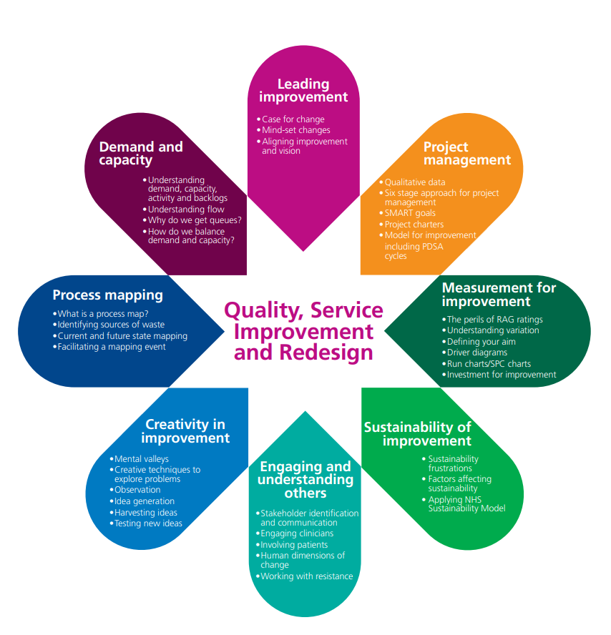




Learning outside of this programme
www.england.nhs.uk/qsir-programme/
www.england.nhs.uk/sustainableimprovement/lean-online/lean-fundamentals/
Learning outside of this programme
www.edx.org/course/practical-improvement-science-in-health-care-a-roa
www.futurelearn.com/courses/quality-improvement
https://horizonsnhs.com/school/
Notes:
Amend dates and add relevant courses for your organisation
Catch up on missed sessions.
Links to further information:
Quality, service improvement and redesign (QSIR)https://aqua.nhs.uk/QSIR
FutureLearn. Quality Improvement in Healthcare: the Case for Change. https://www.futurelearn.com/courses/quality-improvement
Horizons NHS. The School for Change Agents. https://horizonsnhs.com/school/
NHS England. Lean Fundamentals. https://www.england.nhs.uk/sustainableimprovement/lean-online/lean-fundamentals/
Harvard University: Practical Improvement Science in Health Care: A Roadmap for Getting Results. https://www.edx.org/learn/healthcare/harvard-university-practical-improvement-science-in-health-care-a-roadmap-for-getting-results

Slide 63
Today’s learning outcomes
  By the end of the session, you will be able to…
    Be able to apply creative problem-solving methods and behaviour change concepts to support teams to revive
    a stalled effort
    Understand and be able to apply COM-B and the behaviour change wheel to support QI work
    Be able to use convergent thinking tools to facilitate improvement
    Understand the IHI change concepts and how they can be used to inspire improvement work
Today’s learning outcomes
Notes:
Each session has its own learning outcomes. Today’s focus on the human side of change.
As delegates on the programme, we encourage you to reflect on the learning outcomes at the end of each session. Ask yourself: can I meet the outcomes shown on the screen without guidance from a member of the QI team? If not, then think about what you need to meet these learning outcomes.

Slide 64
We need your feedback
Feedback
Notes:
Use your evaluation forms to gather feedback on the day.

Slide 65
References and links
Michie, S., van Stralen, M.M. and West, R. (2011). The behaviour change wheel: A new method for characterising and designing behaviour change interventions. Implementation Science.
  https://implementationscience.biomedcentral.com/articles/10.1186/1748-5908-6-42
Michie, S., Atkins, L., West, R. (2014). The Behaviour Change Wheel: A Guide to Designing Interventions. Silverback Publishing.
  www.behaviourchangewheel.com
McAllister, S., Simpson, A., Tsianakas, V., et al. (2021). Developing a theory-informed complex intervention to improve nurse-patient therapeutic engagement employing Experience-based Co-design and the Behaviour Change Wheel: an acute mental health ward case study. BMJ Open.
  https://pubmed.ncbi.nlm.nih.gov/33986066/
Institute for Healthcare Improvement. Using Change Concepts for Improvement.
  https://www.ihi.org/resources/Pages/Changes/UsingChangeConceptsforImprovement.aspx
Institute for Healthcare Improvement. Change Concepts Worksheet.
  https://www.ihi.org/resources/_layouts/download.aspx?SourceURL=%2fresources%2fKnowledge+Center+Assets%2fTools+-+QualityImprovementProjectChangeConceptsWorksheet_c8af5542-2cb3-467f-a7ac-11000709eed8%2fIHITool_QIProjectChangeConceptsWorksheet.pdf
Langley, G., Moen, R., Nolan, K. M., et al. (2009). The Improvement Guide: A Practical Approach to Enhancing Organizational Performance. Jossey-Bass Publishers.
  https://www.ihi.org/resources/Pages/Publications/ImprovementGuidePracticalApproachEnhancingOrganizationalPerformance.aspx f
References and links

Slide 66
References and links (continued)
Q Community (2020). Creative Approaches to Problem Solving.
  https://q.health.org.uk/resource/creative-approaches-to-problem-solving/
Quality, service improvement and redesign (QSIR).
  https://aqua.nhs.uk/QSIR
FutureLearn. Quality Improvement in Healthcare: the Case for Change.
  https://www.futurelearn.com/courses/quality-improvement
Horizons NHS. The School for Change Agents.
  https://horizonsnhs.com/school/
NHS England. Lean Fundamentals.
  https://www.england.nhs.uk/sustainableimprovement/lean-online/lean-fundamentals/
Harvard University. Practical Improvement Science in Health Care: A Roadmap for Getting Results.
  https://www.edx.org/learn/healthcare/harvard-university-practical-improvement-science-in-health-care-a-roadmap-for-getting-results
,
References and links

Slide 67
Authors
Sidney Beech
Bridget Browne
Hannah Pearson
Contributors
Karleen Huggins
Samantha Machen
Slide design and layout by Studio Quercus

Slide 68
Authors
Sidney Beech
Bridget Browne
Hannah Pearson
Contributors
Karleen Huggins
Samantha Machen
Slide design and layout by Studio Quercus

