Slide 2
Human Side of Change
Session 7
Quality Coach Development Programme

Slide 3
Funding Acknowledgement
The Quality Coach Development Programme was partially funded through Q Exchange by the Health Foundation and NHS England and NHS Improvement
  For additional information contact
  clcht.continuous.improvement@nhs.net or the Q Community
This slide deck and all associated materials of the Quality Coach Development Programme are available under the Creative Commons Attribution-ShareAlike Licence 4.0
  This licence permits others to remix, adapt, and build upon this piece of work even for commercial purposes, as long as you credit us and license any and all new creations under the identical terms. (CC-BY-SA)
Notes:
All materials associated with this programme are copyrighted. CC-BY-SA allows anyone to use this slide deck for free, as long as the authors and contributors are credited.
You should not add your own logos to these materials without the express permission of all authors, as this would be a direct infringement on the copyright. We want to ensure all materials associated with this programme remain free-to-access for everyone.
The legal code for CC-BY-SA can be found here: https://creativecommons.org/licenses/by-sa/4.0/legalcode

Slide 4
Human Side of Change
Session 7
Cohort A
Notes:
Hello faculty of the Quality Coach Development Programme.
Welcome to Session 7 of the Quality Coach Development Programme. Please refer to the Trainer Guide for more detailed information on the day, including activity templates for the breakout rooms.
In advance of delivering this day you should work through the slides with any co-presenters and tailor the content to suit your local context. This may include swapping slides out for your own slides, adding different visuals, changing icebreakers or adapting activities to suit the target audience.
Notes in bold are instructions for the faculty. Notes in regular text are notes for delegates, and can be read out during the session or adapted as required.
Please do not delete large sections of content – if significant changes are made to the content then it may no longer meet the learning outcomes. See further explanation in the Programme Leader Guide
All content is copyrighted by the authors. Please do not remove the © mark from any materials and ensure content is correctly attributed. We have made all materials available for free to the public and just ask that you attribute the content fairly.

Slide 5
Making the most of our virtual environment
We are happy to take questions – raise your hand at any point or ask in your breakout room sessions
When you see this symbol, we recommend you take a photo or screenshot of the task for the breakout room
Indicates page in handbook
Feel free to use the chat box during the session
Making the most of our virtual environment
Indicates activity
We will be using breakout rooms a lot
Top tip: don’t touch anything when you are
being moved to rooms
Indicates an independent task for you to complete later
Notes:
You should edit this slide if delivering the content in person. You will only need the icons shown in the right hand box. However you may still wish to explain that you encourage people to ask questions or chat in the breaks, and that the session includes many activities.
If you are using an online whiteboard, ask delegates to open your preferred internet browser. If you are using Mural, we find it works best with Google Chrome.

Slide 6
Housekeeping
Housekeeping
Notes:
Suggested housekeeping – adapt to suit your environment
Technology
Where possible, please turn off emails, websites, mute phones
Mute yourself when you’re not speaking
Use emojis and reactions
Keep cameras on
Movement
Stretch if you need to, move around as desired
Feel free to fidget and doodle
Excuse yourself when you need to (sign off and re-sign on)
Fun
Have fun
Lean in with curiosity

Slide 7
Agenda for today
9.00
      Introduction and housekeeping
      Coaching circle
      Coffee break
      SPC
      Comfort break
      SPC tool
      Lunch
      Bingo
      Brand thinking
      Coffee break
      Sustainable change and Hawthorne
      Catch up presentations
      Close
9.15
10.15
10.25
11.05
11.10
Agenda for today
12.15
1.00
1.20
2.20
2.30
3.30
4.00

Slide 8



Today’s facilitators
To tint photos:
Format picture > Picture >
Picture colour >
recolour
Person name
  Job title
  Email
  Mobile
Person name
  Job title
  Email
  Mobile
Person name
  Job title
  Email
  Mobile
Today’s facilitators
Notes:
*Notes for faculty – please add in your own images and contact details here*
This is a good point to properly introduce yourselves and explain your background and experience in QI and coaching improvement.

Slide 9
Programme aim
The aim of this eight week programme is to…
Support individuals to develop the skills
and knowledge required to independently
and confidently coach a team through improvement work.
Programme aim

Slide 10
Ten learning outcomes of the programme
      By the end of the programme delegates will be able to independently:
Coach an improvement team ensuring robust application of QI methods and principles
Help teams to explore barriers and enablers relating to their QI work, in support of the sustainability of interventions
1
6
Understand the concepts of coaching improvement and the difference between coaching and advising
Advocate for meaningful involvement in
QI work and advise teams on methods for involvement
2
7
Ten learning outcomes of the programme
Explain their role as a Quality Coach to different stakeholders
Coach a team to identify, collect and interpret data in support of their improvement work
3
8
Promote an environment that encourages team members to contribute equally to the development of improvement work
Apply creative problem-solving methods and behaviour change concepts to support teams to revive a stalled effort
4
9
Assimilate QI knowledge and facilitation skills that support teams to progress through the different stages of QI work
Critically analyse their own limitations and the limitations of coaching
5
10
Notes:
Each session has its own learning outcomes. Today’s focus on the human side of change.
As delegates on the programme, we encourage you to reflect on the learning outcomes at the end of each session. Ask yourself: can I meet the outcomes shown on the screen without guidance from a member of the QI team? If not, then think about what you need to meet these learning outcomes.

Slide 11
Human Side
of Change
  Quality Coach Development Programme
Notes:
Today we will be looking at the human side of change.

Slide 12
Today’s learning outcomes
  By the end of the session, you will be able to…
    Coach a team to identify, collect and interpret data in support of their improvement project
    Apply creative problem-solving methods and behaviour change concepts to support teams to revive a stalled effort
    Explain the key concepts of SPC charts and be able to use them to support improvement work.
Today’s learning outcomes
Notes:
Each session has its own learning outcomes. Today’s focus on the human side of change.
As delegates on the programme, we encourage you to reflect on the learning outcomes at the end of each session. Ask yourself: can I meet the outcomes shown on the screen without guidance from a member of the QI team? If not, then think about what you need to meet these learning outcomes.

Slide 13
Coaching circle
Activity 7.1
Notes:
See activity 7.1 in the Trainer Guide
60 mins

Slide 14
SPC Charts
S
  Statistical
P
  Process
C
  Control
SPC Charts
Notes:
In all improvement work, we use time series data to help us assess the impact of our changes.
Statistical Process Control (SPC) charts are a type of chart we use to study how a system or process changes over time. It allows us to understand the variation in our data highlighting what is ‘different’ and what is the ‘norm’. By using these charts, we can then understand where to focus our improvement efforts.
SPC charts are used to determine:
The variation in our processes
If our improvement strategies have had the desired effect.
If an improvement strategy has sustained the gains.
And to predict how the process will perform in the future.
Fun Fact:
SPC charts were initially developed by Dr. Walter A. Shewhart of Bell Laboratories in the 1920s. This is why they are also known as Shewhart charts. However, they were made popular by Dr. W. Edwards Deming when he introduced the concept to the Japanese car industry after World War II. Nowadays, SPC charts have been incorporated by organisations around the world as one of the primary tools to monitor and improve the control of a process.

Slide 15
Why use SPC charts?
    Understand your data over time using a more powerful tool than a run chart
    Differentiate between common cause and special cause variation
    Assess whether your process is stable and therefore predictable,
    or unstable and unpredictable
    Understand whether your process
    is capable of a desired level of performance.
Why use SPC charts?
Notes:
Why do we use them?
Statistical Process Control charts should be used throughout the life cycle of the project if there is sufficient data.
They will help you identify a project, get a baseline and evaluate how you are currently operating, and help you to assess whether your process is stable and therefore predictable, or unstable and unpredictable.
SPC charts will also help you to assess whether your project has made a sustainable difference.
SPC charts can help you understand the scale of any problem, gather information and identify possible causes when used in conjunction with other investigative tools such as process mapping and spaghetti diagrams*.
They will also help you to measure the impact of any tests of change and evaluate their impact on your process or system.
*Spaghetti diagram: A time in motion study where you observe your team’s workflow to identify ways to shorten the walking time from one activity to another for frequently performed tasks.

Slide 16
Choosing charts for data over time
  Line chart
  Run chart
  SPC chart
Choosing charts for data over time
© Quality Coach Design Group
1 | 2 | 3 | 4 | 5 | 6 | 7 | 8 | 9 | 10 | 11 | 12 | 13 | 14 | 15 | 16 | 17 | 18 | 19 | 20 | 21 | 22 | 23 | 24 | 25+
Number of data points
Notes:
You choose the chart type based on the number of data points you have.
For meaningful analysis of a SPC chart you need to have a minimum of 20 data points. We will come to the rules to interpret SPC charts later.

Slide 17
Run to Statistical Process Control Charts
p183
100
75
50
25
0
Upper Control Limit
Measure of interest
Median
Mean
Run to Statistical Process Control Charts
Lower Control Limit
J | F | M | A | M | J | J | A | S | O | N | D | J | F | M
Data over time (chronological)
Notes:
Being able to plot SPC charts is a great skill to know in improvement. They enable us to visualise trends and changes in data very quickly, and without much effort.
You may have learnt about run charts before but let’s have a quick recap
The basic anatomy of a run chart is simple:
A horizontal line or x axis, plotting data of some sort over time – such as days, weeks or months.
A vertical line, plotting the topic of focus in either numbers, percentages or even in currency such as £Pounds.
We get the data and add it to the chart in chronological order and these data points are connected by a line, as shown.
*** The thing that makes this a run chart, and not a normal line chart is the addition of a median – or centre line. The centreline of a run chart consists of the median (which is the middle value when all values are arranged in ascending order).
Now we have a Run Chart – so what makes an SPC chart different to a run chart?
*** With an SPC chart the centre line is a mean. The mean is the average value of the data, so if you add all the data points up and divide this by the number of data points, then we get the mean.
We also have these two purple lines, known as the Upper and Lower Control Limit – statistically, 99.7% of the data will fall between these two lines.
This is the basic layout of an SPC chart – and it is really powerful as it helps to pick up on variation – particularly that caused by an external factor, such as special cause variation.
So, how to use them?
To produce a control chart you need an absolute minimum of 10 data points to create a chart; however, with less than 20 data points, the mean and the upper and lower control limits would be considered as trial limits. Once we have 20 or more data points there is increased reliability for interpreting our data.

Slide 18
Control limits
68.2%
Control limits
34.1%
34.1%
2.1%
2.1%
13.6%
95.4%
13.6%
99.7%
-3σ
-2σ
-1σ
0
+1σ
+2σ
+3σ
Notes:
You may be familiar with the normal distribution curve (also known as a bell curve or Gaussian distribution curve) from previous studies. The normal distribution is the most common type of distribution for a variable.
For instance, if we plotted the height of all women in London or if we recorded the IQ of people in Paris or the weight of all poodles in Melbourne, we would find that the data would look like a bell curve.
A normal distribution curve, depicting the mean (at zero), and the +/- standard deviations (σ)
The bell curve is a graphical display of normally distributed data. This means that the average value (mean) is located at zero – the middle of the curve. Therefore, we know that 50% of the data is on the left hand side of the curve, and the other 50% is on the right hand side.
Notably, the largest amount of the data is found at the centre of the curve, and this tapers off further away from the mean.
>68% of the data is found within one sigma (+/- 1σ) from the mean.
>95% of the data is found within two sigma (+/- 2σ) from the mean.
>99.7% of the data is found within three sigma (+/- 3σ) from the mean.

Slide 19
Control limits
0.3%
beyond 3σ limits
Control limits
LCL
Lower Control Limit
UCL
Upper Control Limit
← 0.15%
0.15% →
-3σ
-2σ
-1σ
0
+1σ
+2σ
+3σ
Notes:
3 in 1000 chance of being beyond the LCL and UCL. So the likelihood that a value falls outside of these control limits because of common cause is very very small.

Slide 20
Control limits
UCL
Upper Control Limit
Mean
Control limits
LCL
Lower Control Limit
Notes:
You can see here how the concept of normal distribution is mapped onto an SPC chart.

Slide 21
Control charts
UCL
Upper Control Limit
Mean
Control charts
LCL
Lower Control Limit
Notes:
Sigma lines/Upper and Lower Control Limits.
How to use them?
An SPC chart has a mean line and two control lines above and below the mean line, both of which allow more statistical interpretation.
The rationale for the use of three sigma limits includes:
The limits have a basis in statistical theory
The limits have proven in practice to distinguish between special and common causes of variation
In most cases, use of the limits will help reduce over-reaction or under-reaction to variation in the process
The limits help us consider the magnitude of the variation that is built into the process (for example, sometimes the improvement is that we see less variation as indicated by the upper and lower control limits.
For meaningful analysis of a SPC chart you need a minimum of 20 data points to create a statistically valid chart.
There are different types of SPC charts, however, the standard chart we use is an known as an x-MR chart or I-Chart.
References:
NHS England. Making Data Count. https://www.england.nhs.uk/publication/making-data-count/
​Provost, L. P. and Murray, S. (2011). The Health Care Data Guide: Learning from Data for Improvement. Jossey-Bass.

Slide 22
Examples of different forms of variation
Examples of different forms of variation
Notes:
Here is an example dataset looking at Lewis Hamilton’s career positions, charted over time. We are going to take this data and plot it on an SPC. You will then have a go yourselves at creating an SPC from some provided data.

Slide 23
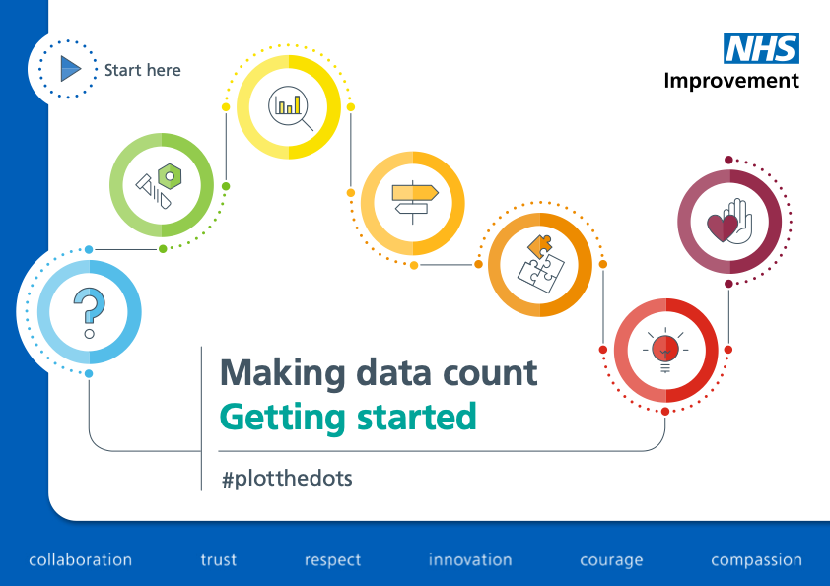
A useful SPC tool – demonstration
Activity 7.2
Notes:
See activity 7.2 – live demonstration of NHS SPC tool
10 mins
Explain the general layout, entering data, quick glimpse of chart.

Slide 24
System of Profound Knowledge
“The system of profound knowledge provides a lens.
It provides a new map of theory by which to understand and optimise our organisations.”
Deming, Out of the Crisis (1992)
Aims or values
Appreciation
of a system
System of Profound Knowledge
Theory of
Knowledge
Human
Behaviour
Understanding
variation
Notes:
Reference:
Deming, W. E. (1992). Out of the Crisis. The MIT Press.

Slide 25
System of Profound Knowledge
“The system of profound knowledge provides a lens.
It provides a new map of theory by which to understand and optimise our organisations.”
Deming, Out of the Crisis (1992)
Aims or values
Appreciation
of a system
System of Profound Knowledge
Theory of
Knowledge
Human
Behaviour
Understanding
variation
Notes:
The system of profound knowledge is a framework introduced by Deming to be used in quality planning. It encourages users to break down a range of variables that impact on the success of change ideas and programmes.
Appreciation of a system/understanding of variation – how do we get just enough data to help us understand our systems and the variation within them?
Theory of knowledge – we see this in practice in our PDSA cycles, we have a theory of what will happen – our prediction of change is our theory of knowledge.
Human behaviour – understanding why people act as they do. You will hear us say things like QI is 80% people and 20% theory. This is the human side of change. It is a large part of our work as improvers to consider human behaviour. Convergent and divergent thinking helps us support the human side of change.
Reference:
Deming, W. E. (1992). Out of the Crisis. The MIT Press.

Slide 26
Variation – heart rate
  Two types of variation…
Variation – heart rate
Common cause
Special cause
Notes:
There are two different types of variation:
Common cause variation
This is also known as normal variation. It is the day-to-day data that you will see, fluctuating up and down. For example – the number of births in London is around 300–350 per day or if I plotted my mean systolic blood pressure by minute it will go up and down around say 5–10mmHg.
Special cause variation
Is due to irregular or unnatural causes that are not inherent in the design of the process i.e. a change is present in the data caused by a specific factor. For example – if I was to make a New Year’s Resolution to improve my physical fitness and plot my resting heart rate by the hour during my first run of the year then you would definitely see that in the data.
Many people assume this means that common cause is good and special cause is bad – this is not necessarily the case!
Just because common cause is stable and predictable doesn’t always mean it’s good. For example, if my resting heart rate was consistently around 170 and stable, then that wouldn’t be good. Similarly, if I weighed 18 stone and over a year it went down week by week to 15 stone because of a healthy diet and regular exercise then this would be a good thing, and is also known as special cause variation.

Slide 27
Special cause variation
        Special cause
Special cause variation
        Unintentional
        When the system is out of control and unstable due to unexpected forces
© Quality Coach Design Group
        Intentional
        When we’re trying to change the system
Notes:
Here are two types of special cause:
Unintentional
Intentional
Can anyone think of an example of unintentional special cause variation that is happening in your workplace at the moment?

Slide 28
SPC charts
        Rule 1
        A single point outside
        the control limits
SPC charts
        Rule 2
        2 out of 3 consecutive points near a control limit
        (Outer one-third)
Notes:
This slide set uses the rules for interpretation highlighted by NHSE. Some organisations may use slightly different rules.
RULE 1:
A single point outside the control limits
Fun Fact: Christmas Day creates an astronomical point for nearly any measure you look at!
RULE 2:
2 out of 3 consecutive points near a control limit (outer one-third)

Slide 29
SPC charts
        Rule 3
        A shift – seven or more consecutive points above or below the mean
SPC charts
        Rule 4
        A trend – seven or more consecutive points increasing (trend up) or decreasing (trend down)
Notes:
RULE 3:
A shift – seven or more consecutive points above or below the mean
This has the probability of 0.39% occurrence (a one in two hundred and fifty-one chance)
RULE 4:
A trend – seven or more consecutive points increasing (trend up) or decreasing (trend down)
Note: a data point that is on the mean line neither adds to nor detracts from the number of data points in the rule.

Slide 30
NHS England SPC tool – symbols
Variation |  |  |  |  |  | Assurance | Assurance
Special Cause concerning variation |  | Special Cause improving variation |  | Special Cause neither improve or concern variation |  | Common Cause | Consistently hit target | Hit and miss target subject to random variation | Consistently fail target
NHS England SPC tool – symbols
Notes:
The tool highlights when a rule has been broken.
It helps us with interpretation.
Talk through the symbols used.

Slide 31
Coffee break
Notes:
15 mins

Slide 32
Activity – spot the special cause!
Activity – spot the special cause!
Notes:
Ask the group to identify any special cause.

Slide 33
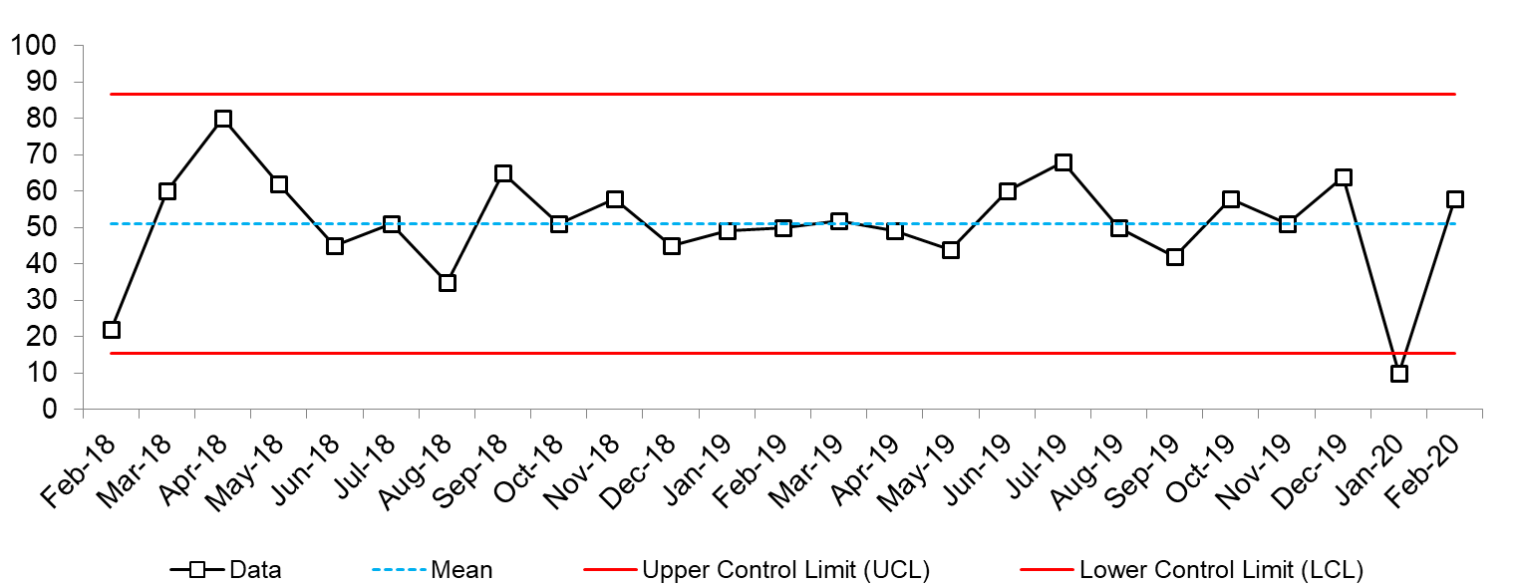
Activity – spot the special cause!
Activity – spot the special cause!
Notes:
Ask the group to identify any special cause.

Slide 34
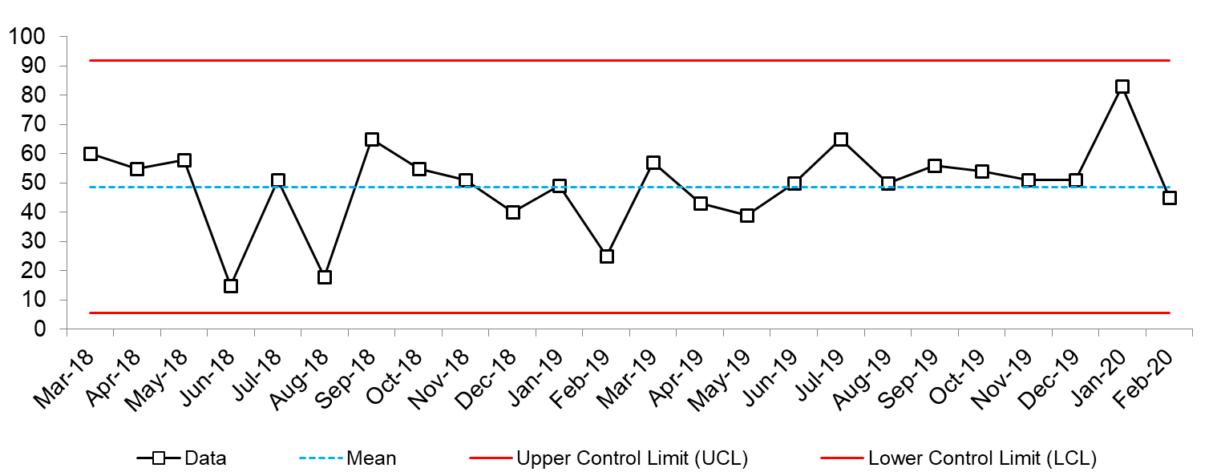
Activity – spot the special cause!
Activity – spot the special cause!
Notes:
Ask the group to identify any special cause.

Slide 35
A useful SPC tool – demonstration
A useful SPC tool – demonstration
Notes:
See activity 7.3 – includes a completed excel SPC chart for you to show.
10 mins
This time looking at the chart and interpreting the rules present. Discuss the variation.
Show extra functionality such as
Adding more data
Annotating the chart
Rebasing the mean.

Slide 36
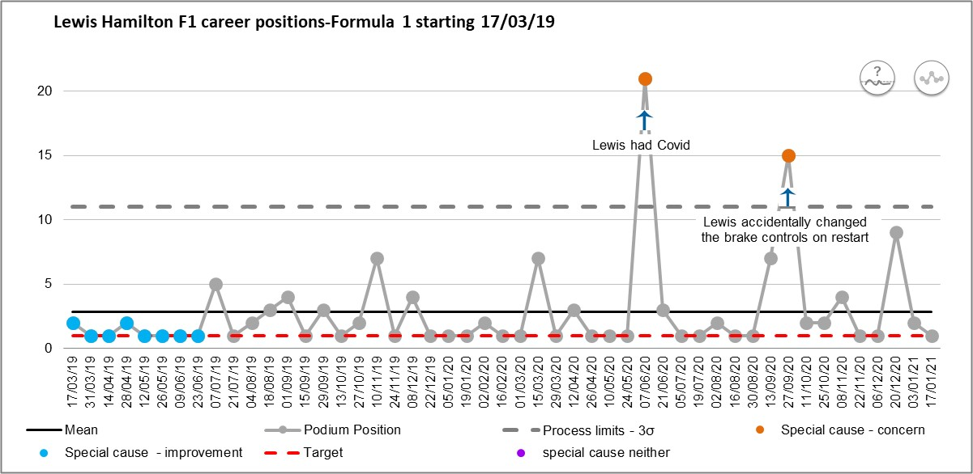
SPC
SPC
Notes:
Backup image of completed dataset. Use the excel document to screen share.
This is the same data as before (NB the data isn’t actually fortnightly but the NHS tool only lets us put data in on a set routine eg daily, weekly, fortnightly. Therefore some of the dates are wrong but we won’t focus on this as it’s just for an example.)
Highlights rules that were broken – shift at the bottom
2 astronomical points
Able to annotate – this might be where you add change ideas or extenuating circumstances that could have affected the data.
Same data – different story – more to say.

Slide 37
A useful SPC tool – demonstration
A useful SPC tool – demonstration
Access the tool: https://future.nhs.uk/MDC/groupHome
Notes:
Any questions?
Access the tool: https://future.nhs.uk/MDC/groupHome

Slide 38
Reflections on NHS SPC Tool
+
Has clear instructions
+
Great for consistent data
+
Easy to read and interpret
–
Clunky
–
Not very flexible
Reflections on NHS SPC Tool
Notes:
Instructions are super clear – whole tab which takes you through step by step how to use the tool
If you do not have consistent data it can be a bit tricky
Need to have regular intervals between collecting data. If you add something that doesn’t keep with the rules you will have to reset them. It doesn’t work it out for you
Lots of Macros built into it – therefore it can be a bit clunky
Clearly flags rules.

Slide 39
Activity
  Three groups: Each group has been provided with a raw dataset from the same QI project – an outcome, process and balancing measure
  Task
      Manipulate the data as required in order to enable you to plot it on an SPC chart
      Plot the data on the NHS England template (provided)
      Review the chart – is there special cause present? If so, which?
      Prepare to present your findings back to the group as if you are an analyst presenting the dataset back to an improvement team.
        Think about what the special cause may mean
        What coaching questions might you ask the team to take the project forward?
Activity 7.4
Notes:
See activity 7.4
40 mins for activity, 10 mins group reflection
Use 3 SPC charts from within your organisation or the case study if necessary.

Slide 40
Today was just an introduction to SPC…
  We decided not to go into the complex detail of the calculations for the SPC
  There are actually many different types of SPC.
  But don’t worry… we’re not going to cover this as this level of specialism is for the QI team
  If you’d like to learn more about SPC and how they can be used in the NHS we’d recommend Making Data Count and signing up for the FutureNHS platform:
  www.england.nhs.uk/publication/making-data-count/ https://future.nhs.uk/MDC/groupHome
Today was just an introduction to SPC…
Notes:
You don’t need to be an expert. There are many other resources to learn more about SPC.
Read the screen
References:
NHS England. Making Data Count. www.england.nhs.uk/publication/making-data-count/
FutureNHS. https://future.nhs.uk/MDC/groupHome

Slide 41
Lunch break
Notes:
45 mins.

Slide 42
QI Bingo
QI Bingo

Slide 43
QI Bingo!
Juran’s trilogy and the first name of Juran | Who said “Everyone has two jobs: to do their work and to improve their work”? | Name two levels of QI training in CNWL …. | According to Ron Heifetz, what are the two types of change? T_______________ A_______________
What are the 3 aspects of context that one must consider when leading QI? M__________________ M__________________ E___________________ | When would you use nominal group technique? | What is the name of the book that introduced the Model for Improvement? | What is 1 more rule to identify special cause in an SPC chart? (not including astronomical point, shift, and trend)
What is the final stage of the 6 stages of a qi project? | What are the two sides of a force field analysis and what might you use force field analysis for? | What is the core rule of a Pareto chart? | Who said: “every system is perfectly designed to get the results it gets” ?
What are the 3 common rules for special cause in a run chart? | What is the centre line on an SPC called and how do you calculate it? | What is the IHI triple aim? | What are the 3 As of PDSA?
QI Bingo!
Notes:
See activity 7.5 in Trainer Guide.
15 mins

Slide 44
Ideation
Ideation
Diverge
Create choices
Converge
Make choices
Notes:
Ideation involves the generation of many ideas and the selection of the best ones to go forward. This is sometimes referred to as divergent thinking (generating ideas) and convergent thinking (selecting ideas).
Divergent thinking – idea generation
Use tools such as brainstorming, brand thinking and simple rules to generate a high quantity of different ideas
Look to other organisations, other industries and other countries for new ideas
Involve patients, laypeople, staff from different departments to provide new insights.
Convergent thinking – idea selection
Use simple tools like ‘dot voting’ to narrow down to a handful of ideas
Again, seek the input of others (patients, carers, lay people, other departments) to select ideas
Use tools like Six Thinking Hats, decision matrices and SWOT analysis to evaluate options
Ultimately you should collectively decide on which idea(s) you want to test.
Let’s start with diverge.

Slide 45
Ideation
      Brainstorming
      Reverse brainstorming
      Random input (random image, object, word)
      Stepping stones
      TRIZ
      Affinity diagrams
      Nominal Group Technique
      That’s impossible!
      Break the rules (aka simple rules)
      Brand thinking
Ideation
Source: Q Community (2020)
Notes:
Here are some common tools that you may use to support ideation. Let’s start with brand thinking.
Reference:
Q Community (2020). Creative Approaches to Problem Solving. https://q.health.org.uk/resource/creative-approaches-to-problem-solving/

Slide 46
Brand
Thinking
Brand Thinking
Notes:
Brand thinking is a method we used to harness new ideas, and to help people think differently. It’s simple to set up and use and given its team approach, it ensures equal contribution and collaboration.

Slide 47
Brand thinking
      Clearly define the problem/task to tackle.
      Choose an innovative brand.
      Note down 5–10 words to describe the brand.
      Share your descriptions with the wider group and create a collated list of descriptor words and phrases.
      Think about how your chosen brand would approach the problem. What would they do differently? What innovative ideas might they come up with?
      Write down or draw your ideas.
      Reflect on which of these new ideas might be useful to take forward.
Brand Thinking
Source: Q Community, 2020
Notes:
Clearly define the problem/task to tackle. (2 mins)
Choose 1–4 innovative brands
Individually think about, and note down, 5–10 words or phrases to describe the brand or organisation (for example for IKEA it might be ‘encourages a do-it-yourself attitude’, ‘simple and affordable’ or Amazon might be ‘personalised’, ‘easy customer feedback loops' or John Lewis, ‘promotes employee engagement and partnership’). (3 mins)
Share your descriptions with the wider group and create a collated list of descriptor words and phrases. (2 mins)
Now go back to your problem/task and think about how your chosen brand/organisation would approach the problem. What would they do differently? What innovative ideas might they come up with? (5-10 mins)
Write down or draw your ideas. (5-15 mins)
Reflect on which of these new ideas, or aspects thereof, might be useful to take forward. (3-10 mins)
Reference:
Q Community (2020). Creative Approaches to Problem Solving. https://q.health.org.uk/resource/creative-approaches-to-problem-solving/

Slide 48
Brand thinking
Let’s have a go!
How do
we make
QI go viral?
Problem
QI has a low profile in the Trust
Activity 7.6
Notes:
See activity 7.6 in the Trainer Guide.
50 mins

Slide 49
Coffee break
Notes:
10 mins

Slide 50
Sustainable
change
Sustainable change

Slide 51
Why does QI not always stick?
Why does QI not always stick?
Notes:
5 mins discussion
Why does QI not always stick?
What are your past experiences of QI (or even just change). What didn’t work, last? Why?
What worked and how did it work?

Slide 52
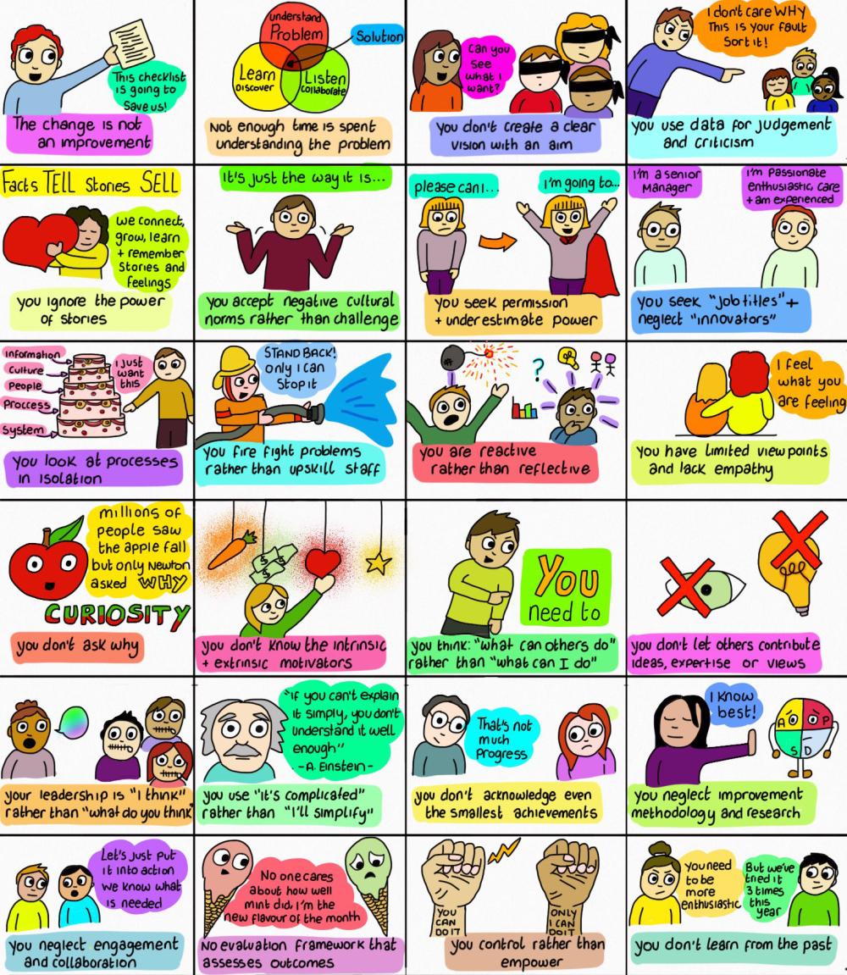
Why do some projects fail?
Why do some projects fail?
soniasparkles.com
Notes:
Click for second part to appear (more reasons why)
Talk through some key points using your own experiences
E.g neglect engagement and collaboration
Project lead wanted to improve neonatal development care positioning on the NICU. Babies should be positioned a certain way to support neurodevelopment. The project lead was extremely passionate about this, engaged a patient rep, but didn’t consult with or engage with her colleagues on the unit. She created loads of helpful guides, training resources but didn’t embed this in the unit or let most of the staff know this info existed.
Only after several months and a chance conversation with nurse on the unit did they learn the reason for the lack of engagement. This was because she was shy, so the improvement team helped share the info.
The change is not an improvement
I’ve seen a lot of checklists and ‘reminders’ in my time – how can these stick?

Slide 53
What proportion of changes last?
1
in 3
What proportion of changes last?
© Quality Coach Design Group
Sources: Ivers et al (2014); Beer and Nohria (2000); Stephani et al (2020); Knudsen et al (2019)
Notes:
What proportion of changes last?
We know from our own experiences and from the literature that many QI projects are not sustained. There are many factors that may influence this, including the local and organisational context, mis-aligned priorities, loss of interest, wrong motivation for doing QI work, as well as the poor design of QI interventions.
The literature shows around only one third of QI work is sustained and achieves the desired results. (Ivers, 2014) (Beer, 2000) (Hill, 2020) (Knudsen, 2019)
This incredibly small proportion clearly indicates more needs to be done to support the sustainability of change.
References:
Ivers, N.M., Grimshaw, J.M., Jamtvedt, G. et al. (2014). Growing Literature, Stagnant Science? Systematic Review, Meta-Regression and Cumulative Analysis of Audit and Feedback Interventions in Health Care. Journal of General Internal Medicine. https://pubmed.ncbi.nlm.nih.gov/24965281/
Beer, M. and Nohria, N. (2000). Cracking the code of change. Harvard Business Review. https://hbr.org/2000/05/cracking-the-code-of-change
Hill, J. E., Stephani, A. M., Sapple, P. et al. (2020). The effectiveness of continuous quality improvement for developing professional practice and improving health care outcomes: a systematic review. Implementation Science. https://implementationscience.biomedcentral.com/articles/10.1186/s13012-020-0975-2
Knudsen, S. V., Laursen, H. V. B.,, Johnsen, S. P. et al. (2019). Can quality improvement improve the quality of care? A systematic review of reported effects and methodological rigor in plan-do-study-act projects. BMC Health Services Research. https://bmchealthservres.biomedcentral.com/articles/10.1186/s12913-019-4482-6

Slide 54
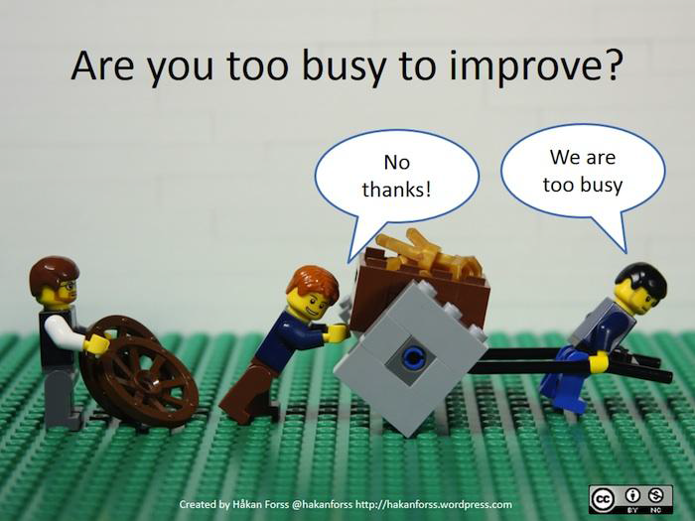
Selecting changes
        Model for Improvement
“While all changes do not lead to improvement, all improvement requires change.”
- IHI
        What are we trying to accomplish?
        How will we know that a change is an improvement?
        What change can we make that will result in improvement?
Selecting changes
        Act
        Plan
        Study
        Do
Notes:
The third and final question of the Model for Improvement asks you to consider the ideas/hunches you have that you want to test. As said by the IHI…

Slide 55
Hierarchy of Intervention Effectiveness
p224
+
More effective
Forcing
functions
Automation &
computerisation
Simplification &
standardisation
Hierarchy of Intervention Effectiveness
Reminders, Checklists
& Double Checks
System-focused
Rules, Policies
& Guidelines
Education
& Training
People-focused
–
Less effective
Source Horsham, P.A. (1999)
Notes:
This tool was developed for selecting changes related to medication error, but can be used anywhere in the health setting.
The concept is simple enough… 2 main types of changes
People-focused changes put the onus on individuals and teams to manage a change
System-focused changes put the onus on the system itself in order to bring about change
You’ll see that this is a hierarchy, with the LEAST effective at the bottom, and MOST effective at the top. So in other words, people-focused changes are less likely to be successful in the long term than system-focused changes.
This is not to say that people-focused changes don’t work… of course they can and do! Training and education gives us highly qualified healthcare professionals who are updating their knowledge constantly to deliver evidence-based care… similar checklists can and do work. Look at the WHO checklist and the significant effect that has had in theatres across the globe.
The three different forms of PF changes are shown at the lower half of the image
Education and training
Why might this not work? Ask the group. Dynamic workforce, highly interprofessional teams, perhaps?
Rules and policies
The complexity of delivering safe care requires clinicians to be flexible – every patient is different and often policies are not able to mirror that – so we tend to ignore them!
Reminders, checklists, double checks
Often used for the wrong form of human error, so they have no chance of ever having success! You are still putting the onus on an individual with many other competing priorities… better to change the system to help people do the right thing?
Three different types of SF change
Simplification and standardisation
If something is easier to do, people tend to do it. Think of the river taking the most efficient route to the sea.
Automation/computerisation
Computers don’t make mistakes (unless the programmer hasn’t coded it correctly)
Think about manual data entry… if a computer can do that for you and your tired brain – then why not? Fewer errors, less taxing, less stress. And perhaps the time can be used on something humans are better at?
Forcing functions
These make you do something before going to the next step.
E.g. a computer, if you close an unsaved document, it prompts you to choose to save it or delete it or cancel. The system intervenes to help you make a better choice
This is the Hierarchy – helpful to consider when designing changes. Look to the top for inspiration.
Reference:
Horsham, P. A. (1999). The hierarchy of intervention effectiveness. Institute of Safe Medication Practices

Slide 56
Hierarchy of Intervention Effectiveness
–
effectiveness
+
Training & Education
Rules, Policies & Guidelines
Reminders, Checklists & Double Checks
Standardisation & Simplification
Automation & Computerisation
Forcing functions
Clinical skills refresher
Card coming out of ATM before cash
Different size nozzle for petrol and diesel
Hierarchy of Intervention Effectiveness
Shopping list
Colour coding system
Car lights turning on when it is dark
Notes:
Where do each of the following change ideas sit on the hierarchy?
Group discussion.

Slide 57
Hierarchy of Intervention Effectiveness
–
effectiveness
+
Training & Education
Rules, Policies & Guidelines
Reminders, Checklists & Double Checks
Standardisation & Simplification
Automation & Computerisation
Forcing functions
Clinical skills refresher
Shopping list
Different size nozzle for petrol and diesel
Car lights turning on when it is dark
Card coming out of ATM before cash
Hierarchy of Intervention Effectiveness
Colour coding system
Notes:
In room discussion
Answers:
Clinical skills refresher - training
Shopping list - reminders, checklist & double checks
Card coming out of ATM before cash - forcing function – you can’t walk away without your card.
Colour coding system - standardisation and simplification
Different nozzle for petrol - standardisation and simplification. (The diesel nozzle is bigger than the petrol nozzle. Therefore the diesel nozzle won’t fit or would be difficult to put in a petrol car – this is because putting diesel in a petrol car is very expensive to fix, whereout the other way round (putting petrol in the diesel) is not ideal but causes less damage.
Car lights turning on if it’s dark - automation and computerisation.

Slide 58
Activity
In groups, discuss the improvement work you
are coaching.
Map your teams’ PDSAs on the hierarchy of intervention effectiveness.
Activity 7.7
Notes:
See activity 7.7 in Trainer Guide.
10 mins

Slide 59
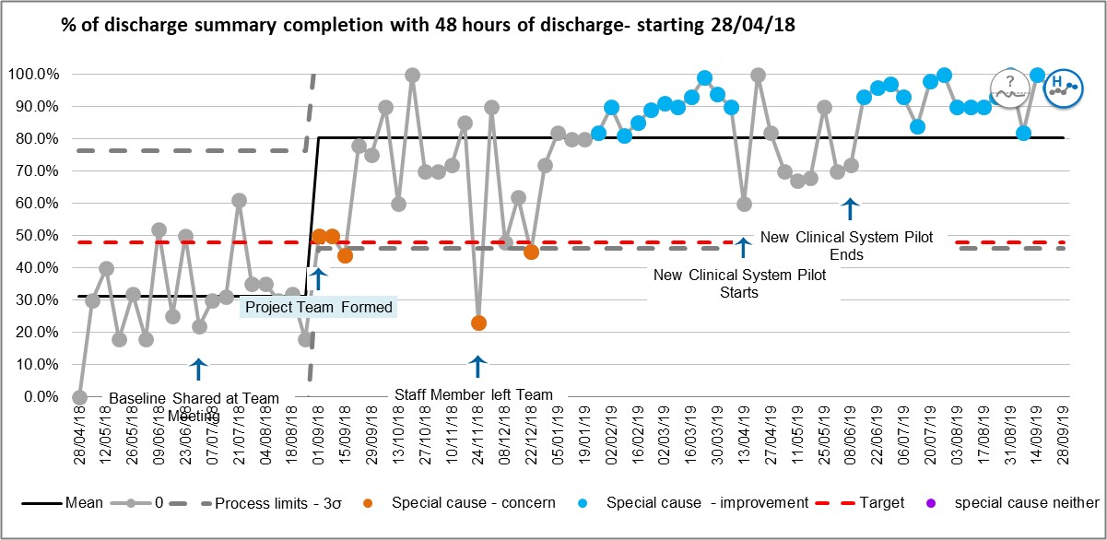
Notes:
Hawthorne following discussion of QI project ideas briefly spikes and then improves to CL of 30 (previous unseen baseline was consistently 0%)
Real project example – looking at % of discharge summary completion within 48 hours
Baseline shared at team meeting – 23/06/18
Project team formed – rebaselined. At this point – as it had consistently improved
2 shifts in blue
Oranges flag when issues within the team e.g. team member left.
Breakout room or in the room, consider this chart – what questions do you have and what are you noticing?
After being discussed at the start – the compliance begins to improve – before any changes are implemented.

Slide 60
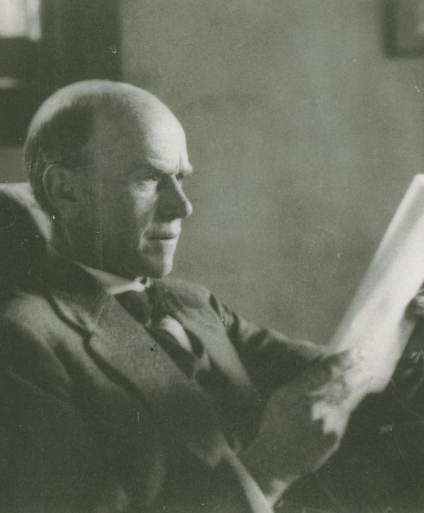
Hawthorne Studies
  Hawthorne Studies were conducted from
  1924–1932 at Western Electric Hawthorne Works
  Prof Elton Mayo was examining the effects of
  monotony and fatigue on productivity
  Everything worked!
Hawthorne Studies
Notes:
Tests included changing lights, rest breaks, company sponsored meals, interviews with employees, incentive based pay, counselling for staff.

Slide 61
Hawthorne Studies
Individuals improve or modify an aspect of their behaviour in response to their awareness of being observed.
Hawthorne Studies

Slide 62
Hawthorne Studies
As a coach it is important to be aware of the Hawthorne Effect.
Improvements as a result of being observed are unlikely to be sustained.
Hawthorne Studies

Slide 63


The power of observation
Before the audit
The power of observation
During the audit
After the audit
Notes:
Pixabay alohamalakhov https://pixabay.com/photos/road-vineyard-countryside-way-path-428039/
CC Empty Highway Overlooking Mountain Under Dark Skies https://www.pexels.com/photo/empty-highway-overlooking-mountain-under-dark-skies-1955134/

Slide 64
Presentations
Presentations
Notes:
This slide is a placeholder to allow you to catch up on any delegate presentations that were missed in session 5 in the All Teach All Learn.

Slide 65
Today’s learning outcomes
  By the end of the session, you will be able to…
    Coach a team to identify, collect and interpret data in support of their improvement work
    Apply creative problem-solving methods and behaviour change concepts to support teams to revive a stalled effort
    Explain the key concepts of SPC charts and be able to use them to support improvement work.
Today’s learning outcomes
Notes:
Each session has its own learning outcomes. Today’s focus on the human side of change.
As delegates on the programme, we encourage you to reflect on the learning outcomes at the end of each session. Ask yourself: can I meet the outcomes shown on the screen without guidance from a member of the QI team? If not, then think about what you need to meet these learning outcomes.

Slide 66
Self-directed learning
1
2
  Prepare teachback for the topics below
  Use the SPC tool for data that you have to hand
Self-directed learning
Notes:
Update the list

Slide 67
We need your feedback
Feedback
Notes:
Use your evaluation forms to gather feedback on the day.

Slide 68
Now what
Add in the slides from the end of Session 6 if you are finishing the programme here.
Now what

Slide 69
References and links
Deming, W. E. (1992). Out of the Crisis. The MIT Press.
FutureNHS.
  https://future.nhs.uk/MDC/groupHome
NHS England. Making Data Count.
  www.england.nhs.uk/publication/making-data-count/
​Provost, L. P. and Murray, S. (2011). The Health Care Data Guide: Learning from Data for Improvement. Jossey-Bass.
Q Community (2020). Creative Approaches to Problem Solving.
  https://q.health.org.uk/resource/creative-approaches-to-problem-solving/
Ivers, N.M., Grimshaw, J.M., Jamtvedt, G. et al. (2014). Growing Literature, Stagnant Science? Systematic Review, Meta-Regression and Cumulative Analysis of Audit and Feedback Interventions in Health Care. Journal of General Internal Medicine.
  https://pubmed.ncbi.nlm.nih.gov/24965281/
Beer, M. and Nohria, N. (2000). Cracking the code of change. Harvard Business Review.
  https://hbr.org/2000/05/cracking-the-code-of-change
Hill, J. E., Stephani, A. M., Sapple, P. et al. (2020). The effectiveness of continuous quality improvement for developing professional practice and improving health care outcomes: a systematic review. Implementation Science.
  https://implementationscience.biomedcentral.com/articles/10.1186/s13012-020-0975-2
Knudsen, S. V., Laursen, H. V. B.,, Johnsen, S. P. et al. (2019). Can quality improvement improve the quality of care? A systematic review of reported effects and methodological rigor in plan-do-study-act projects. BMC Health Services Research.
  https://bmchealthservres.biomedcentral.com/articles/10.1186/s12913-019-4482-6
Horsham, P. A. (1999). The hierarchy of intervention effectiveness. Institute of Safe Medication Practices.
References and links

Slide 70
Authors
Sidney Beech
Bridget Browne
Hannah Pearson
Contributors
Robert Brushfield-Hodges
Jennifer Cotter
Slide design and layout by Studio Quercus

Slide 71
Authors
Sidney Beech
Bridget Browne
Hannah Pearson
Contributors
Robert Brushfield-Hodges
Jennifer Cotter
Slide design and layout by Studio Quercus

