Slide 2
Coaching Measurement
Session 6
Quality Coach Development Programme

Slide 3
Funding Acknowledgement
The Quality Coach Development Programme was partially funded through Q Exchange by the Health Foundation and NHS England and NHS Improvement
  For additional information contact
  clcht.continuous.improvement@nhs.net or the Q Community
This slide deck and all associated materials of the Quality Coach Development Programme are available under the Creative Commons Attribution-ShareAlike Licence 4.0
  This licence permits others to remix, adapt, and build upon this piece of work even for commercial purposes, as long as you credit us and license any and all new creations under the identical terms. (CC-BY-SA)
Notes:
All materials associated with this programme are copyrighted. CC-BY-SA allows anyone to use this slide deck for free, as long as the authors and contributors are credited.
You should not add your own logos to these materials without the express permission of all authors, as this would be a direct infringement on the copyright. We want to ensure all materials associated with this programme remain free-to-access for everyone.
The legal code for CC-BY-SA can be found here: https://creativecommons.org/licenses/by-sa/4.0/legalcode

Slide 4
Coaching Measurement
Session 6
Cohort A
Notes:
Hello faculty of the Quality Coach Development Programme.
Welcome to Session 6 of the Quality Coach Development Programme. Please refer to the Trainer Guide for more detailed information on the day, including activity templates for the breakout rooms.
In advance of delivering this day you should work through the slides with any co-presenters and tailor the content to suit your local context. This may include swapping slides out for your own slides, adding different visuals, changing icebreakers or adapting activities to suit the target audience.
Notes in bold are instructions for the faculty. Notes in regular text are notes for delegates, and can be read out during the session or adapted as required.
Please do not delete large sections of content – if significant changes are made to the content then it may no longer meet the learning outcomes. See further explanation in the Programme Leader Guide
All content is copyrighted by the authors. Please do not remove the © mark from any materials and ensure content is correctly attributed. We have made all materials available for free to the public and just ask that you attribute the content fairly.

Slide 5
Making the most of our virtual environment
We are happy to take questions – raise your hand at any point or ask in your breakout room sessions
When you see this symbol, we recommend you take a photo or screenshot of the task for the breakout room
Indicates page in handbook
Feel free to use the chat box during the session
Making the most of our virtual environment
Indicates activity
We will be using breakout rooms a lot
Top tip: don’t touch anything when you are
being moved to rooms
Indicates an independent task for you to complete later
Notes:
You should edit this slide if delivering the content in person. You will only need the icons shown in the right hand box. However you may still wish to explain that you encourage people to ask questions or chat in the breaks, and that the session includes many activities.
If you are using an online whiteboard, ask delegates to open your preferred internet browser. If you are using Mural, we find it works best with Google Chrome.

Slide 6
Housekeeping
Housekeeping
Notes:
Suggested housekeeping – adapt to suit your environment
Technology
Where possible, please turn off emails, websites, mute phones
Mute yourself when you’re not speaking
Use emojis and reactions
Keep cameras on
Movement
Stretch if you need to, move around as desired
Feel free to fidget and doodle
Excuse yourself when you need to (sign off and re-sign on)
Fun
Have fun
Lean in with curiosity

Slide 7
Agenda for today
9.00
      Introduction and teachback
      Your experience with data
      Coffee break
      Coaching measurement
      Lunch
      Just enough data
      Presenting data
      Comfort break
      Resistance to change
      Coffee break
      Human Factors and bias
      Close
9.50
10.30
10.45
12.00
Agenda for today
12.45
1.30
1.55
2.00
2.30
2.45
4.00

Slide 8


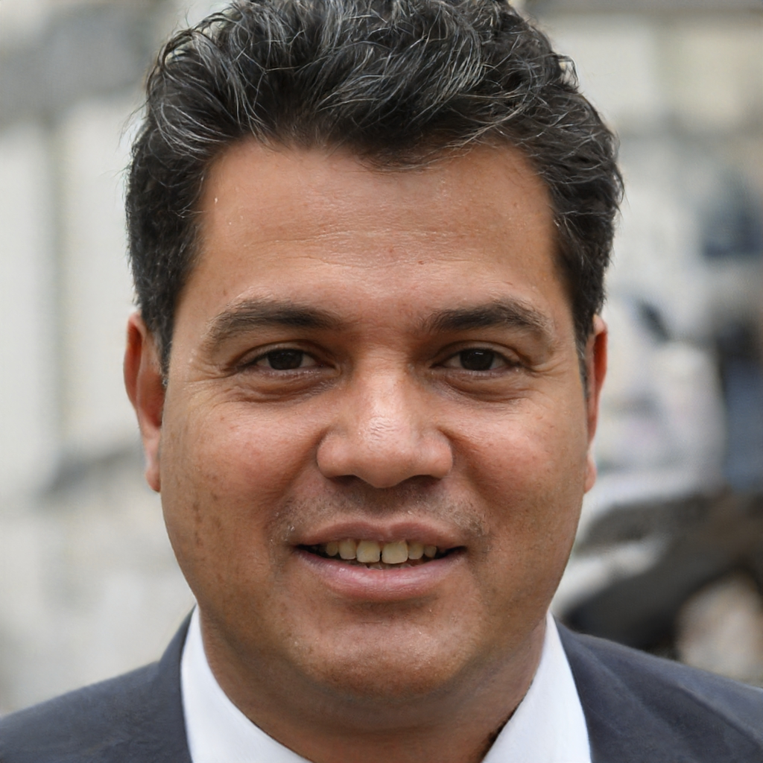
Today’s facilitators
To tint photos:
Format picture > Picture >
Picture colour >
recolour
Person name
  Job title
  Email
  Mobile
Person name
  Job title
  Email
  Mobile
Person name
  Job title
  Email
  Mobile
Today’s facilitators
Notes:
*Notes for faculty – please add in your own images and contact details here*
This is a good point to properly introduce yourselves and explain your background and experience in QI and coaching improvement.

Slide 9
Programme aim
The aim of this eight week programme is to…
Support individuals to develop the skills
and knowledge required to independently
and confidently coach a team through improvement work.
Programme aim

Slide 10
Ten learning outcomes of the programme
      By the end of the programme delegates will be able to independently:
Coach an improvement team ensuring robust application of QI methods and principles
Help teams to explore barriers and enablers relating to their QI work, in support of the sustainability of interventions
1
6
Understand the concepts of coaching improvement and the difference between coaching and advising
Advocate for meaningful involvement in
QI work and advise teams on methods for involvement
2
7
Ten learning outcomes of the programme
Explain their role as a Quality Coach to different stakeholders
Coach a team to identify, collect and interpret data in support of their improvement work
3
8
Promote an environment that encourages team members to contribute equally to the development of improvement work
Apply creative problem-solving methods and behaviour change concepts to support teams to revive a stalled effort
4
9
Assimilate QI knowledge and facilitation skills that support teams to progress through the different stages of QI work
Critically analyse their own limitations and the limitations of coaching
5
10
Notes:
The main outcomes for today’s session are to be able to:
Coach a team to identify, collect and interpret data to support improvement work
Apply creative problem-solving methods and behaviour change concepts to support teams to revive a stalled effort

Slide 11
Coaching Measurement
  Quality Coach Development Programme
Notes:
Today we will be looking at coaching measurement.

Slide 12
Today’s learning outcomes
  By the end of the session, you will be able to…
    Coach a team to identify, collect and interpret data in support of their improvement work
    Apply creative problem-solving methods and behaviour change concepts to support teams to revive a stalled effort
    Understand your role as a ‘connector’ in supporting teams through measurement of improvement work
    Advocate for just enough data in QI work
    Recognise how Human Factors, bias and resistance can
    influence QI work.
Today’s learning outcomes
Notes:
Each session has its own learning outcomes. Today’s focus on coaching measurement.
As delegates on the programme, we encourage you to reflect on the learning outcomes at the end of each session. Ask yourself: can I meet the outcomes shown on the screen without guidance from a member of the QI team? If not, then think about what you need to meet these learning outcomes.

Slide 13
Self-directed learning
1
2
3
  Prepare teachback for the topics below
  Work with team to identify one qualitative measure for their project
  Find some data that is meaningful to you.
  This could be from a project they are working on, a project they are coaching or data from their team. They should analyse it and chart it.
        Stakeholder mapping
Self-directed learning
        Fishbone diagrams
        Process mapping
        Emotional mapping
        System of profound knowledge
        Using Excel to create bar charts
Notes:
Reminder of the self-directed tasks from the previous session.
Remember to update the topics provided on the slide for teachback if you changed them previously.

Slide 14
Teachback
Activity 6.1
Notes:
See activity 6.1 in the Trainer Guide.

Slide 15
Teachback – over to you!
    Groups of three to five people
    You have ten minutes to create
    a short teaching sessions on
    a given topic
    Each group will present for
    three to five minutes plus
    two minutes of questions
    Your target audience are beginners in QI
    You can use slides but you
    don’t have to.
Today’s topics:
Activity 6.1
Stakeholder mapping
Emotional mapping
Fishbone diagrams
Lens of profound knowledge
Process mapping
Using Excel to create bar charts
Notes:
See Trainer Guide – activity 6.1
45 minutes (breakout rooms)
We have suggested six common concepts/tools and will give you 10 minutes in small groups to collate some info and teach it back.
Remember to update the self-directed learning in session 5 slides if you change these!

Slide 16
Your experience with data
Discuss
How confident are you out of 10 with measurement in improvement?
Why?
Activity 6.2
Notes:
See activity 6.2 in the Trainer Guide.
40 mins

Slide 17
Coffee break
Notes:
15 mins

Slide 18
Important!
You do not need to be an expert in measurement as a Quality Coach.
You do not need to know complex analytical methods, statistics, or anything that often requires years of experience or a qualification.
Instead, you need to understand the key principles and who is in your ‘coach network’ to support you to support teams in the measurement of improvement work.
Important note
Notes:
This is key.

Slide 19
You’re a connector!
You’re a connector!
Adapted from: Gladwell, M. (2002)
Notes:
In the book The Tipping Point, author Malcolm Gladwell talks about three different archetypes of people: mavens, connectors, and salespeople. In improvement work, especially as a coach, this framework can help you see who you need around you in this new role.
Salespeople make change happen through persuasion. They can take an idea, make it sticky and accessible, and convince a group to get behind it. They often use stories about their own experiences to help to persuade people to see their point of view. We all just had a go at being salespeople in some capacity, by thinking about how we can encourage people to adopt good measurement for their QI work.
Connectors make change happen through people. Like the image – they are the hub of a network of people. Connectors are people who, every time you ask a question, start going through their list of contacts in the back of their mind, saying, “Who do I know who knows this? Who do I know who has done this? Who do I know that I need to connect you with?”. They drive improvements through their connection to people – people who can help. Which brings us to Mavens…
Mavens make change happen through information and ideas. These are the people you ask whenever you want to know something about anything — they’re always the people in the know. They’re builders, engineers, process folks, and system folks. It’s all about the ideas and the information.
As a coach – particularly where data is concerned – you will probably find that you are mostly in this connector role. You help teams to connect to data specialists – perhaps an analyst, someone with access to key data. These specialists are the mavens. You also help to connect directly to the data itself – helping to get hold of that pivotal dataset.
Reference:
Gladwell, M. (2002). The Tipping Point: How Little Things Can Make a Big Difference. Abacus.

Slide 20
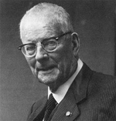
“Without data, you’re just another person with an opinion.”
W Edwards Deming, Data Scientist
Why measure?
Notes:
The first question you might encounter when supporting a team who are trying to improve is ‘why measure’?
Measurement takes time, measurement means more work, measurement can be complicated – so as a coach you need to be really clear on the value and purpose of data and the measurement process that goes with it.
This quote from the guru of modern quality improvement makes the point in a very succinct way… QI is a robust, scientific approach that is most relevant where the best way forwards is unclear. Therefore, effective improvement relies on data to guide us through the process.

Slide 21
Coaching measurement
  Your role is to advocate for measurement
  You should help teams to embed a good measurement system in their QI work
    Identify key measures
    Measure at the right time
    Be a connector
  Work through the common challenges
  of coaching measurement.
Coaching measurement
Notes:
We’ll focus on the coaching aspect of measurement and less on the technical side of measurement.
This morning we will explore how you can advocate for the importance of robust, timely measurement in improvement work. All too often we see teams neglect measurement until the later stages of QI work – at which point the task is much harder and the measures are often more abstract or by proxy.
We’ll look at how you can help teams to get off on the right foot with measures. Helping them to frame their project using measures that matter, and collecting data as it is needed.
We’ll look at some of the common challenges and pitfalls in measurement – and how you can help teams to navigate these.

Slide 22
Hesitancy around measurement
  In groups, brainstorm the potential drivers for disengagement in the measurement aspect of QI work. Try to come up with at least 10 and group similar drivers together.
  Once you have a good outline of the key drivers, think about potential strategies you could take as a coach to overcome these.
Hesitancy around measurement
Notes:
See activity 6.3 in the Trainer Guide.
20 mins for activity, 10 mins for group reflection.
This activity asks delegates to consider the causes/reasons to disengage in measurement, and then identify potential strategies to address these.
As a Quality Coach, you will often find that a key part of the role is around encouragement with a slight nudge in the right direction. This is particularly true when measurement is involved. Teams can often be hesitant around measurement – there are many potential reasons for this.
We’d like for you to explore this together in small groups. There are two steps to this short activity:
brainstorm the potential drivers for disengagement in the measurement aspect of QI work. Try to come up with at least ten and group similar drivers together.
Once you have a good outline of the key drivers, think about potential strategies you could take as a coach to overcome these.

Slide 23
Explaining measurement for QI
Characteristic | Judgement | Research | Improvement
Aim | Achievement of target | New knowledge | Improvement of service
Testing strategy | No tests | One large, blind test | Sequential, observable test
Sample size | Obtain 100% of available relevant data | ‘Just in case’ data | ‘Just enough’ data Small, sequential steps
Hypothesis | No hypothesis | Fixed hypothesis | Hypothesis is flexible; changes as learning takes place
Variation | Adjust measures to reduce variation | Design to eliminate unwanted variation | Accept consistent variation
Determining if change is an improvement | No change focus | Statistical tests (t-test, F-test, chi-square, p-values) | Run chart or SPC charts
Explaining measurement for QI
Adapted from: Solberg, L.I., Mosser, G. and McDonald, S. (1997).
Notes:
This table shows how measurement can be used differently for various purposes. For…
Judgement – measure to check performance (RAG status)
Research – find new knowledge – testing, critical for new knowledge
Improvement – to guide you to measure change – you don’t need comprehensive data, you just need to know if you are going in the right direction. Sampling is fine. Measurement is not the process, Improvement is the importance.
Reference:
Solberg, L.I., Mosser, G. and McDonald, S. (1997). The Three Faces of Performance Management: Improvement, Accountability and Research. Journal of Quality Improvement. https://pubmed.ncbi.nlm.nih.gov/9103968/

Slide 24
Coaching measurement
The purpose is
for learning,
not judgement.
  All measures have limitations, but they
  do not negate the value for learning.
Coaching measurement
Notes:
In improvement the purpose of measurement is learning and not judgement. This is often a mindset shift for people and can be hard to get used to.

Slide 25
Coaching measurement
Coaching measurement
  The measurement should be linked to your aim
  Measures should guide improvement and testing of change
  Measurement should be integrated into a team’s routine
  and data should be plotted over time on graphs
Notes:
These are some key points on coaching measurement.

Slide 26
Lunch break
Notes:
45 mins.

Slide 27

Coaching measurement
You need a balanced set of measures reported daily, weekly or monthly to determine if the process has improved, stayed the same or become worse.
Coaching measurement

Slide 28
Developing your measures
    Outcome measures
    Process measures
    Balancing measures
Outcome measures
Process measures
Balancing measures
Developing your measures
Notes:
Teachback in the room
Ask someone to explain what we mean by an outcome measure
Ask someone to explain what we mean by a process measure
Ask someone to explain what we mean by a balancing measure.

Slide 29
Developing your measures
  Is the project getting the right outcome?
  Is the system working as planned?
  What about the bigger picture?
Developing your measures
Outcome measures
  Are we making things better?
  Are we on track to achieve our aim?
Process measures
  Is the process improving?
  Is the process reliable?
Balancing measures
  Is our work having an unexpected impact elsewhere?
Notes:
Talk through the slide, building on what has been said previously

Slide 30

Measurement for improvement
Measurement for improvement
Mike Davidage – Measurement for improvement. https://www.youtube.com/watch?v=Za1o77jAnbw
Notes:
Play Mike Davidage – Measurement for improvement
https://www.youtube.com/watch?v=Za1o77jAnbw
Ask group for reflections – what stood out to them/any lightbulb moments/anything anyone doesn’t understand/agree with. Discuss.

Slide 31
What are the challenges we may face?
Inexperienced team
        The data for the selected measures is harder to collect than anticipated
Risk aversion is part of the culture
Over-reliance on surveys
Top-down pressure to collect a lot of data
Too many options for data
Over-reliance on quantitative data
Pressure to ‘just do it’ and therefore collect no data
What are the challenges we may face?
Overly critical of ‘imperfect’ data
Research experience leading to an intrinsic desire for more data
        Time
Losing sight of the goal – too much focus on measurement
Notes:
Going back to the three different types of measurement in the table.
In measurement for research and for judgement – once a decision is made, it tends to be conclusive (i.e. there is an expectation of widespread action as a result) therefore there is a significant requirement for data to be accurate so as to avoid unintended consequences.
People who are stuck in these measurement traditions, or those who are particularly risk averse, can struggle with less stringent approaches to measurement and push for more rigorous data collection before making any decisions. They can over-do data.
At the other extreme there are some people who do not place much faith in numbers – maybe due to previous experience of poor data quality which have led to bad decisions or a fear of working with numbers in public (arithmophobia) – for some, they prefer to rely on their instincts, valuing experience over data.
However, with measurement for improvement any action resulting from a decision should only lead to a small scale testing to evaluate the effectiveness of the idea; or a new iteration to test under different conditions. This reduces the requirement for ‘perfection’ and allows more scope for decision making with limited data.
But we shouldn’t forget that sometimes the challenges may relate to the availability of resources….
Data collection requires time, capacity and motivation. People may be unwilling or unable to commit the time required to gather robust data sets, especially when under pressure
There may be limited availability of data with existing systems, requiring either expensive adjustments to the IT systems or manual processes to be established.

Slide 32
Comfort break
Notes:
5 mins

Slide 33

Just enough data
Sunnybrook Health Sciences Centre – Toronto, Canada
Just enough data
  Sunnybrook Health Sciences Centre
  Toronto, Canada
      Participated in IHI Breakthrough series
      Needed some baseline data regarding age distribution of patients visiting the ED for asthma care over last year
      Put in a formal request to Information Systems (IS) department for this information and waited
      Months passed and no data was given – so a small team decided it was taking too long
      Physician and team went through the charts of all ED patients over 3-month period (94 patients)
      2 months later, the IS team got back to them with a sample size of four times the amount.
Notes:
Measurement should speed up improvement, not slow it down.
Often, organisations get bogged down in measurement, and delay making changes until they have collected all of the data they believe they require.
Sampling is a simple, efficient way to help a team understand how a system is performing.
Sampling can save time and resources while accurately tracking performance.
The Sunnybrook Health Sciences Centre in Toronto, Canada, learned this lesson when they participated in the Institute for Healthcare Improvement's (IHI) Improving Asthma Care Breakthrough Series Collaborative in 1995.
Reference:
Institute for Healthcare Improvement. Know When Enough Data is Enough. https://www.ihi.org/resources/Pages/ImprovementStories/KnowWhenEnoughDataisEnough.aspx

Slide 34
Just enough data – an example
Just enough data
Sunnybrook Health Sciences Centre – Toronto, Canada
  Sunnybrook Health Sciences Centre
  Toronto, Canada
      Participated in IHI Breakthrough series
      Needed some baseline data regarding age distribution of patients visiting the ED for asthma care over last year
      Put in a formal request to Information Systems (IS) department for this information and waited
      Months passed and no data was given – so a small team decided it was taking too long
      Physician and team went through the charts of all ED patients over 3-month period (94 patients)
      2 months later, the IS team got back to them with a sample size of four times the amount.
Just enough data – an example
Source: Institute for Healthcare Improvement
Sunnybrook Health Sciences Centre
Ages of patients visiting ED for asthma, Oct–Dec, 1995
Total patients: 94
Sunnybrook Health Sciences Centre
Ages of patients visiting ED for asthma, Fiscal 94/95
Total patients: 437
Notes:
The team needed some baseline data regarding the age distribution of patients visiting the Emergency Department (ED) for asthma care. So, they put in a formal request to their Information Systems (IS) department for a report with this information. And then they waited. And waited… and waited.
Impatient that the request was taking too long, one team member, an emergency doctor, decided to take the matter into his own hands, literally.
This physician went through the charts for all ED patients in a three-month period, and manually noted the ages of asthma patients. His informal research provided a sampling of 94 patients, with an age distribution as shown in the upcoming graphs.
The team had enough confidence in this data that it decided to proceed with its improvement agenda.
Sure enough, when the Information Systems finally delivered the report nearly two months later, it confirmed the team's instincts. With a sample more than four times the informal sample taken two months earlier, the results were nearly identical.
Here is the link if you want to know more:
https://www.ihi.org/resources/Pages/ImprovementStories/KnowWhenEnoughDataisEnough.aspx
Reference:
Institute for Healthcare Improvement. Know When Enough Data is Enough. https://www.ihi.org/resources/Pages/ImprovementStories/KnowWhenEnoughDataisEnough.aspx

Slide 35
Distribution of patient age – two similar stories
  Sunnybrook Health Sciences Centre
  Toronto, Canada
      Participated in IHI Breakthrough series
      Needed some baseline data regarding age distribution of patients visiting the ED for asthma care over last year
      Put in a formal request to Information Systems (IS) department for this information and waited
      Months passed and no data was given – so a small team decided it was taking too long
      Physician and team went through the charts of all ED patients over 3-month period (94 patients)
      2 months later, the IS team got back to them with a sample size of four times the amount.
Sunnybrook Health Sciences Centre
Ages of patients visiting ED for asthma, Oct–Dec, 1995
Total patients: 94
Sunnybrook Health Sciences Centre
Ages of patients visiting ED for asthma, Fiscal 94/95
Total patients: 437
Distribution of patient age – two similar stories
What would the team have gained by waiting the four months for the data on the right from IS?
It is important to use judgement to infer what is just enough to start improving.
Notes:
This team would have learned nothing more by waiting for more data.
They saved valuable time by sampling and depending on their own sound judgment to know when enough data was enough.
Key point was they were able to identify what is necessary to move on and search for it in an alternative way.

Slide 36
Distribution of patient age – two similar stories
  Sunnybrook Health Sciences Centre
  Toronto, Canada
      Participated in IHI Breakthrough series
      Needed some baseline data regarding age distribution of patients visiting the ED for asthma care over last year
      Put in a formal request to Information Systems (IS) department for this information and waited
      Months passed and no data was given – so a small team decided it was taking too long
      Physician and team went through the charts of all ED patients over 3-month period (94 patients)
      2 months later, the IS team got back to them with a sample size of four times the amount.
Sunnybrook Health Sciences Centre
Ages of patients visiting ED for asthma, Oct–Dec, 1995
Total patients: 94
Sunnybrook Health Sciences Centre
Ages of patients visiting ED for asthma, Fiscal 94/95
Total patients: 437
Distribution of patient age – two similar stories
What would the team have gained by waiting the four months for the data on the right from IS?
It is important to use judgement to infer what is just enough to start improving.
Notes:
This team would have learned nothing more by waiting for more data.
They saved valuable time by sampling and depending on their own sound judgment to know when enough data was enough.
Key point was they were able to identify what is necessary to move on and search for it in an alternative way.
Read out the question at the bottom of the slide.

Slide 37
Just enough data
Each group should work through a different coaching scenario and discuss how you might arrive at just enough data.
Activity 6.4
Notes:
See activity 6.4 in the Trainer Guide.
25 mins

Slide 38
Take away points
Measurement is not the goal, improvement is.
Take away points
  For teams to move forward, your team needs just enough
  data to make a sensible judgement as to next steps
  Don't let your team get bogged down in measurement or
  delay making changes until they have collected all the data
  they believe they need.

Slide 39
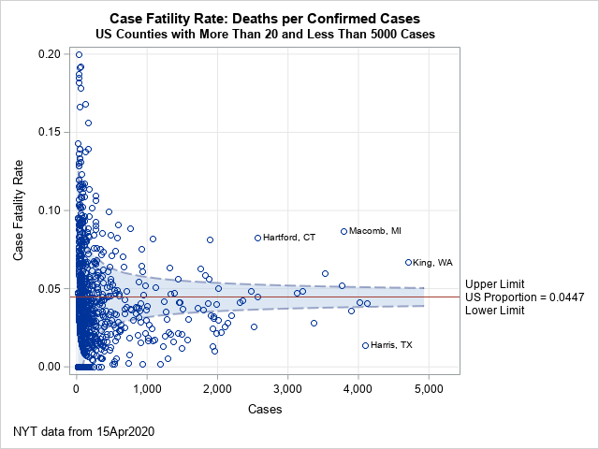
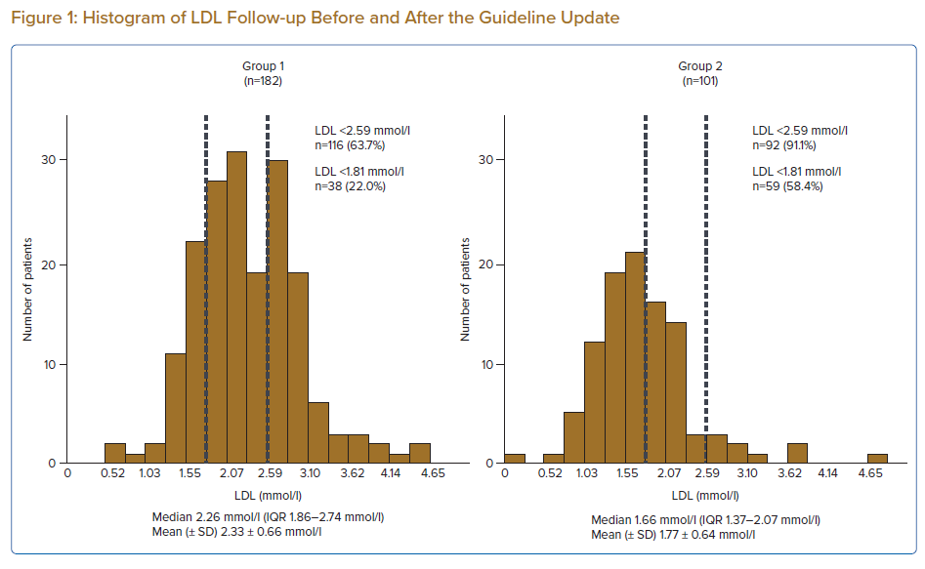
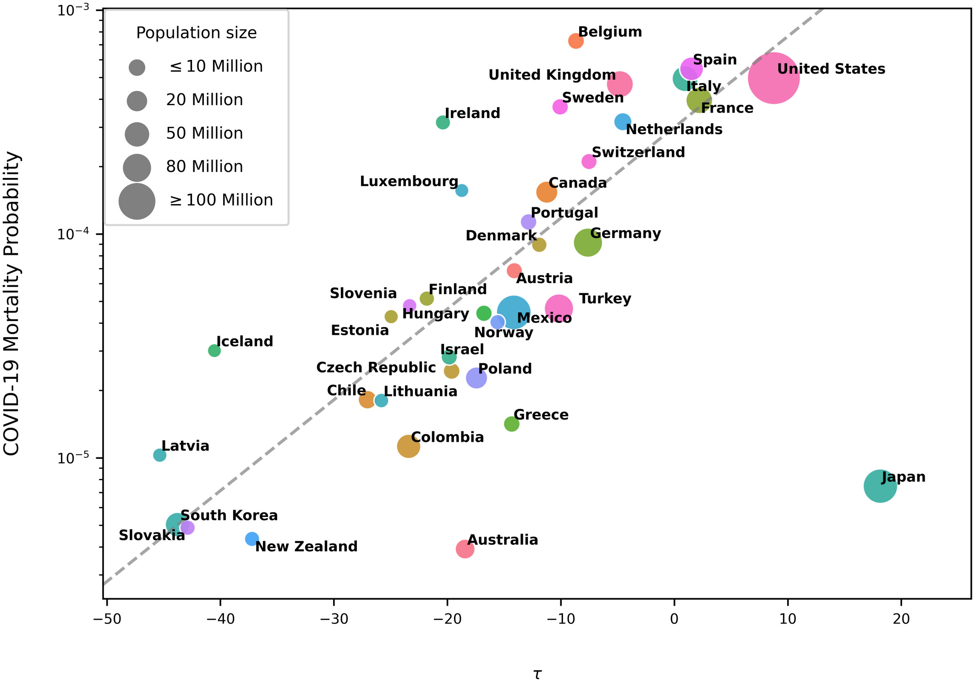
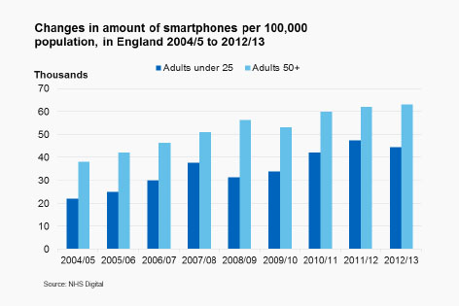
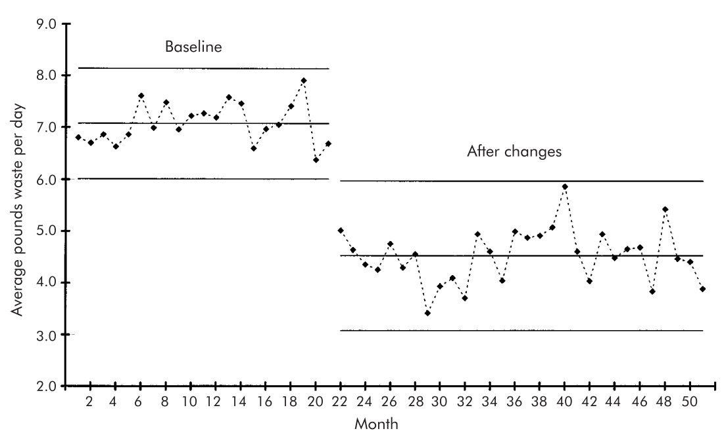
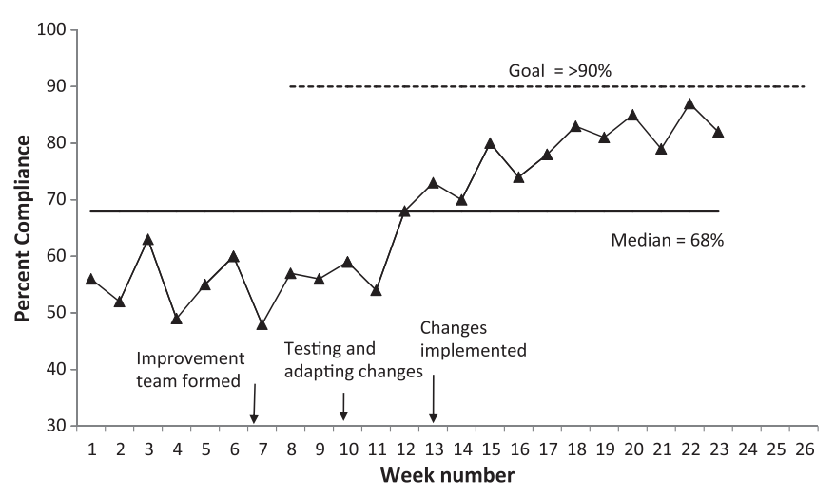
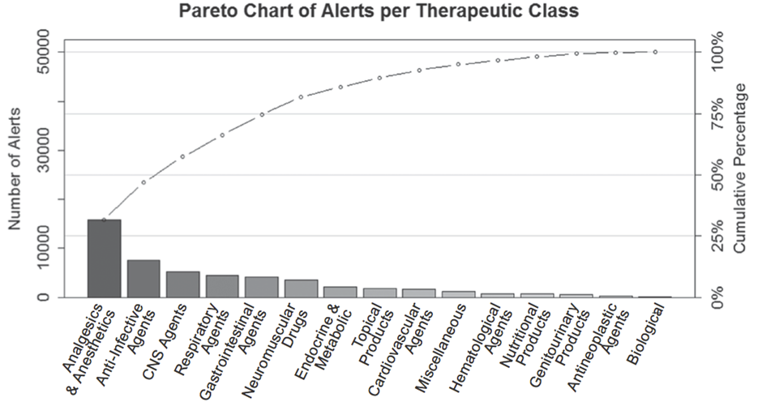
Many ways to look at data
Tabular format
Histogram (frequency plot)
Scatter plot
Funnel plot
Tabular format | Histogram (Frequency plot) | Scatter plot | Funnel plot
Pareto chart | Bar chart | Run chart | SPC chart
Percentage change GDP compared with pre-pandemic level (Q4 2019 v Q1 2021)
China | +7.1%
India | +2.7%
Australia | +0.8%
S. Korea | +0.6%
Brazil | 0%
Indonesia | -0.8%
US | -0.9%
Japan | -2%
South Africa | -3.2%
Mexico | -3.9%
France | -4.7%
Germany | -5%
UK | -8.7%
Many ways to look at data
https://www.bbc.co.uk/news/business-57427997
www.japscjournal.com/articles/effects-current-japanese-guideline-dedicated-intensive-lipid-lowering-therapy-lipid
www.embopress.org/doi/full/10.15252/emmm.202013171
https://blogs.sas.com/content/iml/2020/04/22/funnel-plot-covid-us.html
Pareto chart
Bar chart
Run chart
SPC chart
https://qi.elft.nhs.uk/the-pareto-principle
https://digital.nhs.uk/about-nhs-digital/corporate-information-and-documents/our-style-guidelines/visual-style-guide/charts#choosing-the-right-chart-type
https://qualitysafety.bmj.com/content/20/1/46
https://qualitysafety.bmj.com/content/qhc/12/6/458.full.pdf
Notes:
There are many ways to look at data – these eight are common methods to analyse and present quantitative data.
Talk through the eight shown including the example charts.
References:
BBC News. UK economy lags behind other countries in Covid recovery (tabular format example). https://www.bbc.co.uk/news/business-57427997
Yamada, R., Kume, T., Okamoto, H. et al. (2022). Effects of the Current Japanese Guideline for Dedicated, Intensive Lipid-lowering Therapy on Lipid Profile and Coronary Events in Patients After Acute Coronary Syndrome, Journal of Asian Pacific Society of Cardiology. www.japscjournal.com/articles/effects-current-japanese-guideline-dedicated-intensive-lipid-lowering-therapy-lipid
Loewenthal, G. et al (2020). COVID-19 pandemic-related lockdown: response time is more important than its strictness. EMBO Molecular Medicine. www.embopress.org/doi/full/10.15252/emmm.202013171
SAS Blogs (2020). Visualize the case fatality rate for COVID-19 in US counties. https://blogs.sas.com/content/iml/2020/04/22/funnel-plot-covid-us.html
East London NHS Foundation Trust. The Pareto Principle. https://qi.elft.nhs.uk/the-pareto-principle
NHS Digital. Charts. https://digital.nhs.uk/about-nhs-digital/corporate-information-and-documents/our-style-guidelines/visual-style-guide/charts#choosing-the-right-chart-type
Perla, R. J., Provost, L. P., Murray, S. K. (2011). The run chart: a simple analytical tool for learning from variation in healthcare processe. BMJ Quality & Safety. https://qualitysafety.bmj.com/content/20/1/46
Benneyan, J., Lloyd, R., Plsek, P. (2003). Statistical process control as a tool for research and healthcare improvement. Quality & Safety in Healthcare. https://qualitysafety.bmj.com/content/qhc/12/6/458.full.pdf

Slide 40
Many ways to look at data
Tabular format | Histogram (Frequency plot) | Scatter plot | Funnel plot
Pareto chart | Bar chart | Run chart | SPC chart
Percentage change GDP compared with pre-pandemic level (Q4 2019 v Q1 2021)
China | +7.1%
India | +2.7%
Australia | +0.8%
S. Korea | +0.6%
Brazil | 0%
Indonesia | -0.8%
US | -0.9%
Japan | -2%
South Africa | -3.2%
Mexico | -3.9%
France | -4.7%
Germany | -5%
UK | -8.7%
Many ways to look at data
https://www.bbc.co.uk/news/business-57427997
www.japscjournal.com/articles/effects-current-japanese-guideline-dedicated-intensive-lipid-lowering-therapy-lipid
www.embopress.org/doi/full/10.15252/emmm.202013171
https://blogs.sas.com/content/iml/2020/04/22/funnel-plot-covid-us.html
https://qi.elft.nhs.uk/the-pareto-principle
https://digital.nhs.uk/about-nhs-digital/corporate-information-and-documents/our-style-guidelines/visual-style-guide/charts#choosing-the-right-chart-type
https://qualitysafety.bmj.com/content/20/1/46
https://qualitysafety.bmj.com/content/qhc/12/6/458.full.pdf
Notes:
So we will now look at the bottom four. We see these all of the time in QI – and for a very good reason. We’ll explore how they are used over the coming slides.
References:
East London NHS Foundation Trust. The Pareto Principle. https://qi.elft.nhs.uk/the-pareto-principle
NHS Digital. Charts. https://digital.nhs.uk/about-nhs-digital/corporate-information-and-documents/our-style-guidelines/visual-style-guide/charts#choosing-the-right-chart-type
Perla, R. J., Provost, L. P., Murray, S. K. (2011). The run chart: a simple analytical tool for learning from variation in healthcare processe. BMJ Quality & Safety. https://qualitysafety.bmj.com/content/20/1/46
Benneyan, J., Lloyd, R., Plsek, P. (2003). Statistical process control as a tool for research and healthcare improvement. Quality & Safety in Healthcare. https://qualitysafety.bmj.com/content/qhc/12/6/458.full.pdf

Slide 41
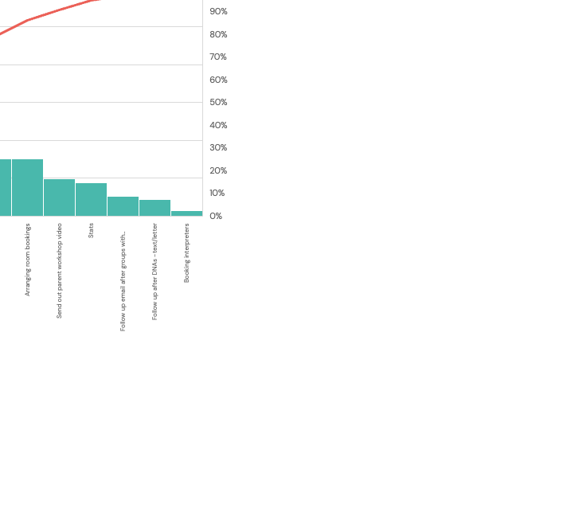
Pareto
p182
  What is it?
    A visual tool used to highlight the ‘vital few’ from a group of different causes (of a problem)
    The ‘vital few’ are the 20% of total causes that result in 80% of the problem – tells you where to focus your improvement efforts.
  Why use it?
    Stops teams from tackling a minor problem (those on the right side of the chart – called the ‘trivial many’) or too many problems at once
  When do you use it?
    Often used in the preliminary stages of a project – when analysing the problem.
  How to create it?
    MS Excel has a simple Pareto tool.
Pareto
Vital few
Notes:
The concepts often used in economics came from Vilfredo Pareto in the 1800s. It’s known as the 80/20 rule. For example, you probably wear 20% of your clothes 80% of the time.
Talk through slide

Slide 42
Bar charts
p181
Bar charts
https://migrationobservatory.ox.ac.uk/resources/briefings/east-of-england-census-profile/
Notes:
Bar charts are useful in presenting categorical data. In QI you may sometimes collect data that is not numerical. Think of categories like patient age, disease, geography etc. In the example shown, this is the population change from the UK Census from 2001 to 2011. It shows the number of foreign-born people living in the UK by UK region, with the largest on the left and smallest on the right.
Bar charts easily convey information that may otherwise be in a table. Given this is a 2 point comparison we cannot plot this on a graph. We could if we had it by year and for one geography – for instance London. This would be shown as a line or run chart.

Slide 43
Run to Statistical Process Control Charts
p183
100
75
50
25
0
Upper Control Limit
Measure of interest
Median
Mean
Run to Statistical Process Control Charts
Lower Control Limit
J | F | M | A | M | J | J | A | S | O | N | D | J | F | M
Data over time (chronological)
Notes:
Run charts are a powerful visual tool used very frequently in QI. You should already feel confident around the use and interpretation of run charts. Use the visual of run charts and ask the group to teachback including the rules for special cause.
Another very useful tool in QI is statistical process control (SPC) charts. These are a more powerful version of run charts. You can see that the difference between run and control charts is the inclusion of control limits and the use of a different centre line – a mean instead of a median.
We will focus much more on SPC next time. For now, it's important to know that there are different tools used to visualise data in QI – pareto charts, bar charts, run charts and SPC charts.

Slide 44
Time Series
... but also to explain sudden improvements as well
Time Series
!
It would be useful to have annotations to explain dips in performance
Notes:
Here is an example of complaints data plotted to help a team see if things are getting better.
They are... but the team had to use excel to create the data to make it more accessible.
Some pointers for best practice on a graph:
- Plot it over time when you can
- Have a clear title of what your data topic is
- Have clear axes titles – percentage and month for example
- Annotate the graph, it helps us understand trends, change in the data. Why did it improve, how? Why did it dip that month?
- Have a legend – it helps us to understand what the lines mean.
Reference:
Kettering General Hospital (2018). Quality Report 2017–2018. https://www.kgh.nhs.uk/download.cfm?doc=docm93jijm4n681.pdf&ver=1022

Slide 45
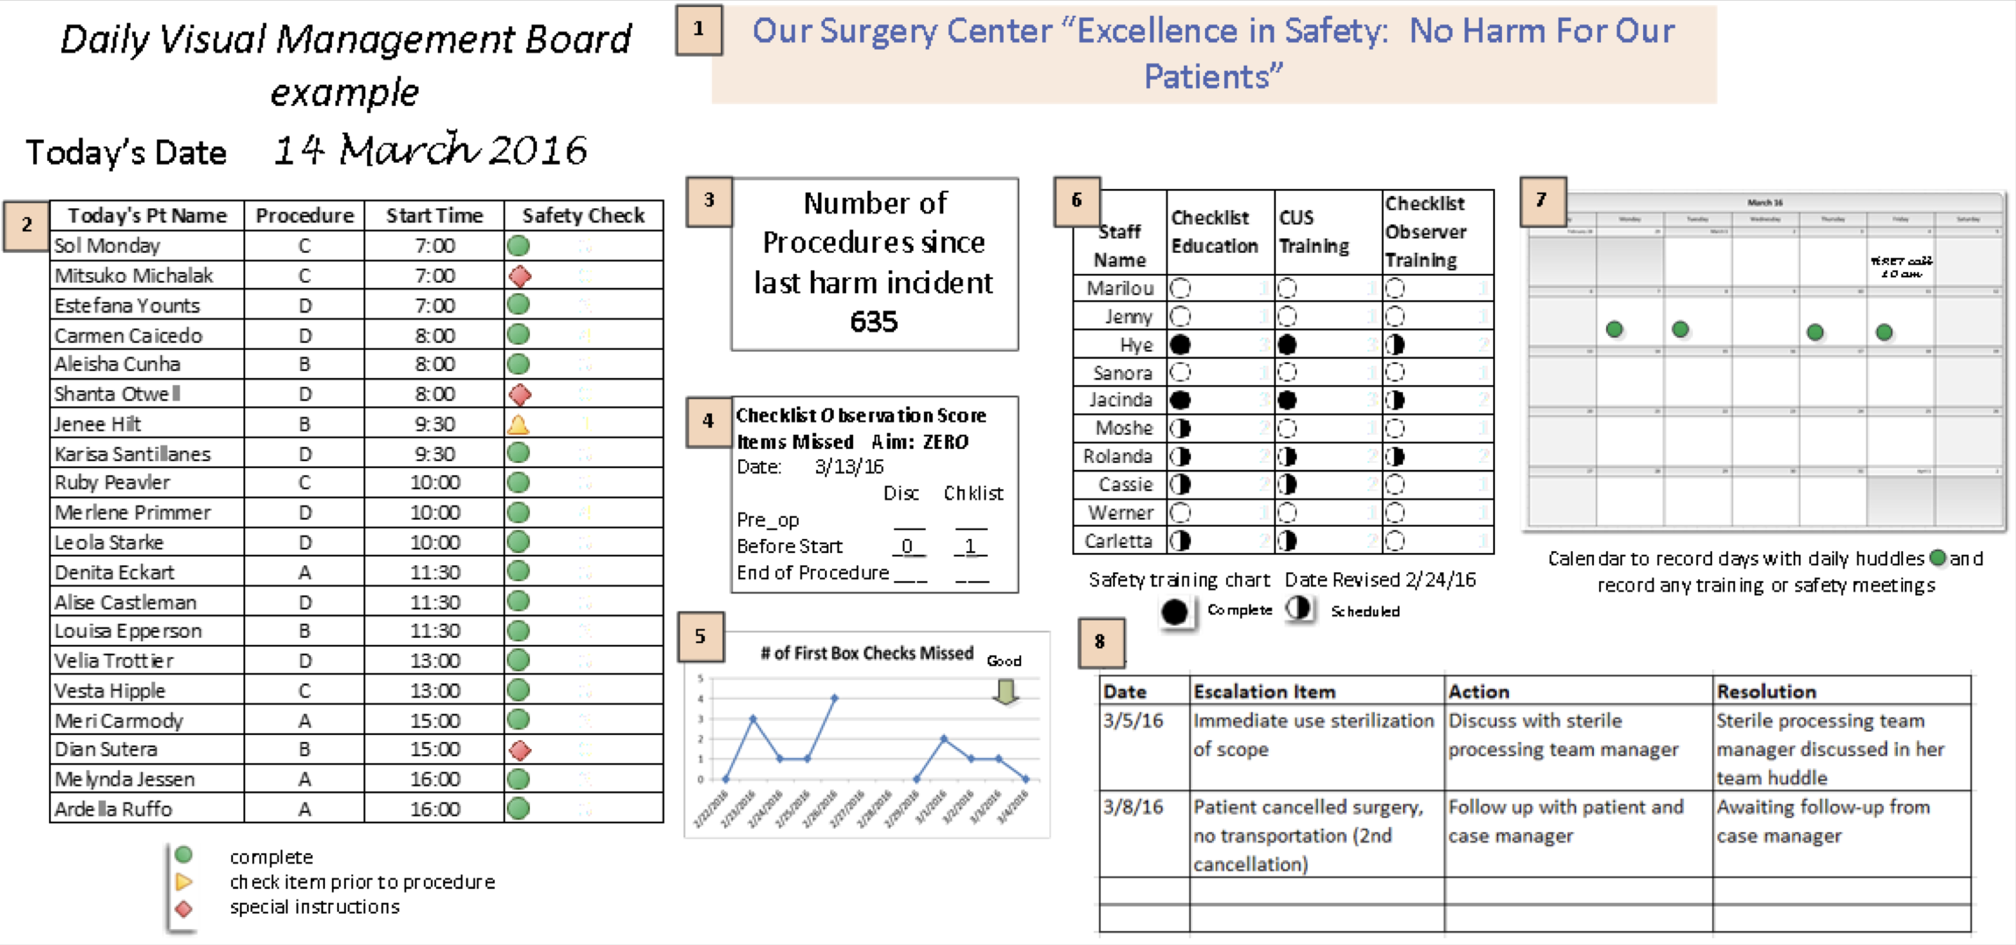
Visual displays
Visual displays
Source: Institute for Healthcare Improvement
Notes:
One way a team may wish to showcase their project is through the use of visual displays. Visual displays are used in healthcare to provide frequent insight into how a team works, through the use of images, data and brief information.
You can use these for many things. Wards often use them for oversight on key safety measures, for example. On the screen is a recommendation from the IHI on how you might use visual management for QI work.
Next slide for what they look like in reality and top tips.
Reference:
Institute for Healthcare Improvement (2018). Visual Management Board. https://www.ihi.org/resources/Pages/Tools/Visual-Management-Board.aspx

Slide 46
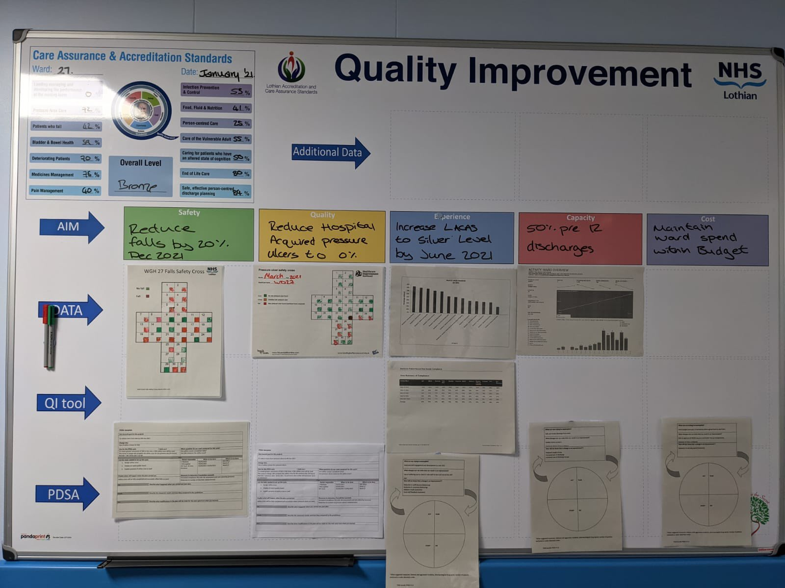
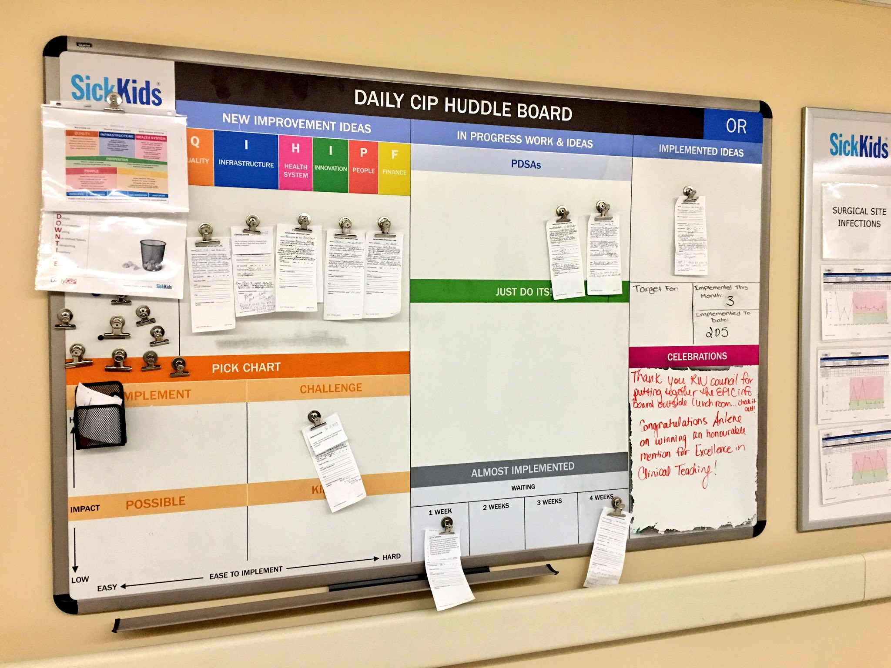
Visual displays
Visual displays
@LothianACAS
@DrEdFitzgerald
Notes:
In practice, the boards are often more colourful and pinned with print outs of data, information and learning from a team. Here we can see a QI board from NHS Lothian on the left, supporting them with their ward accreditation. On the right we have a continuous improvement board, supporting the daily huddle in the operating room in Sick Kids hospital in Toronto, Canada.
Image on left: https://twitter.com/LothianACAS/status/1384606175002460168/photo/1
Image on right: https://twitter.com/DrEdFitzgerald/status/963514140936486912/photo/1
Here are some top tips for creating your own visual management board:
1. Keep it simple. Teams should keep boards simple, especially at the beginning. They may start with process measures that can lead to immediate action, such as those that track fidelity to established, standard work. Teams should also choose items for display on the board that can be updated frequently.
2. Include visual tools. Charts, graphs, and images provide useful guidance to the team. Over time, teams can add items such as huddle agendas, patient feedback, and examples of standard work (e.g. checklists or care protocols).
3. Carefully choose the board display location. Display the board in a location that offers both convenience and a comfortable level of privacy. Staff may initially resist displaying performance data in public, especially if results do not meet performance targets. Teams may consider establishing the visual management board in a discrete location, such as in a staff break room. Over time, as teams gain trust, they may transition to a location that is more visible to patients and families. Try to find a location that can accommodate a stand-up daily huddle at the board, even if the team is not yet conducting huddles.
4. Use the board to communicate with leaders. The visual management board can offer helpful information to senior leaders that reduces paperwork and meeting frequency. Leaders can use the board to ask questions and engage the team in discussions about the work, and to drive improvement rather than judge the team for poor performance.
5. Delegate maintenance. Team leaders will need to ask for volunteers or assign team members to update each item on the board, to ensure the most current information is displayed.

Slide 47
Comfort break
Notes:
5 mins

Slide 48
Resistance
to change
Resistance to change

Slide 49

Rick Maurer – Three levels of resistance
Three levels of resistance
      Video link www.youtube.com/watch?v=a0sdpX1JOrU
      For more information watch Rick Maurer’s YouTube videos, visit his website and download his challenges of change white paper www.energybartools.com/images/The-Challenges-of-Change-White-Paper.pdf
Notes:
Video link https://www.youtube.com/watch?v=a0sdpX1JOrU (3 mins)
Rick Maurer is an independent author, consultant and speaker who has developed a model called the 3 levels of resistance as part of his wider work on the management of change.
References:
Maurer, R. (2008). Resistance to Change (video). https://www.youtube.com/watch?v=a0sdpX1JOrU
Maurer, R. Dealing Effectively with the Seven Key Challenges of Major Change. https://www.energybartools.com/images/The-Challenges-of-Change-White-Paper.pdf

Slide 50
Rick Maurer – Three levels of resistance
Three levels of resistance
      Level 1
      Level 2
      Level 3
      I don’t get it.
      I don’t like it.
      I don’t like you.
      I don’t understand the purpose of the change
      Emotional reaction to change
      Lack of trust and confidence
      Understanding is important.
      Bring people on
      the journey.
      People need time to come to terms with changes.
      Improving the future
      is not a criticism of
      the past.
      This can be difficult.
      The more people who can champion the change the better – get away from association with one person.
Notes:
This simple model and the accompanying self-assessment template is very accessible to use in improvement coaching. Teams often like being able to unpack the three levels of resistance and see which level is more dominant at that moment in time.
It’s easy to use and to teach and can help teams and leaders with insight into how people are conceptualising and experiencing change.
Talk through the slide.

Slide 51
Rick Maurer – Overcoming three levels of resistance
      Lack of trust and confidence
      Emotional reaction to change
      I don’t understand the purpose of the change
      Level 1
      Level 2
      Level 3
      I don’t get it.
      I don’t like it.
      I don’t like you.
Three levels of resistance
      Understanding is important.
      Bring people on
      the journey.
      People need time to come to terms with changes.
      Improving the future
      is not a criticism of
      the past.
      This can be difficult.
      The more people who can champion the change the better – get away from association with one person.
Notes:
Now that we have thought about the 3 levels, it’s important to think about ways to overcome the different levels of resistance.
Level 1 – (Don’t get it) Remember one of the main reasons people won’t carry out a change is because they don’t understand it or why it’s important. Bring people on the journey with you. Participation and sustainability comes from understanding the why? And what is being done.
Level 2 – (Don’t like it) Emotional reactions are often due to people feeling like what they’ve been doing isn’t good enough, or people don’t like to be rushed into change – the discussion should focus on how it is an improvement for the future, not a criticism of the current state or the past. Take their views and add to your plans (mitigate).
Level 3 – (Don’t like you) This can be the hardest to deal with. If one person is leading it, is there someone else who you can get on board to champion this change? The more people to champion the more successful it will be, as it won’t be associated with just one person.
Sometimes the messenger may need to change, not the improvement – who can support moving the project forward? Who is an influential voice?

Slide 52

Coaching use
    Can be useful for improvement coaches to help frame the different types of resistance. Helps to see why change feels personal.
    Rick’s suggestions about how to deal with the three levels of resistance here:
    https://rickmaurer.com/wrm/
Coaching use
Notes:
Here is a useful book should you wish to know more.
References:
Maurer, R. Resistance to Change – Why it Matters and What to Do About It. https://rickmaurer.com/articles/resistance-to-change-why-it-matters/
Maurer, R. (2010). Beyond the Wall of Resistance. Bard Press.

Slide 53
Activity
  In groups of 3–5, discuss one of the 3 levels of resistance and discuss how it could affect your role as a QI coach.
  Can you relate these to any personal experiences of reacting to change?
  The QI project should be one you were involved in.
  Three levels of
  resistance to change
      Group 1
      I don’t get it.
      I don’t understand the purpose of the change or know how to change it.
Activity 6.5
      Group 2
      I don’t like it.
      Emotional reaction to change.
      Group 3
      I don’t like you.
      Lack of trust and confidence.
Notes:
See activity 6.5 in Trainer Guide.
10 mins for activity, 15 mins for group reflection.
In groups we will discuss one of the three levels of resistance and discuss how it could affect your role as a Quality Coach.
Group 1: I don’t get it: I don’t understand the purpose of the change or know how to change it
Group 2: I don’t like it: emotional reaction to change
Group 3: I don’t like you: lack of trust and confidence
Think about when you may have experienced this level in particular, either as a person introducing the change, or being on the receiving end.
When you return from your breakout groups, each group will share, so we get an overview of all 3 types of resistance.

Slide 54
Coffee break

Slide 55
QI can sometimes be too simplistic
Improvement efforts sometimes take an overly simplistic world view of their context.
As a coach, you may need to consider the human factors and biases that exist in the context of the QI work.
QI can sometimes be too simplistic
Notes:
Read slide.

Slide 56
An example
  A team are looking to reduce the number of falls in a bedded unit
    Their theory of change focuses on staff remembering to complete the risk assessment for falls, including recording lying and standing BPs. This isn’t always done and so they keep reminding people to complete it through posters, emails and at handover.
    They saw a short term improvement.
  As a coach, we appreciate that this is an overly simplistic approach to a problem.
  Can you think of what human factors may influence the lack of sustainable change?
An example
Notes:
Potential answers
Perception – the team have a perception that the priority for falls should focus on the recording of lying and standing BP. They feel they have noticed that this is not always done. Does the data confirm their perception?
Team working – there may be a lack of clarity of the defined roles around the management of falls and patients at risk of falling on the unit. For instance, the bay nurse may assume the HCA knows that they are asked to document the BP on admission, however this may not be communicated.
Communication – there could be a lack of clarity on new admissions to the unit, or lack of clarity on when the tasks are supposed to be completed.
Organisational factors – falls are not a priority as the majority are no harm or low harm for this unit. Other focuses such as medication errors are seen as a higher priority. Therefore this QI project is not seen as important and isn’t well resourced.
Situation awareness – the team are focused on one defined solution – the recording of BPs. However they haven’t taken a broader view of the situation around falls, such as the environment – are the light switches near the bed? Are the slippers safe to use? Are there rails when needed?
Fatigue – the team may not have the mental capacity to consider the proposed ideas due to other competing demands – are there other QI projects? There may be change fatigue – so many changes at once!
Errors – this approach assumes that the error can be fixed by being more vigilant or aware of what needs to be done. It is telling someone to do something – but if they are busy or distracted then this solution won’t work. It’s a fallacy to approach a slip or a lapse with this type of solution – we will explore errors and mistakes later.
Bias – let’s explore this next… there are many examples of bias for this project.

Slide 57
Raise your hand if you are biased!
Bias
Bias
      A tendency to respond one way compared to another when making some kind of a life choice
Notes:
Ask the group to raise their hands if they are biased.
If you were slow to raise your hand, you are not alone.
Many of us are reluctant to admit we harbour some bias.
We have been taught that to be biased means that we are bad. Or worse, that we are bigots and discriminators.
But bias is a normal part of human behaviour. It helps us survive by helping us make snap decisions that can save us from danger or protect our families and livelihoods. But it can also interfere with our desire to appreciate others and be fair to all.
We all strive to be aware of the judgments we make about others. But it takes practice to question your gut instincts. Bias resides inside all of us, whether we like it or not.
Bias occurs because our fundamental way of encountering the world is driven by a hard-wired pattern of making unconscious decisions about others based on what feels safe, likeable, valuable, and competent. And that includes our reactions to the people we live with and work with every day.
The pathway to overcoming bias begins by accepting the normalcy of it. When we accept that we have normal biases, it becomes much easier to observe how they may be impacting our decisions or reactions. Accepting personal biases makes them less, not more, likely to impact others.

Slide 58
People don’t…
Do what they say
See the world as it is
Say what they think
Think how they feel
Do what
they say
Think how they feel
Say what they think
See the world as it is
`
Framing effect
Due to this effect people can react to a particulary choice in different ways depending on how information about it is presented
Example
Although the sentences “90 patients have survived” and “10 patients have died” in a month in a hospital include the same information, the reputation of that hospital may be interpreted in a slightly different way.
Bandwagon effect
It takes place when an individual’s thoughts and beliefs change if a large number of people think or believe in a different way
Example
If attendants to a work meeting do not write down their own thoughts in advance, it is very likely that all of htem end up thinking in the same way.
Confirmation bias
People usually consider the information that supports their own hypothesis only and discard the one that goes against it
Example
If investors do not analyse the signals of a sudden change in the evolution of financial markets and stick to their old strategy, they may incur huge losses.
Negativity bias
Propensity of unpleasant memories to have a greater effect on our psychological state than positive or nutral ones
Example
Entrepreneurs may not repeat twice if they had a bad experience when they first decided to set up a business, even if they have learnt from it and know how to correct their mistakes.
People don’t…
© Quality Coach Design Group
Notes:
When we think of those around us we take into consideration potential bias in the form of:
People don’t always: see the world as it is; say what they think; think how they feel; do what they say.

Slide 59
Biases
See the world as it is
Say what they think
Think how they feel
Do what
they say
Framing effect
Due to this effect people can react to a particulary choice in different ways depending on how information about it is presented
Example
Although the sentences “90 patients have survived” and “10 patients have died” in a month in a hospital include the same information, the reputation of that hospital may be interpreted in a slightly different way.
Bandwagon effect
It takes place when an individual’s thoughts and beliefs change if a large number of people think or believe in a different way
Example
If attendants to a work meeting do not write down their own thoughts in advance, it is very likely that all of htem end up thinking in the same way.
Confirmation bias
People usually consider the information that supports their own hypothesis only and discard the one that goes against it
Example
If investors do not analyse the signals of a sudden change in the evolution of financial markets and stick to their old strategy, they may incur huge losses.
Negativity bias
Propensity of unpleasant memories to have a greater effect on our psychological state than positive or nutral ones
Example
Entrepreneurs may not repeat twice if they had a bad experience when they first decided to set up a business, even if they have learnt from it and know how to correct their mistakes.
IKEA effect
Subjective preference for those items or activities that we have created by our own means, even if less useful or functional
Example
Some managers do not consider good ideas developed out of the organization in favour of (possibly inferior) internally developed ideas.
Illusory correlation
It occurs if we assume that there is a relationship between two variables even if there is no data that supports this idea
Example
We think that updating our facebook profile with better content gives us more “likes”, when the key variable is the time at which we add the new post.
Overconfidence
It happens when a person trusts more their own decisions or judgements than they should from an objective point of view
Example
The Ukrainian Minister of Power stated the probability of a meltdown is 0.0001% two months before the Chernobyl disaster.
Stereotyping
Expecting a member of a group to have certain attributes typically associated to that group, without having analysed the specific person
Example
Nowadays it is a mistake to consider only housewifes as interested in cleaning products, as it usually happens in TV commercials.
Biases
Source: LINEEX, Heuristics and Cognitive Biases
Notes:
Read from the slide and ask the group to reflect on anything that stands out to them.
Reference:
LINEEX. Heuristics and Cognitive Biases. https://www.lineex.es/en/cognitive-biases/

Slide 60
Biases
IKEA effect
Subjective preference for those items or activities that we have created by our own means, even if less useful or functional
Example
Some managers do not consider good ideas developed out of the organization in favour of (possibly inferior) internally developed ideas.
Illusory correlation
It occurs if we assume that there is a relationship between two variables even if there is no data that supports this idea
Example
We think that updating our facebook profile with better content gives us more “likes”, when the key variable is the time at which we add the new post.
Overconfidence
It happens when a person trusts more their own decisions or judgements than they should from an objective point of view
Example
The Ukrainian Minister of Power stated the probability of a meltdown is 0.0001% two months before the Chernobyl disaster.
Stereotyping
Expecting a member of a group to have certain attributes typically associated to that group, without having analysed the specific person
Example
Nowadays it is a mistake to consider only housewifes as interested in cleaning products, as it usually happens in TV commercials.
Confirmation bias
People usually consider the information that supports their own hypothesis only and discard the one that goes against it
Example
If investors do not analyse the signals of a sudden change in the evolution of financial markets and stick to their old strategy, they may incur huge losses.
Negativity bias
Propensity of unpleasant memories to have a greater effect on our psychological state than positive or nutral ones
Example
Entrepreneurs may not repeat twice if they had a bad experience when they first decided to set up a business, even if they have learnt from it and know how to correct their mistakes.
Bandwagon effect
It takes place when an individual’s thoughts and beliefs change if a large number of people think or believe in a different way
Example
If attendants to a work meeting do not write down their own thoughts in advance, it is very likely that all of htem end up thinking in the same way.
Framing effect
Due to this effect people can react to a particulary choice in different ways depending on how information about it is presented
Example
Although the sentences “90 patients have survived” and “10 patients have died” in a month in a hospital include the same information, the reputation of that hospital may be interpreted in a slightly different way.
Biases
Source: LINEEX, Heuristics and Cognitive Biases
Notes:
Read from the slide and ask the group to reflect on anything that stands out to them.
Reference:
LINEEX. Heuristics and Cognitive Biases. https://www.lineex.es/en/cognitive-biases/

Slide 61
Cognitive Biases & Human Factors
Stereotyping
Expecting a member of a group to have certain attributes typically associated to that group, without having analysed the specific person
Example
Nowadays it is a mistake to consider only housewifes as interested in cleaning products, as it usually happens in TV commercials.
Cognitive biases and human factors
Leadership
Fatigue & stress
Error management
Device and equipment design
Physical environment
Organisational factors
Perception
Personality types
Communication
Team working
Situation awareness
Cognition
Decision making
Overconfidence
It happens when a person trusts more their own decisions or judgements than they should from an objective point of view
Example
The Ukrainian Minister of Power stated the probability of a meltdown is 0.0001% two months before the Chernobyl disaster.
Illusory correlation
It occurs if we assume that there is a relationship between two variables even if there is no data that supports this idea
Example
We think that updating our facebook profile with better content gives us more “likes”, when the key variable is the time at which we add the new post.
IKEA effect
Subjective preference for those items or activities that we have created by our own means, even if less useful or functional
Example
Some managers do not consider good ideas developed out of the organization in favour of (possibly inferior) internally developed ideas.
Cognitive Biases & Human Factors
Notes:
Human factors is such a nebulous concept to many people. It can be used as a catchup phrase to mean anything related to how humans interact within their environment in their everyday lives. Here we can see human factors broken down into some key domains, such as cognition, communication, team working, perception and leadership, for example.
This list is not exhaustive…
Many are non-technical skills.
But they are the main things we should consider when thinking about bias.
Reference:
Mitchell, P. (ed.) (2013). Safer Care: Human Factors for Healthcare Course Handbook. Swan & Horn.

Slide 62
Cognitive Biases & Human Factors
Cognitive biases and human factors
Leadership
Fatigue & stress
Error management
Device and equipment design
Physical environment
Organisational factors
Perception
Personality types
Communication
Team working
Situation awareness
Cognition
Decision making
Cognitive Biases & Human Factors
Notes:
But don’t worry... lots we have already looked at
Turqoise – we will touch on today
Pink – we have looked at these in previous sessions
* Team working and personality types – through facilitation, working styles
* Organisational factors and physical environment – through the context and culture

Slide 63
Judges are human too…
Judges are human too…
Source: Danzinger et al (2011)
Notes:
Let’s look at another example of what we’ve been talking about in a more real-world situation.
Research in Israel looking at the decisions judges make about granting prisoners parole.
The graph shows the likelihood through the day of a judge granting parole, with a clear pattern of high likelihood diminishing to almost zero likelihood, then jumping up again. and repeating.
What did the researchers find that explained this? (ask) Prisoners are much less likely to be granted parole if their hearing is before lunchtime or a snack break.
Decision-making over time and without the replenished energy, judges are more likely to revert to the default option of not granting parole.
This example focuses on fatigue and stress, and decision making. Often we see many human factors present at once.
Note: this is a high quality study. It was published in the journal Science and edited by Professor Daniel Kahneman, who won the Nobel prize.
Reference:
Danzinger, S., Levav, J., Avnaim-Pesso, L. (2011). Extraneous factors in judicial decisions. PNAS. https://www.pnas.org/doi/epdf/10.1073/pnas.1018033108

Slide 64
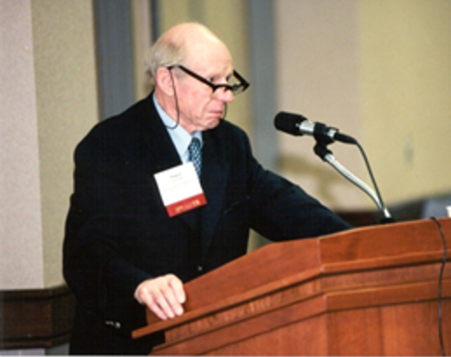
“For a long time people were saying most accidents were due to human error and this is true in a sense, but it’s not very helpful. It’s a bit like saying that falls are due to gravity.”
Trevor Kletz , safety expert
Human error and QI
Notes:
We need to better understand why things fail, particularly looking at the human aspect and human error.
Trevor Kletz said yes accidents are caused by humans, but blaming them doesn’t help move us forward or eliminate future accidents.
Similarly, blaming humans for failure of QI doesn’t get us anywhere. Understanding why helps us for next time.

Slide 65

Human error and QI
S – Skill
R – Rule
K – Knowledge
Human error and QI
Video link www.youtube.com/watch?v=cLbui_sh3KU
Notes:
https://www.youtube.com/watch?v=cLbui_sh3KU
A simple and helpful model we use in healthcare to understand human error is known as the SRK Framework. SRK stands for skill, rules and knowledge.
SRK provides a useful framework for identifying the types of error likely to occur in different situations and settings.
We use SRK in QI when we are designing changes linked to human error. We need to be sure the solutions are designed for the problem at hand.
As it says in the video – are we trying to find a solution to the wrong problem?
Reference:
Institute for Healthcare Improvement (2018). The SRK Framework (video). https://www.youtube.com/watch?v=cLbui_sh3KU

Slide 66
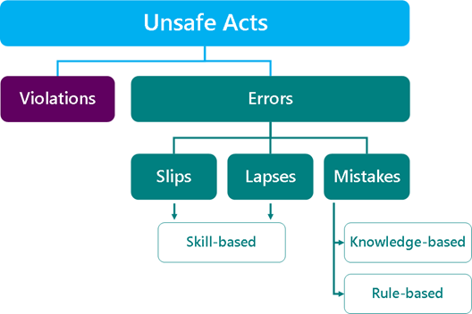
Human error and QI
Unsafe Acts
Violations
Errors
Human error and QI
Slips
Lapses
Mistakes
Skill-based
Knowledge-based
Rule-based
Notes:
The image here outlines the SRK framework. There are two main types of unsafe acts - violations (they intended to do it and knew it would be bad) and error (didn’t intend to do it, or if they did, that it was the right course of action to take).
We are focusing on errors.
Skill-based errors tend to occur during highly routine activities, when attention is diverted from a task, either by thoughts or external factors. Generally when these errors occur, the individual has the right knowledge, skills, and experience to do the task properly. The task has probably been performed correctly many times before. Even the most skilled and experienced people are susceptible to this type of error. As tasks become more routine and less novel, they can be performed with less conscious attention – the more familiar a task, the easier it is for the mind to wander.
When the action is completed, but not fully or incorrectly, then it is called a slip. This is an attention failure (too focused on something).
When the action is not completed, then this is a lapse. This is a memory failure (just forgot to do it).
Moving to the final error - these are known as mistakes, and can be broken down to two categories – knowledge-based and rule-based errors. Mistakes are where someone intended to do what happened, it was just the incorrect course of action.
Knowledge-based errors result from ‘trial and error’. In these cases, insufficient knowledge about how to perform a task results in the development of a solution that is incorrectly expected to work.
Rule-based mistakes refer to situations where the use or disregard of a particular rule or set of rules results in an undesired outcome.
This framework is helpful for designing change ideas… if we design a solution to fix a problem in a different bucket, then we’ll get nowhere.

Slide 67
Back to the falls example…
    The team are looking to tackle a slip or lapse i.e. a skill-based error
    The solution of raising awareness won’t work as this would fix a knowledge-based error
    Perhaps we should think more broadly about the causes of the
    slip or lapse…
    Is it environmental?
    Is it a process challenge?
    Do they need to go back to an understanding of the relationship between cause and effect?
    Have you experienced anything similar?
Back to the falls example
Notes:
Back to the falls example…
The team are looking to tackle a slip or lapse i.e. a skill-based error.
The solution of raising awareness won’t work as this would fix a knowledge-based error.
Perhaps we should think more broadly about the causes of the slip or a lapse…
Is it environmental?
Is it a process challenge?
Do they need to go back to an understanding of the relationship between cause and effect?
Does this make sense?
Have you experienced anything similar?

Slide 68
Cognitive biases and human factors
  As a coach you will often experience the role human factors play in supporting or inhibiting QI work.
  Bias plays a very large role in the way we operate and therefore could impact QI work.
  Your role is to recognise the role of bias, behaviour and human factors in QI and help teams to work with this information to design and implement sustainable change.
Cognitive biases and human factors

Slide 69

Whodunnit!
Whodunnit!
Notes:
Let’s end with a little fun – linked with being observant.
A final reflection: https://www.youtube.com/watch?v=ubNF9QNEQLA
Reflect on the video with group.
What did you notice?
What does this tell us?
Reference:
Do The Test (2008). Test Your Awareness: Whodunnit? (video): https://www.youtube.com/watch?v=ubNF9QNEQLA

Slide 70
Self-directed learning
1
3
  Find your local data expert to support you going forward
Self-directed learning
Notes:
Find your local data expert to support you going forward.

Slide 71
Today’s learning outcomes
  By the end of the session, you will…
    Coach a team to identify, collect and interpret data in support of their improvement work
    Apply creative problem-solving methods and behaviour change concepts to support teams to revive a stalled effort
    Understand your role as a ‘connector’ in supporting teams through measurement of improvement work
    Advocate for just enough data in QI work
    Recognise how human factors, bias and resistance can influence QI work.
Today’s learning outcomes
Notes:
Each session has its own learning outcomes. Today’s focus is on working with people.
As delegates on the programme, we encourage you to reflect on the learning outcomes at the end of each session. Ask yourself: can I meet the outcomes shown on the screen without guidance from a member of the QI team? If not, then think about what you need to meet these learning outcomes.

Slide 72
Join the Q Community
    Great network for learning, networking, funding and more.
    There are 5000 members and the community continues to grow.
    Q is being delivered by the Health Foundation and supported and co-funded by partners across the UK and Ireland.
    Opportunities to join Q are open on a continuous basis.
Q Community
  https://q.health.org.uk/join-q/
Notes:
Connect, share and learn with people from different disciplines and sectors, from across the UK and Ireland to help create real change
Join a diverse community that brings together those from the frontline of health and social care, patient leaders, managers, researchers, commissioners and policy makers and others
Tap into all that Q offers as a source of innovation and practical problem solving – benefits include journals and learning resources, Q visits and inspiring events scheduled throughout the year
Get involved in other activities including special interest groups, Q Lab and Randomised Coffee Trials with others in the community
Let Q grow with you as your career progresses – participate in ways that fit with your life and improvement priorities
Develop your improvement skills and help lead and develop others beyond Q
Free – no membership fee. Gain access to funding opportunities.

Slide 73
We need your feedback
Feedback
Notes:
Use your evaluation forms to gather feedback on the day.

Slide 74
References and links
Gladwell, M. (2002). The Tipping Point: How Little Things Can Make a Big Difference. Abacus.
Solberg, L.I., Mosser, G. and McDonald, S. (1997). The Three Faces of Performance Management: Improvement, Accountability and Research. Journal of Quality Improvement.
  https://pubmed.ncbi.nlm.nih.gov/9103968/
Mike Davidage – Measurement for improvement
  https://www.youtube.com/watch?v=Za1o77jAnbw
Institute for Healthcare Improvement. Know When Enough Data is Enough.
  https://www.ihi.org/resources/Pages/ImprovementStories/KnowWhenEnoughDataisEnough.aspx
Kettering General Hospital (2018).
Quality Report 2017–2018.
  https://www.kgh.nhs.uk/download.cfm?doc=docm93jijm4n681.pdf&ver=1022
BBC News. UK economy lags behind other countries in Covid recovery (tabular format example).
  https://www.bbc.co.uk/news/business-57427997
East London NHS Foundation Trust. The Pareto Principle.
  https://qi.elft.nhs.uk/the-pareto-principle
Yamada, R., Kume, T., Okamoto, H. et al. (2022). Effects of the Current Japanese Guideline for Dedicated, Intensive Lipid-lowering Therapy on Lipid Profile and Coronary Events in Patients After Acute Coronary Syndrome. Journal of Asian Pacific Society of Cardiology.
  www.japscjournal.com/articles/effects-current-japanese-guideline-dedicated-intensive-lipid-lowering-therapy-lipid
Loewenthal, G. et al (2020). COVID-19 pandemic-related lockdown: response time is more important than its strictness. EMBO Molecular Medicine.
  www.embopress.org/doi/full/10.15252/emmm.202013171
SAS Blogs (2020). Visualize the case fatality rate for COVID-19 in US counties.
  https://blogs.sas.com/content/iml/2020/04/22/funnel-plot-covid-us.html
NHS Digital. Charts.
  https://digital.nhs.uk/about-nhs-digital/corporate-information-and-documents/our-style-guidelines/visual-style-guide/charts#choosing-the-right-chart-type
References and links

Slide 75
References and links (continued)
Perla, R. J., Provost, L. P., Murray, S. K. (2011). The run chart: a simple analytical tool for learning from variation in healthcare processe. BMJ Quality & Safety.
  https://qualitysafety.bmj.com/content/20/1/46
Benneyan, J., Lloyd, R., Plsek, P. (2003). Statistical process control as a tool for research and healthcare improvement. Quality & Safety in Healthcare.
  https://qualitysafety.bmj.com/content/qhc/12/6/458.full.pdf
Institute for Healthcare Improvement (2018). Visual Management Board.
  www.ihi.org/resources/Pages/Tools/Visual-Management-Board.aspx
Maurer, R. (2008). Resistance to Change.
  www.youtube.com/watch?v=a0sdpX1JOrU
Maurer, R. Dealing Effectively with the Seven Key Challenges of Major Change.
  www.energybartools.com/images/The-Challenges-of-Change-White-Paper.pdf
Maurer, R. Resistance to Change – Why it Matters and What to Do About It.
  https://rickmaurer.com/articles/resistance-to-change-why-it-matters/
Maurer, R. (2010). Beyond the Wall of Resistance. Bard.
LINEEX. Heuristics and Cognitive Biases. https://www.lineex.es/en/cognitive-biases/
  Danzinger, S., Levav, J., Avnaim-Pesso, L. (2011). Extraneous factors in judicial decisions. PNAS. www.pnas.org/doi/epdf/10.1073/pnas.1018033108
Mitchell, P. (ed.) (2013). Safer Care: Human Factors for Healthcare Course Handbook. Swan & Horn.
Institute for Healthcare Improvement (2018). The SRK Framework (video).
  www.youtube.com/watch?v=cLbui_sh3KU
Do The Test (2008). Test Your Awareness: Whodunnit?
  www.youtube.com/watch?v=ubNF9QNEQLA
The Q Community.
  https://q.health.org.uk/join-q
References and links (continued)

Slide 76
Authors
Sidney Beech
Bridget Browne
Jonathon Grellier
Samantha Machen
Hannah Pearson
Jem Ramazanoglu
Emma Stinton
Contributors
Jennifer Cotter
Geetika Singh
Slide design and layout by Studio Quercus

Slide 77
Authors
Sidney Beech
Bridget Browne
Jonathon Grellier
Samantha Machen
Hannah Pearson
Jem Ramazanoglu
Emma Stinton
Contributors
Jennifer Cotter
Geetika Singh
Slide design and layout by Studio Quercus

