Slide 2
Working
With People
Session 5
Quality Coach Development Programme

Slide 3
Funding Acknowledgement
The Quality Coach Development Programme was partially funded through Q Exchange by the Health Foundation and NHS England and NHS Improvement
  For additional information contact
  clcht.continuous.improvement@nhs.net or the Q Community
This slide deck and all associated materials of the Quality Coach Development Programme are available under the Creative Commons Attribution-ShareAlike Licence 4.0
  This licence permits others to remix, adapt, and build upon this piece of work even for commercial purposes, as long as you credit us and license any and all new creations under the identical terms. (CC-BY-SA)
Notes:
All materials associated with this programme are copyrighted. CC-BY-SA allows anyone to use this slide deck for free, as long as the authors and contributors are credited.
You should not add your own logos to these materials without the express permission of all authors, as this would be a direct infringement on the copyright. We want to ensure all materials associated with this programme remain free-to-access for everyone.
The legal code for CC-BY-SA can be found here: https://creativecommons.org/licenses/by-sa/4.0/legalcode

Slide 4
Working with People
Session 5
Cohort A
Notes:
Hello faculty of the Quality Coach Development Programme.
Welcome to Session 5 of the Quality Coach Development Programme. Please refer to the Trainer Guide for more detailed information on the day, including activity templates for the breakout rooms.
In advance of delivering this day you should work through the slides with any co-presenters and tailor the content to suit your local context. This may include swapping slides out for your own slides, adding different visuals, changing icebreakers or adapting activities to suit the target audience.
Notes in bold are instructions for the faculty. Notes in regular text are notes for delegates, and can be read out during the session or adapted as required.
Please do not delete large sections of content – if significant changes are made to the content then it may no longer meet the learning outcomes. See further explanation in the Programme Leader Guide
All content is copyrighted by the authors. Please do not remove the © mark from any materials and ensure content is correctly attributed. We have made all materials available for free to the public and just ask that you attribute the content fairly.

Slide 5
Making the most of our virtual environment
We are happy to take questions – raise your hand at any point or ask in your breakout room sessions
When you see this symbol, we recommend you take a photo or screenshot of the task for the breakout room
Indicates page in handbook
Feel free to use the chat box during the session
Making the most of our virtual environment
Indicates activity
We will be using breakout rooms a lot
Top tip: don’t touch anything when you are
being moved to rooms
Indicates an independent task for you to complete later
Notes:
You should edit this slide if delivering the content in person. You will only need the icons shown in the right hand box. However you may still wish to explain that you encourage people to ask questions or chat in the breaks, and that the session includes many activities.
If you are using an online whiteboard, ask delegates to open your preferred internet browser. If you are using Mural, we find it works best with Google Chrome.

Slide 6
Housekeeping
Housekeeping
Notes:
Suggested housekeeping – adapt to suit your environment
Technology
Where possible, please turn off emails, websites, mute phones
Mute yourself when you’re not speaking
Use emojis and reactions
Keep cameras on
Movement
Stretch if you need to, move around as desired
Feel free to fidget and doodle
Excuse yourself when you need to (sign off and re-sign on)
Fun
Have fun
Lean in with curiosity

Slide 7
Agenda for today
9.00
      Introduction and housekeeping
      Coaching circle
      Coffee break
      Involvement and force field analysis
      Comfort break
      Qualitative data
      Lunch
      PDSA challenges
      All teach, all learn
      Comfort break
      All teach, all learn (continued)
      Close
9.15
10.20
10.35
11.40
Agenda for today
11.45
12.15
1.00
1.30
2.45
2.55
3.50

Slide 8


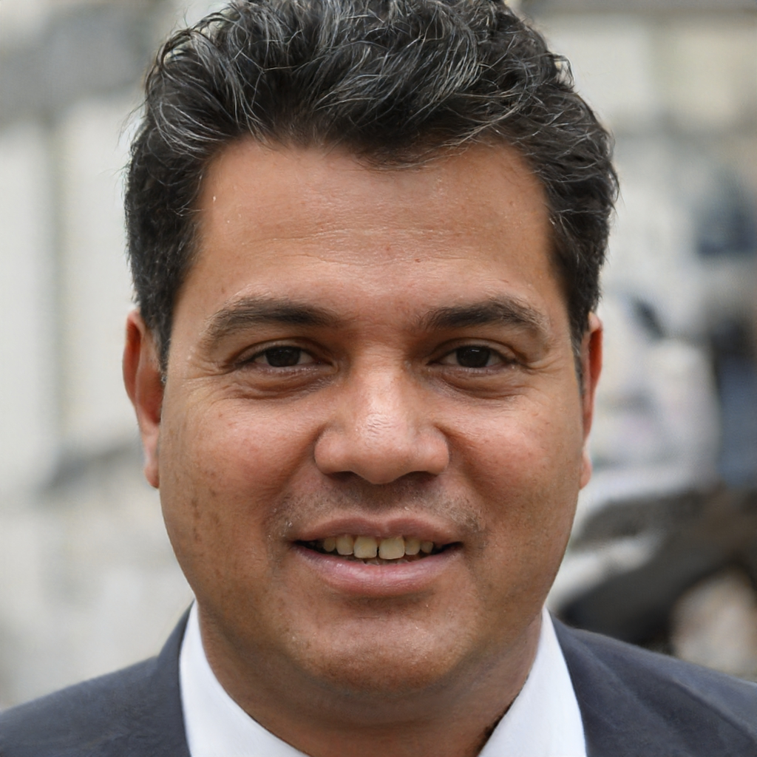
Today’s facilitators
To tint photos:
Format picture > Picture >
Picture colour >
recolour
Person name
  Job title
  Email
  Mobile
Person name
  Job title
  Email
  Mobile
Person name
  Job title
  Email
  Mobile
Today’s facilitators
Notes:
*Notes for faculty – please add in your own images and contact details here*
This is a good point to properly introduce yourselves and explain your background and experience in QI and coaching improvement.

Slide 9
Programme aim
The aim of this eight week programme is to…
Support individuals to develop the skills
and knowledge required to independently
and confidently coach a team through improvement work.
Programme aim

Slide 10
Ten learning outcomes of the programme
      By the end of the programme delegates will be able to independently:
Coach an improvement team ensuring robust application of QI methods and principles
Help teams to explore barriers and enablers relating to their QI work, in support of the sustainability of interventions
1
6
Understand the concepts of coaching improvement and the difference between coaching and advising
Advocate for meaningful involvement in
QI work and advise teams on methods for involvement
2
7
Ten learning outcomes of the programme
Explain their role as a Quality Coach to different stakeholders
Coach a team to identify, collect and interpret data in support of their improvement work
3
8
Promote an environment that encourages team members to contribute equally to the development of improvement work
Apply creative problem-solving methods and behaviour change concepts to support teams to revive a stalled effort
4
9
Assimilate QI knowledge and facilitation skills that support teams to progress through the different stages of QI work
Critically analyse their own limitations and the limitations of coaching
5
10

Slide 11
Coaching circle
Activity 5.1
Notes:
See activity 5.1 in the Trainer Guide.
60 mins

Slide 12
Coffee break
Notes:
15 mins

Slide 13
Working
with People
  Quality Coach Development Programme
Notes:
Explain that this is the second of four modules of the coach programme.

Slide 14
Today’s learning outcomes
  By the end of the session, you will…
    Be able to advocate for meaningful involvement in improvement work
    Understand the importance of qualitative data in improvement work
    Consider the potential challenges in using PDSA cycles in QI work
    Recognise the role of a Quality Coach as an educator and practise teaching more advanced QI concepts.
Today’s learning outcomes
Notes:
Each session has its own learning outcomes. Today’s focus is on working with people.
As delegates on the programme, we encourage you to reflect on the learning outcomes at the end of each session. Ask yourself: can I meet the outcomes shown on the screen without guidance from a member of the QI team? If not, then think about what you need to meet these learning outcomes.

Slide 15
Did you know…?
Research has shown that projects with involvement were four times more likely to succeed than those with none?
Did you know…?
Source: Kostal, G. and Shah, A. (2021)
Notes:
This data comes from ELFT – they did a review in 2019 looking at the involvement of pts in their projects.
Read slide
Flag up further reading: see reference
Reference:
Kostal, G. and Shah, A. (2021). Putting improvement in everyone's hands: opening up healthcare improvement by simplifying, supporting and refocusing on core purpose. British Journal of Healthcare Management. https://www.magonlinelibrary.com/doi/full/10.12968/bjhc.2020.0189

Slide 16
What is ‘involvement’?
p148
        Co-producing
        Doing with
        Co-designing
        Engaging
        Consulting
        Doing for
What is ‘involvement’?
Ladder of participation
        Informing
        Educating
        Doing to
        Coercing
Sources: Arnstein (1969); Slay and Stephens (2013); Iriss and Nesta (2012)
Notes:
Nesta model, also known as Arnstein’s ladder of participation, also known as NHSI patient involvement ladder.
Engagement and involvement can take many forms, ranging from little-to-no involvement through to the co-production of change and improvement.
Many improvers use the ‘ladder of participation’ as a guiding tool for identifying the level of engagement and participation that stakeholders experience in a project. This is particularly relevant for patient involvement in improvement. A visual representation of the ladder of participation is shown on the slide.
National Institute for Health and Care Research (NIHR) define involvement as ‘an activity that is done ‘with’ and ‘by’ patients, carers, members of the public and wider communities not ‘to’, ‘for’ or ‘about’ them’.
[NIHR https://www.spcr.nihr.ac.uk/PPI/what-is-patient-and-public-involvement-and-engagement]
As a coach, your role will be to advocate for better involvement of all stakeholders in the project, with a particular emphasis on patient involvement. Teams may be unsure of how to do this; so be prepared to support them with patient engagement. Let’s break down what doing to, for and with looks like in QI…
References:
Arnstein, S. (1969). A Ladder of Citizen Participation. Journal of the American Institute of Planners. http://lithgow-schmidt.dk/sherry-arnstein/ladder-of-citizen-participation.html
Ladder source: Slay, J. and Stephens, L. (2013). Co-production in mental health: a literature review. New Economics Foundation. https://neweconomics.org/2013/11/co-production-mental-health -
Image adapted from: Iriss. Participation: its impact on services and the people who use them. https://www.iriss.org.uk/resources/insights/participation-its-impact-services-and-people-who-use-them
Nesta (2012). People powered health co-production catalogue. https://media.nesta.org.uk/documents/co-production_catalogue.pdf

Slide 17
Doing to…
        Co-producing
        Doing with
        Co-designing
        Engaging
        Consulting
        Doing for
Doing to…
Ladder of participation
        Informing
        Educating
        Doing to
        Coercing
Sources: Arnstein (1969); Slay and Stephens (2013); Iriss and Nesta (2012)
    Involvement is mostly on professionals’ terms
    People invited to give a view but the power to make decisions is retained by professionals
    Cultural norms remain unchanged
    There may be a risk of tokenism.
    Traditional paternalistic approach
    Expectation of compliance
    Expertise and control lies with professionals
    Passive role for patients and participants
    No meaningful service user engagement in design.
Notes:
These slides were created by Janet Seale – Carer at CNWL – this is what doing to means to her.
References:
Ladder source: Slay, J. and Stephens, L. (2013). Co-production in mental health: a literature review. New Economics Foundation. https://neweconomics.org/2013/11/co-production-mental-health -
Image adapted from: Iriss. Participation: its impact on services and the people who use them. https://www.iriss.org.uk/resources/insights/participation-its-impact-services-and-people-who-use-them

Slide 18
Doing for…
    Traditional paternalistic approach
    Expectation of compliance
    Expertise and control lies with professionals
    Passive role for patients and participants
    No meaningful service user engagement in design.
        Co-producing
    Involvement is mostly on professionals’ terms
    People invited to give a view but the power to make decisions is retained by professionals
    Cultural norms remain unchanged
    There may be a risk of tokenism.
        Doing with
        Co-designing
        Engaging
        Consulting
        Doing for
Doing for…
Ladder of participation
        Informing
        Educating
        Doing to
        Coercing
Sources: Arnstein (1969); Slay and Stephens (2013); Iriss and Nesta (2012)
    Equal and reciprocal relationships
    ‘Blank piece of paper approach’
    Power and roles are shared
    Strengths and talents of service users are nurtured
    People become catalysts for change – considered as genuine assets
    Changes nature of conversation
    But – this can feel at odds with cultural norms.
Notes:
After that we move up the ladder – more meaningful engagement occurs.
This next section including engaging, consulting and informing is ‘doing for’
Read through bullet points
References:
Ladder source: Slay, J. and Stephens, L. (2013). Co-production in mental health: a literature review. New Economics Foundation. https://neweconomics.org/2013/11/co-production-mental-health -
Image adapted from: Iriss. Participation: its impact on services and the people who use them. https://www.iriss.org.uk/resources/insights/participation-its-impact-services-and-people-who-use-them

Slide 19
Doing with…
    Involvement is mostly on professionals’ terms
    People invited to give a view but the power to make decisions is retained by professionals
    Cultural norms remain unchanged
    There may be a risk of tokenism.
        Co-producing
    Equal and reciprocal relationships
    ‘Blank piece of paper approach’
    Power and roles are shared
    Strengths and talents of service users are nurtured
    People become catalysts for change – considered as genuine assets
    Changes nature of conversation
    But – this can feel at odds with cultural norms.
        Doing with
        Co-designing
        Engaging
        Consulting
        Doing for
Doing with
Ladder of participation
        Informing
        Educating
        Doing to
        Coercing
Sources: Arnstein (1969); Slay and Stephens (2013); Iriss and Nesta (2012)
Notes:
At the top of the ladder we have the most meaningful types of engagement – co-production and co-design – where we are ‘doing with’ patients/carers/family.
Read bullet points
Speak through an example
Does anyone have any experience of ‘doing with’?
References:
Ladder source: Slay, J. and Stephens, L. (2013). Co-production in mental health: a literature review. New Economics Foundation. https://neweconomics.org/2013/11/co-production-mental-health -
Image adapted from: Iriss. Participation: its impact on services and the people who use them. https://www.iriss.org.uk/resources/insights/participation-its-impact-services-and-people-who-use-them

Slide 20

Experts by Experience bring solutions that can help the project succeed
        User experience
Experts by Experience bring solutions that can help
        Design
Desire line in Santander, Spain. Emilio Gómez Fernández / Wikimedia Commons
Notes:
This is just a nice visualisation of why user experience is important.
How many times have you seen something like this?
People will find the best route for them – they will not always follow the path.
In Canada they sometimes create ‘desire paths’; this means that they look at where people walk when there is heavy snowfall, and any footpaths are created in line with this – so that they don’t have this problem.

Slide 21
How might a patient support QI?
Identify areas for improvement | Help with the setting of aims | Being a QI project team member from start to finish | Designing leaflets and questionnaires | Engaging with other patients and carers
Completing surveys | Helping to produce the driver diagram | Share findings of the QI project | Attending focus groups
How might a patient support QI?
Notes:
A starter for ten of how patients can be involved.
If involving in QI – how can we make it accessible? For example the phrase ‘driver diagram’ may alienate some people as it is not a common term outside of improvement. You should make sure you explain things, when needed.

Slide 22
Force field analysis
Who or what is on our side when involving patients in QI?
Who or what is against us when involving patients in QI?
Force field analysis
Notes:
See activity 5.2 in the Trainer Guide.
Reference:
Lewin, K. (1951). Field Theory in Social Science. Harper and Row. https://ia802905.us.archive.org/4/items/in.ernet.dli.2015.138989/2015.138989.Field-Theory-In-Social-Science-Selected-Theoretical-Oaoers.pdf

Slide 23
Force field analysis – example
Good access to data
Lack of communication across the team
How to
List all the forces for and against the plan/change
Estimate power of strength of each force (Rate 1–5)
Consider any actions to take
Driving forces
For
Restraining forces
Against
Chief nurse sponsoring
the project
        Aim
        Reduce the average number of unobserved falls on Red Ward by 25% within the next nine months
Admin not engaged
3
4
Team have some
QI experience
Similar falls initiatives have failed
Force field analysis
5
2
© Quality Coach Design Group
Identified as a key
ward priority
Limited access to IT
2
3
Total
Total
4
1
14
10
What coaching questions can you ask to reduce the power of restraining forces?

Slide 24
Force field analysis
Driving forces
For
Restraining forces
Against
How to
List all the forces for and against the plan/change
Estimate power of strength of each force (Rate 1–5)
Consider any actions to take
        Plan
        Involve patients/ service users and/or carers in 50% of QI projects
        Aim
        Reduce the average number of unobserved falls on Red Ward by 25% within the next nine months
Activity 5.2
Total
Total
What coaching questions can you ask to reduce the power of restraining forces?
Identified as a key
ward priority
Limited access to IT
14
10
4
1
Notes:
See activity 5.2 in the Trainer Guide.
20 mins in small groups
5 mins group feedback

Slide 25
Your role as a coach – discussion
Your role as a coach
You are a champion for QI and you have a lot of power and influence in improvement.
What things on the left (driving forces) can you amplify and make better as a coach?
What things on the right (restraining forces) can you reduce or remove as a coach?
Notes:
Force field analysis is a useful tool for QI teams to use. It helps them explore what is supporting and hindering their work and what they might need to do differently to shift things.
Beyond that it’s also a powerful tool for reflection. As a coach you are a key part of the wider QI team in the organisation and a representative of all that we do to improve. This brings responsibility and your insights are crucial to helping to enhance our approach to improvement. We know that we can always do more with involvement. Some of the topics today are the responsibility of the QI team, others are our collective responsibility and some are yours.

Slide 26
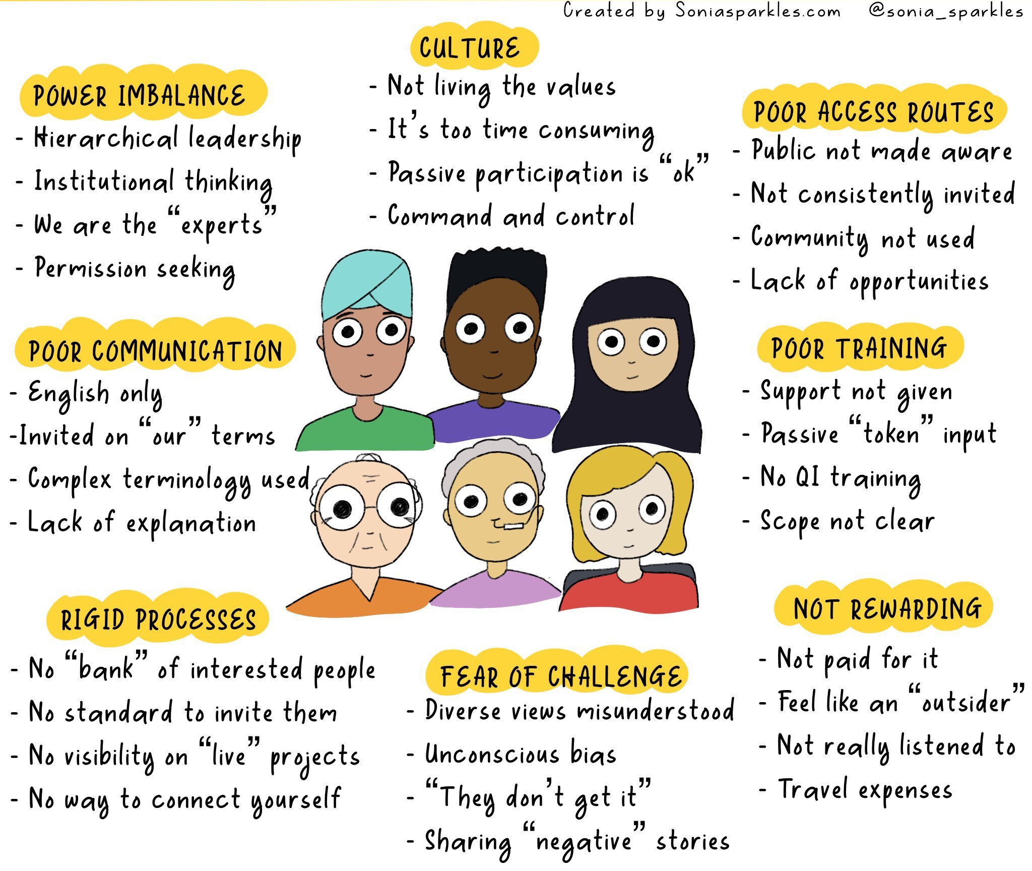
Barriers to patient leadership in improvement
Barriers to patient leadership in improvement
Sonia Sparkles / twitter.com

Slide 27
What works well with the involvement of service users and carers
    Have the service users and carers involved from the start of your project – not just as an afterthought
    Make sure they have all the training they need to be involved
    Have a designated link person
    Be inclusive, copy them into all group emails, meetings decisions etc
    Explain any jargon/acronyms that you use both in meetings and in documents. Use plain English in your documents
    Pick the right person for the project – not just any old service user
    or carer.
What works well with the involvement of service users and carers

Slide 28
Challenges with involving patients+
    Mind shift/mindset
    Fear/challenges
Challenges with involving patients
Notes:
It’s not normal for us to think to involve patients, therefore it can be hard to remember to do, and because we’re not used to it, it means that it requires more effort. We need to change this mindset and involve patients throughout projects, co-producing effective healthcare solutions with them not for them
Sometimes involving patients can create challenges. With the already existing issues of scheduling/engagement then to have to engage someone outside the organisation can add another layer of complexity. It’s important to push past this.
Mindset of staff can be that involving carers and patients may make the project slow down; this may be true. But is that a reason not to do it?
Involving a different perspective can bring challenges that you might not have thought of.
Example: (Facilitator to use own example)

Slide 29
Formal ethical approval isn’t needed for QI projects
  BUT it is important to act ethically and
  to always take ethical considerations into account, for example:
    Choice to participate
    Choice to step back
    Our duty to act on views
    (or have reasons not to)
    A space for open reflection
    Managing expectations
    Not leaving people feeling exploited.
Poll
Yes
No
Maybe
Notes:
In the chat or using the poll function.

Slide 30
Generally not
  BUT it is important to act ethically and
  to always take ethical considerations into account, for example:
    Choice to participate
    Choice to step back
    Our duty to act on views
    (or have reasons not to)
    A space for open reflection
    Managing expectations
    Not leaving people feeling exploited.
No
Notes:
References to answer this question:
Hunt, D.F., Dunn, M., Harrison, G., et al. (2021). Ethical considerations in quality improvement: key questions and a practical guide. BMJ Open Quality. https://bmjopenquality.bmj.com/content/10/3/e001497
Lynn, J., Baily, M.A., Bottrell, M. et al. (2007). The ethics of using quality improvement methods in health care. Annals of Internal Medicine. https://pubmed.ncbi.nlm.nih.gov/17438310/
Healthcare Quality Improvement Project (2017). Guide to managing ethical issues in quality improvement or clinical audit projects. https://www.hqip.org.uk/wp-content/uploads/2017/02/guide-to-managing-ethical-issues-in-quality-improvement-or-clinical-audit-projects.pdf

Slide 31
How to make patients and carers feel genuinely involved?
    Make it engaging and fun!
    Avoid jargon
    Respect all views – give airtime to all
    Bring people into the conversation
    Establish ground rules
    Good preparation
    Respect people’s difference experiences, skills and motivations
    Be open and prepared to be challenged
    Be flexible.
How to make patients and carers feel genuinely involved?
Notes:
Here are a few tips for how you as a new Quality Coach can make it easier to involve patients in improvement work.

Slide 32
Comfort break
Notes:
5 mins

Slide 33
Qualitative Data in Improvement
Qualitative Data in Improvement

Slide 34
Poll
Three words to describe how you feel
about coaching
Poll

Slide 35
What is the difference between qualitative and quantitative?
 | Qualitative | Quantitative
Description | Non-numerical data (shown in words, sentences, paragraphs) | Numerical data
Focus | The 'why' and 'how' | The 'how many' and 'how much'
Sample size | Typically small | Typically large
Design | Dynamic and subjective, open to interpretation | Fixed and universal, operational definitions
Collection | Gathered through observations and interviews | Gathered by measuring and counting
Analysis | Grouping of themes, codes PDSA, wordclouds | Statistical analysis via run charts
What is the difference between qualitative and quantitative?
Source: Scribbr (2019)
Notes:
Qualitative data
Focuses on the how and why
Data is represented in word form
Data is narrative and normally can be seen to develop a story or guide someone through a process
Qualitative data can be used to understand how an individual subjectively perceives and gives meaning to things.
Overview
Depth versus breadth
Perspective of the individual
Insights are specific to a context
Allows an open-ended conversation
Individuals can guide the conversation rather than you as the lead.
References:
Scribbr (2019). Qualitative vs. Quantitative Research | Differences, Examples & Methods. https://www.scribbr.com/methodology/qualitative-quantitative-research/
Renjith, V., Yesodharan, R., Noronha, J.A., Ladd, E., George, A. (2021). Qualitative Methods in Health Care Research. International Journal of Preventative Medicine. https://www.ncbi.nlm.nih.gov/pmc/articles/PMC8106287/

Slide 36
How do I collect qualitative data?
  Interviews
  (unstructured or semi-structured)
  Documentary analysis
  Focus groups
  (typically 6–8 people)
  Diaries/journals
How do I collect qualitative data?
  Patient stories
  (incl. emotional mapping)
  Surveys
  Observations
Notes:
Interviews
A common and very useful tool for supporting improvement in healthcare. Interviews provide unique and detailed perspectives on a selected topic, with flexibility to probe for further detail and clarity when needed. They can be used to understand patient or staff perspectives on particular services, processes or problems
Can be used at various stages of a project – to help clarify the situation, learn about what matters to stakeholders, develop ideas, explore a particular topic in detail or even to evaluate findings
When done well, they offer the most descriptive insights in qualitative data collection. This means that data may not be generalisable.
Focus groups
Similar to interviews, focus groups have a lot of potential in QI. They provide detailed perspectives on a selected topic, with flexibility to probe for further detail and clarity when needed. However, they may provide less depth on an individual basis, owing to their group nature
Focus groups are typically used to understand stakeholder needs, prioritise these needs, test concepts and seek feedback
Beware the time taken to undertake these. Don't just suggest these or interviews on a whim... they require a lot of planning and thought.
Stories
Patient stories are used to provide a ‘human face’ to patient safety problems. Storytelling is an effective strategy for growing and learning. Patients are encouraged to provide their own individual experiences, typically relating to a poor outcome or experience, as a form of learning. These are either presented in person, via video or even through social media (X, Facebook, blogs etc)
Patient stories are typically used at the start of a project to provide the groundwork for improvement
Less focused on analysis and more on motivation.
Observations
Recorded description of events, actions and artefacts or ‘things’
May be a blend of qual and quant (see example).
Documentary analysis
Analysis of existing (generally written) pre-existing materials.
Diaries/journals
As a team you may keep note of how things felt/what was unexpected etc during the project. As a coach I try to encourage teams I work with to reflect often and in detail. This information is rich and almost always qualitative. It can be really powerful for the way forward.
Surveys
Surveys are often the most generalisable qualitative data. This is often as the pool is much larger and varied. Think about QI work you’ve undertaken in the past. Have you asked teams questions like “how could this process be better?” “name 3 things that come to mind when…” ?
References:
QuestionPro. Qualitative Data – Definition, Types, Analysis, and Examples. https://www.questionpro.com/blog/qualitative-data/
QuestionPro: Qualitative Data Collection: What it is + Methods to do it. https://www.questionpro.com/blog/qualitative-data-collection-methods/
The Health Foundation (2013). Measuring patient experience. https://www.health.org.uk/sites/default/files/MeasuringPatientExperience.pdf

Slide 37

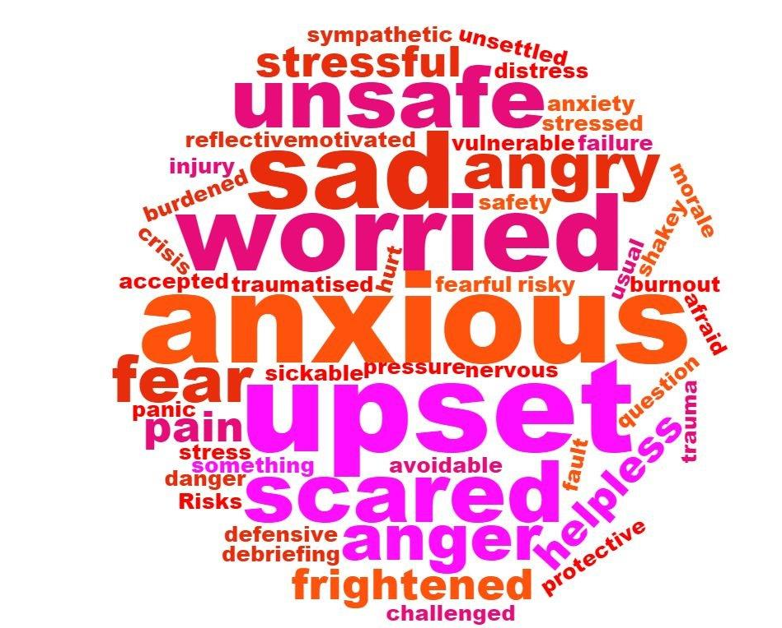
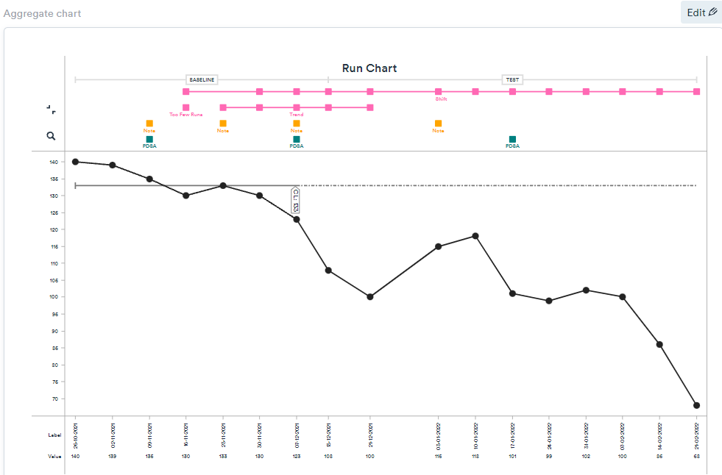
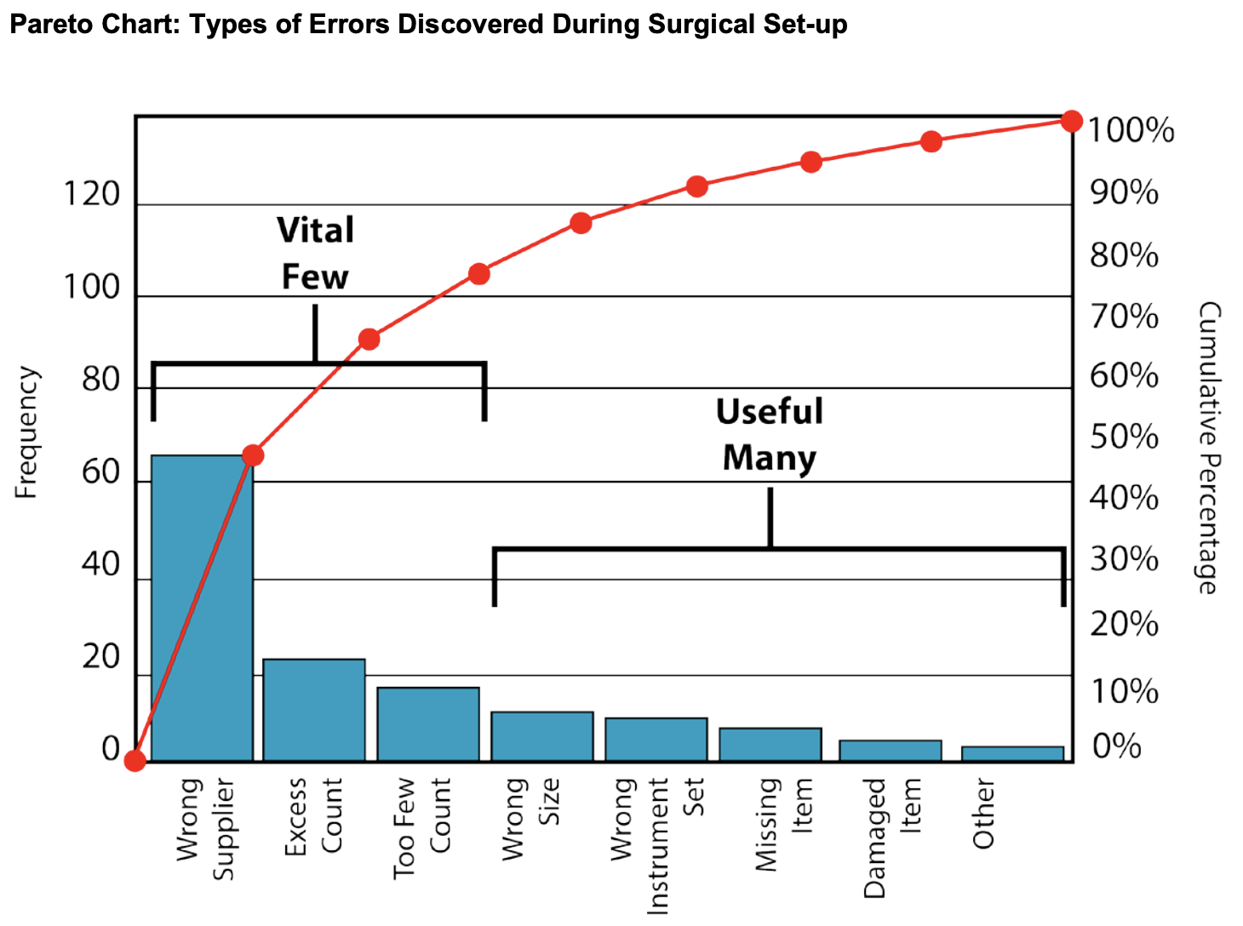
How might you present qualitative data?
It’s not that we don’t want to improve. We have no time.
Clinical Lead
“
I'm much happier with the information I receive from the doctors and nurses about [my husband in the stroke unit] – it takes much less time to get much more detail about how he is doing and when he will be coming home.
How might you present qualitative data?
We no longer feel like we are fire fighting
Triage Nurse
We are now meeting our social care KPIs too and have no open complaints. We have a sense of pride in our work
”
Team Manager
Notes:
How might you present qualitative data:
How do you show it?
Annotated charts
Patient stories
Word clouds
Pareto Chart – analysis of qualitative data
Quotes
Sometimes there is so much emphasises on the presentation of data (don’t make that your main focus). Qualitative data can be a really useful tool for informing decisions (helping to develop driver diagrams, fishbones and stakeholder analysis).

Slide 38
How do I collect qualitative data?
Surveys
Comment cards
Kiosk questions
More generalisable
In-depth interviews
SMS questions
Focus groups/panels
How do I collect qualitative data?
Less descriptive
More descriptive
Patient stories
Online ratings
Photovoice
More generalisable
Public meetings
Ward rounds/observation
Complaints and compliments
Source: The Health Foundation (2013)
Notes:
There may be different focuses for qualitative data, so you will need to keep in mind the type of data collected, the source of data, sample size and the rationale for that method.
This diagram highlights the relationship between how descriptive/generalisable a method might be – this should be considered when collecting/analysing the data.
E.g – understanding the service – data could be gathered either via one patient interview to understand the patient pathway (deep detailed understanding in one interview – descriptive) or a large samples survey with a small number of questions – more generalised.
Reference:
The Health Foundation (2013). Measuring patient experience. https://www.health.org.uk/sites/default/files/MeasuringPatientExperience.pdf

Slide 39
When might we use these methods?
Stage 1
Identification of
a quality issue
Stage 2
Understand the current situation/
problem
Stage 3
Measure for
improvement
Stage 4
Develop a strategy
and change ideas
Stage 5
Small-scale testing
Stage 6
Sustain improvement
  Surveys
When might we use these methods?
  Observations
  Focus groups
  Documentary analysis
  Interviews
  Focus groups
  Diaries/journals
  Documentary analysis
  Patient stories
  Interviews
  Diaries/
  journals
  Surveys
  Surveys
  Diaries/journals
  Interviews
  Focus groups
  Observations
Notes:
Get group to discuss. When might we use surveys?
We want to ensure that we have the patient voice throughout the journey of improvement work. This activity can help us think about this.
Some suggestions:
Surveys – Stages 1/5/6
Observations – Stages 2/5
Focus groups – Stages 2/4/5
Documentary analysis – Stages 2/4
Interviews – Stages 1/2/4
Diaries/journals – Stages 5/1/2

Slide 40
When might we use these methods?
Stage 1
Identification of
a quality issue
Stage 2
Understand the current situation/
problem
Stage 3
Measure for
improvement
Stage 4
Develop a strategy
and change ideas
Stage 5
Small-scale testing
Stage 6
Sustain improvement
  Surveys
  Surveys
  Surveys
  Observations
  Observations
When might we use these methods?
  Focus groups
  Focus groups
  Focus groups
  Documentary analysis
  Documentary analysis
  Interviews
  Interviews
  Interviews
  Diaries/
  journals
  Diaries/journals
  Diaries/journals
  Patient stories
Notes:
These are some ideas.
Talk through some examples, referring to the discussion you have just had with the group.

Slide 41
Your role as a coach
  Advocate for a qualitative approach, when needed
  Recognising when qualitative data is already available
Your role as a coach
  Mythbust
  Help with qual design (right tool, right time)
  Advise on questioning
Notes:
As a Quality Coach you have an important role in advocating for qualitative data.
Summarise the slide.
You should always consider these points:
Always ask the question – does the data already exist in this format? Are they already collecting qualitative data?
Encourage people to use it – QI is about learning, can they use one piece qualitative data in their work?
Myth bust – you are there to ease their concerns – highlight the benefits etc
6 Stages – when to use it
Surveys – sometimes it is more helpful to shift from quant to qual to get useful data.

Slide 42
Lunch break
Notes:
45 mins

Slide 43
Icebreaker
Icebreaker
© Quality Coach Design Group

Slide 44
Reality check
#3
#2
Reality check
Complexity
#1
Time
Inspired by: NIHR CLAHRC
Notes:
This is the theory of a PDSA cycle. Subsequent and more complex PDSA are tested over time. This is the theory of testing on a small scale and scaling up the best ideas.
Next slide shows what it might look like in real life.
References/inspired by:
NIHR CLAHRC. QI4U. https://www.qi4u.org/
Unaettie.com. Plan-Do-Study-Act (PDSA) Model. https://unaettie.com/en-us/pz/pdsa_basic.php

Slide 45
Reality check
Challenges
Too complex!
Reality check
Complexity
Simpler PDSA
Time
Inspired by: NIHR CLAHRC; Unaettie.com
Notes:
Here we can see the complexity of PDSA in practice
You may start some cycles and realise quite quickly that they are too complex and so stop and move on (shown in top left ‘too complex’). The other dotted lines show where change becomes quite complex. Sometimes a small scale and challenging PDSA helps to inform other, simpler ideas. (Shown with the challenges in the top right feeding to a PDSA in the bottom right.)
Does anyone in the group have any reflections on this slide? Can they relate? What makes PDSA so hard?
Real world view (testing multiple PDSA vs not)
References/inspired by:
NIHR CLAHRC. QI4U. https://www.qi4u.org/
Unaettie.com. Plan-Do-Study-Act (PDSA) Model. https://unaettie.com/en-us/pz/pdsa_basic.php

Slide 46
Reality check
Quick wins
Major projects
Impact
Customer satisfaction,
Quality, Timeliness
×
Impact–Effort
Matrix
Reality check
Effort (£, Time)
Nice to have
Thankless tasks
Source: TURAS Learn
Notes:
We can use an impact and effort matrix to make sure that we’re focussing on the right thing – this can be particularly helpful during the ‘study’ part of PDSA.
Do we want to pursue something that had a minor impact but took up loads of effort ? Probably not, that’s definitely not the best way to get people on board with our work.
Make sure that you help the team to identify quick wins.
Also make sure you think back to the CIA model – thinking about the pebbles and the boulders.
Don’t spend a long time on the boulders, start with the pebbles.
Improvement work shouldn’t be trying to change the world – just making improvement
Remember to start small.
Reference:
TURAS Learn. Prioritisation Matrix. https://learn.nes.nhs.scot/3981

Slide 47
Some common challenges with PDSA
Lots of PDSAs at once | No documentation | Doing PDSA when it isn’t needed | Planning paralysis
Fear of ‘failure’ | Skipping the plan | Testing things that won’t last | Changes not addressing the cause of the problem
Some common challenges with PDSA
Notes:
These are eight common pitfalls with PDSA.
You will see these a lot as a coach. It’s important not to be thrown off – help guide the team where you can. We’re going to go through some common fixes for them.
Pitfall: Lots of PDSAs at once. Possible fix: Use PDSA series/ramps to manage different topics. Delegate responsibility for ramps. Meet frequently to update one another (weekly is best)
Pitfall: Documentation (PDSAs in the ether). Possible fix: Have consistency in the team in the tool you use to document PDSA learning. Use Life QI to record PDSAs centrally
Pitfall: Doing PDSA when it isn’t needed. Possible fix: Sense check with a QI Team – they are always happy to help! Ask yourself… do we need to test this to learn?
Pitfall: Planning Paralysis. Possible fix: Ask yourself… does this level of detail in planning/analysis actually help with the PDSA test? Remember – PDSA is small/rapid cycles of improvement so don’t be OTT!

Slide 48
Some common challenges with PDSA
Lots of PDSAs at once | No documentation | Doing PDSA when it isn’t needed | Planning paralysis
Fear of ‘failure’ | Skipping the plan | Testing things that won’t last | Changes not addressing the cause of the problem
Some common challenges with PDSA
Notes:
These are eight common pitfalls with PDSA (continued).
You will see these a lot as a coach. It’s important not to be thrown off – help guide the team where you can. We’re going to go through some common fixes for them.
Pitfall: Fear of ‘failure’. Possible fix: Don’t be afraid to fail! It is often the best opportunity for learning. Sometimes PDSAs can ‘stop’ quickly.
Pitfall: Skipping the Plan (or any other step). Possible fix: Use PDSAs as part of the Model for Improvement to ensure you have a clear aim, measures and theory of change. Meet as a team.
Pitfall: Testing things that won’t last. Possible fix: Ensure that you consider the sustainability of this change. If the responsibility for this change is with one person, what happens if that person is not there? You don’t want a ‘flash in the pan’ solution that fixes the change and then it regresses to how it was before because it will be much harder to engage people with a change the next time, and the hard work will be wasted.
Pitfall: Changes not addressing the cause (root cause) of the problem. Possible fix: Use tools such as fishbone diagrams, 5 whys, appreciative inquiry or process maps to explore the cause-and-effect relationship.

Slide 49
It’s not all bad!
  There is no such thing as a ‘perfect’ PDSA… so don’t worry if you get it ‘wrong’
  The most important thing is that you are trying something to improve and reflecting
It’s not all bad!
  PDSA is a powerful approach, and projects that make successful use of PDSA can solve specific quality problems
  PDSAs help shape the culture of healthcare organisations for the better
  The effort required to apply PDSA successfully has a substantial return on investment

Slide 50
All teach, all learn
Activity 5.3
Notes:
See activity 5.3 in the Trainer Guide
2 hours 20 mins with break

Slide 51
Comfort break
Notes:
5 mins

Slide 52
All teach, all learn (continued)
Activity 5.3 (continued)
Notes:
See activity 5.3 in the Trainer Guide
2 hours 20 mins with break

Slide 53
Today’s learning outcomes
  By the end of the session, you will…
    Be able to advocate for meaningful involvement in improvement work
    Understand the importance of qualitative data in improvement work
    Consider the potential challenges in using PDSA cycles in QI work
    Recognise the role of a Quality Coach as an educator and practise teaching more advanced QI concepts.
Today’s learning outcomes
Notes:
Each session has its own learning outcomes. Today’s focus is on working with people.
As delegates on the programme, we encourage you to reflect on the learning outcomes at the end of each session. Ask yourself: can I meet the outcomes shown on the screen without guidance from a member of the QI team? If not, then think about what you need to meet these learning outcomes.

Slide 54
Self-directed learning
1
2
3
  Prepare teachback for the topics below
  Work with team to identify one qualitative measure for their project
  Find some data that is meaningful to you.
  This could be from a project they are working on, a project they are coaching or data from their team. They should analyse it and chart it.
        Stakeholder mapping
Self-directed learning
        Fishbone diagrams
        Process mapping
        Emotional mapping
        System of profound knowledge
        Using Excel to create bar charts
Notes:
You should revise for the teachback on the topics, if you do not feel confident in all of them.
You may wish to change the topics provided on the slide for teachback. This may be helpful if you do not use some of the tools provided or want to strengthen knowledge in particular areas.

Slide 55
Additional reading
  The problem with Plan-Do-Study-Act cycles
      Julie Reed and Alan Card
  Systematic review of the application of the plan–do–study–act method to improve quality in healthcare
      Michael J Taylor, Chris McNicholas, Chris Nicolay, Ara Darzi, Derek Bell and Julie E Reed
  A primer on PDSA: executing plan–do–study–act cycles in practice, not just in name
      Jerome A Leis and
      Kaveh G Shojania
Additional reading
Notes:
References:
Reed, J. and Card, A. (2016). The problem with Plan-Do-Study-Act cycles. BMJ Quality & Safety. https://qualitysafety.bmj.com/content/25/3/147
Taylor M. J., McNicholas C., Nicolay C. et al. (2014). Systematic review of the application of the plan–do–study–act method to improve quality in healthcare. BMJ Quality & Safety. https://qualitysafety.bmj.com/content/23/4/290
Leis J. A., Shojania K. G. (2017). A primer on PDSA: executing plan–do–study–act cycles in practice, not just in name. BMJ Quality & Safety. https://qualitysafety.bmj.com/content/26/7/572

Slide 56
We need your feedback
Feedback
Notes:
Use your evaluation forms to gather feedback on the day.

Slide 57
References and links
Kostal, G. and Shah, A. (2021). Putting improvement in everyone's hands: opening up healthcare improvement by simplifying, supporting and refocusing on core purpose. British Journal of Healthcare Management.
  https://www.magonlinelibrary.com/doi/full/10.12968/bjhc.2020.0189
Arnstein, S. (1969). A Ladder of Citizen Participation. Journal of the American Institute of Planners.
  http://lithgow-schmidt.dk/sherry-arnstein/ladder-of-citizen-participation.html
Slay, J. and Stephens, L. (2013). Co-production in mental health: a literature review. New Economics Foundation.
  https://neweconomics.org/2013/11/co-production-mental-health
Iriss. Participation: its impact on services and the people who use them.
  https://www.iriss.org.uk/resources/insights/participation-its-impact-services-and-people-who-use-them
Nesta (2012). People powered health co-production catalogue.
  https://media.nesta.org.uk/documents/co-production_catalogue.pdf
Lewin, K. (1951). Field Theory in Social Science. Harper and Row.
  https://ia802905.us.archive.org/4/items/in.ernet.dli.2015.138989/2015.138989.Field-Theory-In-Social-Science-Selected-Theoretical-Oaoers.pdf
Renjith, V., Yesodharan, R., Noronha, J.A., Ladd, E., George, A. (2021). Qualitative Methods in Health Care Research. International Journal of Preventative Medicine.
  https://www.ncbi.nlm.nih.gov/pmc/articles/PMC8106287/
Hunt, D.F., Dunn, M., Harrison, G., et al. (2021). Ethical considerations in quality improvement: key questions and a practical guide. BMJ Open Quality.
  https://bmjopenquality.bmj.com/content/10/3/e001497
Lynn, J., Baily, M.A., Bottrell, M. et al. (2007). The ethics of using quality improvement methods in health care. Annals of Internal Medicine.
  https://pubmed.ncbi.nlm.nih.gov/17438310/
Healthcare Quality Improvement Project (2017). Guide to managing ethical issues in quality improvement or clinical audit projects.
  https://www.hqip.org.uk/wp-content/uploads/2017/02/guide-to-managing-ethical-issues-in-quality-improvement-or-clinical-audit-projects.pdf
Scribbr (2019). Qualitative vs. Quantitative Research | Differences, Examples & Methods.
  https://www.scribbr.com/methodology/qualitative-quantitative-research/
QuestionPro. Qualitative Data – Definition, Types, Analysis, and Examples.
  https://www.questionpro.com/blog/qualitative-data/
QuestionPro: Qualitative Data Collection: What it is + Methods to do it.
  https://www.questionpro.com/blog/qualitative-data-collection-methods/
The Health Foundation (2013). Measuring patient experience.
  https://www.health.org.uk/sites/default/files/MeasuringPatientExperience.pdf
References and links

Slide 58
References and links (continued)
NIHR CLAHRC. QI4U.
  https://www.qi4u.org/
Unaettie.com. Plan-Do-Study-Act (PDSA) Model.
  https://unaettie.com/en-us/pz/pdsa_basic.php
TURAS Learn. Prioritisation Matrix.
  https://learn.nes.nhs.scot/3981
Reed, J. and Card, A. (2016). The problem with Plan-Do-Study-Act cycles. BMJ Quality & Safety.
  https://qualitysafety.bmj.com/content/25/3/147
Taylor M. J., McNicholas C., Nicolay C. et al. (2014). Systematic review of the application of the plan–do–study–act method to improve quality in healthcare. BMJ Quality & Safety.
  https://qualitysafety.bmj.com/content/23/4/290
Leis J. A., Shojania K. G. (2017). A primer on PDSA: executing plan–do–study–act cycles in practice, not just in name. BMJ Quality & Safety.
  https://qualitysafety.bmj.com/content/26/7/572
References and links (continued)

Slide 59
Authors
Sidney Beech
Bridget Browne
Lucy Palmer
Hannah Pearson
Janet Seale
Contributors
Jennifer Cotter
Slide design and layout by Studio Quercus

Slide 60
Authors
Sidney Beech
Bridget Browne
Lucy Palmer
Hannah Pearson
Janet Seale
Contributors
Jennifer Cotter
Slide design and layout by Studio Quercus

