Slide 2
Working with People
Session 3
Quality Coach Development Programme

Slide 3
Funding Acknowledgement
The Quality Coach Development Programme was partially funded through Q Exchange by the Health Foundation and NHS England and NHS Improvement
For additional information contact
clcht.continuous.improvement@nhs.net or the Q Community
This slide deck and all associated materials of the Quality Coach Development Programme are available under the Creative Commons Attribution-ShareAlike Licence 4.0
This licence permits others to remix, adapt, and build upon this piece of work even for commercial purposes, as long as you credit us and license any and all new creations under the identical terms. (CC-BY-SA)
Notes:
All materials associated with this programme are copyrighted. CC-BY-SA allows anyone to use this slide deck for free, as long as the authors and contributors are credited.
You should not add your own logos to these materials without the express permission of all authors, as this would be a direct infringement on the copyright. We want to ensure all materials associated with this programme remain free-to-access for everyone.
The legal code for CC-BY-SA can be found here: https://creativecommons.org/licenses/by-sa/4.0/legalcode

Slide 4
Working with People
Session 3
Cohort A
Notes:
Hello faculty of the Quality Coach Development Programme.
Welcome to Session 3 of the Quality Coach Development Programme. Please refer to the Trainer Guide for more detailed information on the day, including activity templates for the breakout rooms.
In advance of delivering this day you should work through the slides with any co-presenters and tailor the content to suit your local context. This may include swapping slides out for your own slides, adding different visuals, changing icebreakers or adapting activities to suit the target audience.
Notes in bold are instructions for the faculty. Notes in regular text are notes for delegates, and can be read out during the session or adapted as required.
Please do not delete large sections of content – if significant changes are made to the content then it may no longer meet the learning outcomes. See further explanation in the Programme Leader Guide.
All content is copyrighted by the authors. Please do not remove the © mark from any materials and ensure content is correctly attributed. We have made all materials available for free to the public and just ask that you attribute the content fairly.

Slide 5
Making the most of our virtual environment
We are happy to take questions – raise your hand at any point or ask in your breakout room sessions
When you see this symbol, we recommend you take a photo or screenshot of the task for the breakout room
When you see this symbol, we recommend you take a photo or screenshot of the task for the breakout room
Indicates page in handbook
Feel free to use the chat box during the session
Making the most of our virtual environment
Indicates page in handbook
Indicates activity
We will be using breakout rooms a lot
Top tip: don’t touch anything when you are being moved to rooms
Indicates an independent task for you to complete later
Indicates an independent task for you to complete later
Notes:
You should edit this slide if delivering the content in person. You will only need the icons shown in the right hand box. However you may still wish to explain that you encourage people to ask questions or chat in the breaks, and that the session includes many activities.
If you are using an online whiteboard, ask delegates to open your preferred internet browser. If you are using Mural, we find it works best with Google Chrome.

Slide 6
Housekeeping
Housekeeping
Notes:
Suggested housekeeping – adapt to suit your environment
Technology
Where possible, please turn off emails, websites, mute phones
Mute yourself when you’re not speaking
Use emojis and reactions
Keep cameras on
Movement
Stretch if you need to, move around as desired
Feel free to fidget and doodle
Excuse yourself when you need to (sign off and re-sign on)
Fun
Have fun
Lean in with curiosity

Slide 7
Agenda for today
9.00
Introduction and housekeeping
Teachback
Coffee break
Working styles
Comfort break
Human side of change
Lunch
Mad tea
Liberating Structures in practice
Coffee break
Appreciative inquiry
Close
9.15
10.00
10.15
11.15
Agenda for today
11.20
12.00
12.45
1.05
2.00
2.15
3.00

Slide 8


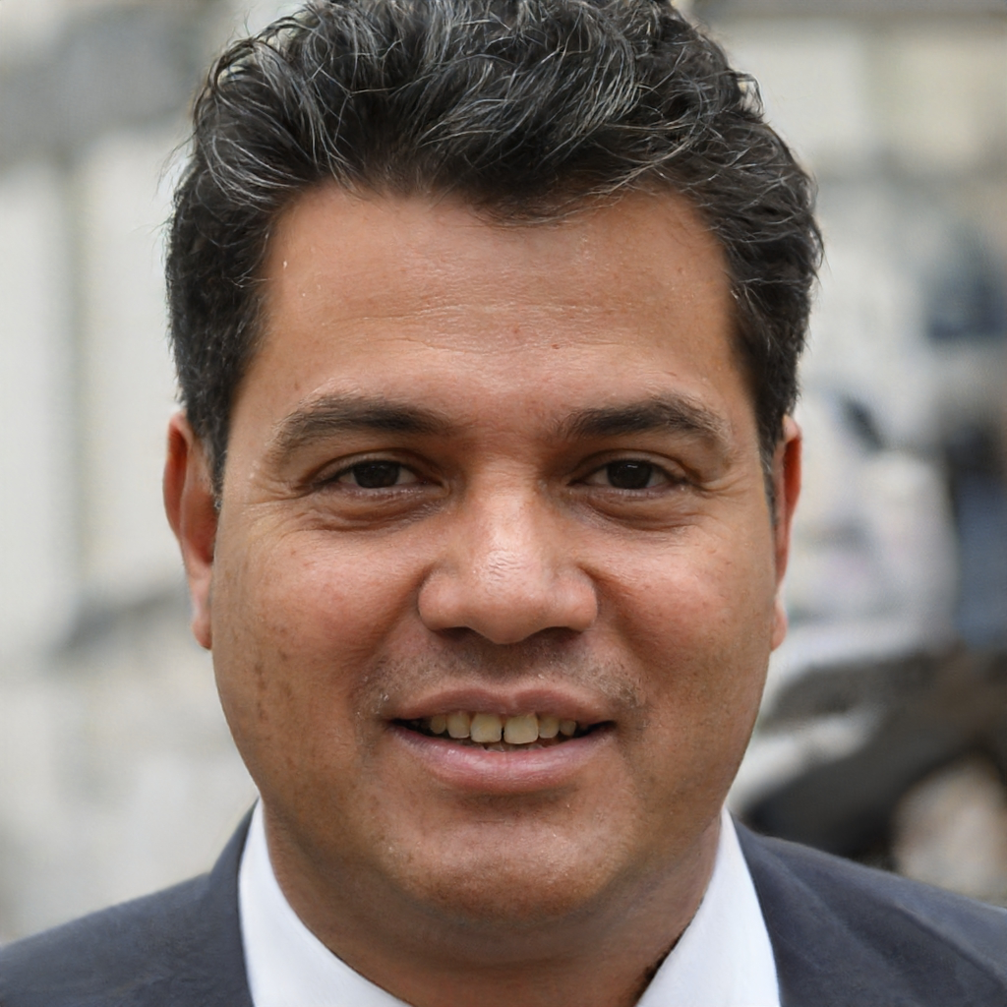
Today’s facilitators
To tint photos:
Format picture > Picture > Picture colour > recolour
Person name
Job title
Email
Mobile
Person name
Job title
Email
Mobile
Person name
Job title
Email
Mobile
Today’s facilitators
Notes:
*Notes for faculty – please add in your own images and contact details here*
This is a good point to properly introduce yourselves and explain your background and experience in QI and coaching improvement.

Slide 9
Programme aim
The aim of this eight week programme is to…
Support individuals to develop the skills and knowledge required to independently and confidently coach a team through improvement work.
Programme aim

Slide 10
Ten learning outcomes of the programme
By the end of the programme delegates will be able to independently:
Coach an improvement team ensuring robust application of QI methods and principles
Help teams to explore barriers and enablers relating to their QI work, in support of the sustainability of interventions
1
6
Understand the concepts of coaching improvement and the difference between coaching and advising
Advocate for meaningful involvement in QI work and advise teams on methods for involvement
2
7
Ten learning outcomes of the programme
Explain their role as a Quality Coach to different stakeholders
Coach a team to identify, collect and interpret data in support of their improvement work
3
8
Promote an environment that encourages team members to contribute equally to the development of improvement work
Apply creative problem-solving methods and behaviour change concepts to support teams to revive a stalled effort
4
9
Assimilate QI knowledge and facilitation skills that support teams to progress through the different stages of QI work
Critically analyse their own limitations and the limitations of coaching
5
10

Slide 11
Working with People
Quality Coach Development Programme
Notes:
Explain that this is the second of four modules of the coach programme.

Slide 12
Self-directed learning
1
2
3
Remove #3 if video was used in the session
Complete the Working Styles questionnaire. This will help us with an activity next time
Read the Pitfalls of Coaching section of the handbook
page 101
Read the Group Dynamics section of the handbook
page 133
Self-directed learning

Slide 13
Today’s learning outcomes
By the end of the session, you will…
Be able to promote an environment that encourages team members to contribute equally to the development of improvement work
Be able to assimilate QI knowledge and facilitation skills that support teams to progress through the different stages of QI work
Have an awareness of different working styles and how they may interact in a group
Understand the importance of psychological safety in improvement efforts
Be able to apply simple methods to promote psychological safety within groups.
Today’s learning outcomes
Notes:
Each session has its own learning outcomes. Today’s focus on working with people.
As delegates on the programme, we encourage you to reflect on the learning outcomes at the end of each session. Ask yourself: can I meet the outcomes shown on the screen without guidance from a member of the QI team? If not, then think about what you need to meet these learning outcomes.

Slide 14
Just-in-Time learning (JIT)
What
A targeted approach providing people with the information they need, when they need it.
Typically attributed to Toyota.
Why
Good to respond to demands.
Expect information to be readily available when we need it.
How
Bite-sized information or training that can be delivered on the spot so learners can absorb the information when they need it.
Just-in-Time learning
Source: Growth Engineering
Notes:
See activity 3.1 in Trainer Guide.
45 mins
Read slide
Just-in-Time approaches have their origins in the world of manufacturing. In fact, the origin is typically attributed to the car manufacturer Toyota, as they created a production system where parts arrive at their warehouse only when they are ready to be distributed.
Activity – we will be doing this next session.
Example – give an example of Just-in-Time learning used by Facilitator. E.g. when coaching a team, googling a PDSA and talking them through how it works, or finding a trusted video to play. Everyone will have ways that works best for them, and that’s fine!
Reference
Growth Engineering. Just-in-Time Learning: 8 steps to success. www.growthengineering.co.uk/what-is-just-in-time-learning/

Slide 15
Teachback – over to you!
Groups of three to five people
You have ten minutes to create a short teaching sessions on a given topic
Each group will present for three to five minutess plus two minutes of questions
Your target audience are beginners in QI
You can use slides but you don’t have to.
Today’s topics:
Teachback – next time
Run charts
PDSA cycles
SMART aims
Using Life QI – starting a project
Driver diagrams
Family of measures
Notes:
Change the topics for this slide, if you would like to.

Slide 16
Coffee break
Reminder
If you haven’t already, please complete the Working Styles questionnaire. We will be using this after the break.
Notes:
15 mins.

Slide 17
Project-based learning
Project-based learning
You will start coaching QI work very soon
Notes:
You will soon be meeting with the teams you will be coaching through this programme, and beyond. You will each have two pieces of improvement work to coach, to provide you with the opportunity to use different techniques and tools in practice. Your teams may be very different, often they are – and so this will also provide insight into the differences and similarities we see in all QI work.
This is part of the project-based learning aspect of the programme we mentioned in the welcome session. Arguably this is the most important part of the programme, as it gives you a chance to put learning and theory into practice.

Slide 18
Working styles
We all have different personalities, preferences, working styles
Teams should play to one another's strengths
As a coach you should use your knowledge about working styles to help teams throughout their project.
Working styles
Notes:
This is helpful because we all...
• Work differently when we are in groups
• Plan differently when we are with others
• Are motivated by different things
• Differ in willingness to take risks
• Make use of time differently
• Make decisions differently
• Manage tasks differently.

Slide 19
Working styles
A Analytical
Cautious actions and decisions
Likes organisation and structure
Dislikes involvement with others
Asks many questions about specific details
Prefers objective, task-oriented work environment
Wants to be accurate and therefore relies too much on data collection
Seeks security and self-actualization.
B Driver
Takes action and acts decisively
Likes control
Dislikes inaction
Prefers maximum freedom to manage self and others
Cool and independent, competitive with others
Low tolerance for feelings, attitudes and advice of others
Works quickly and efficiently by themselves.
Working styles
C Amiable
Slow at taking action and making decisions
Likes close, personal relationships
Dislikes interpersonal conflict
Supports and ’actively’ listens to others
Weak at goal setting and self-direction
Demonstrates excellent ability to gain support from others
Works slowly and cohesively with others
Seeks security and inclusion.
D Expressive
Spontaneous actions and decisions, risk taker
Not limited by tradition
Likes involvement
Generates new and innovative ideas
Tends to dream and get others caught up in the dream
Jumps from one activity to another
Works quickly and excitingly with others
Not good with follow-through.
Source: Bolton and Bolton (2009)
Notes:
You will by now have all completed the working styles worksheet and watched the video discussing it. This framework is really helpful when considering group dynamics – as we know not everyone thinks or behaves exactly like you.
Talk through key points of all four styles using the image.
Discussion
Ask: What are the pros of this?
Usefulness of working styles:
Know your own style (especially as a coach)
Interact more effectively with your team leader
Support your team leader in more effectively interacting with the team
Observe team dynamics and facilitate conversations amongst team members.
Ask: What are the cons?
Limitations of working styles:
Working styles are predictable patterns of behaviour that others can observe
We are all more complex than a single label and have all styles (and more!) within us
Every style has its strengths and weaknesses.
Reference
Bolton, R. and Bolton, D. G. (2009). People Styles at Work and Beyond: Making Bad Relationships Good and Good Relationships Better. Amacom.

Slide 20
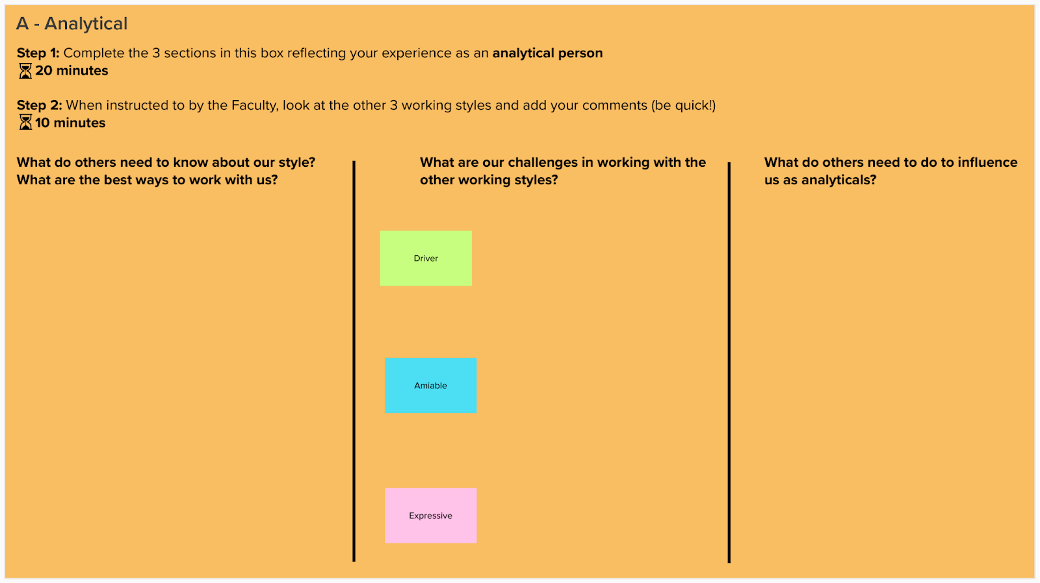
Working styles
Activity 3.2
Notes:
Activity 3.2
35 mins for activity, 10 mins for reflection and feedback
Breakout rooms (via Mural)
20 mins – four groups to work on a different style
10 mins – look at other group styles and discuss (five mins per style)
15 mins – all room chat.

Slide 21
Comfort break
Notes:
5 mins

Slide 22
Human side of change – why focus on it as a coach?
Change is wholly dependent on human behaviour
People approach change differently and therefore understanding the human side of change can help you as coaches to better understand this challenge
Change is not linear and therefore understanding barriers to change is a key role of a Quality Coach
It’s often overlooked by improvement teams – as they often only learn technical improvement skills and do not learn about human behaviour.
Human side of change – why focus on it as a coach?
Notes:
Agency = action or intervention producing a particular effect.

Slide 23
Human side of change
Methods
Team/Group dynamics
Tools
Culture & leadership
Measures
Behaviour & habits
Human side of change
Evidence
Power, relationships & trust
20% 80%
Technical
Adaptive
Adapted from Burhouse, A. and Bailey, S. (2019)
Notes:
Here we have a visual representation of the term often used that QI is 20% technical and 80% people
Technical change is defined as something that can be solved by the knowledge of experts. The problem, solution, and implementation are clear – we just need to get on with putting the solutions in place.
Adaptive change requires new learning. Solutions come from the collective intelligence of the employees at all levels. So, together they learn their way toward solutions.
It’s important to recognise that much of the effort in improvement work is about people and relationships and less on the tools and methods we use. When teams focus more on the technical change, they can often face resistance or apathy.
On the flip side – if we solely focus on the adaptive change (i.e. just relationships, people) you can overlook the technical aspects such as measures and evidence.
Ask the group their reflections on this image – does this feel right to you?
Reference:
Burhouse, A. and Bailey, S. (2019) From super-hero to super-connector, changing the ­leadership culture in the NHS. Future Healthcare Journal. https://www.ncbi.nlm.nih.gov/pmc/articles/PMC6616190/

Slide 24
What do we mean by QI
What barriers have you come up against in the past when trying to improve?
What do we mean by QI
Notes:
In-room discussion – 5 mins.

Slide 25
Adaptive barriers to change
Power struggles
Lack of buy-in
Few or no results early on
Need to adapt to different contexts
Too much change at once
Maintaining motivation
Competing demands on people’s time
Opposition within ourselves to change
Misaligned incentives
Fear of failure, rejection, job loss
Confusing strategies
Lack of leadership
One-way communication
Poor workforce planning
Stifling innovation
Playing it safe
Poor project management
Undervaluing people
Inhibiting environment
Extrinsic motivation only
Adaptive barriers to change
Source: Institute for Healthcare Improvement (2019)
Notes:
This list is from the IHI and outlines some of the common adaptive barriers to change. Do any stand out do you, if so why?
Reference: Institute for Healthcare Improvement (2019). Applying the Psychology of Change Framework to Quality Improvement. https://chronicdisease.org/resource/resmgr/website-2019/peertopeer2019/alex_anderson_ihi_psych_of_c.pdf

Slide 26
Common methods of engagement
Presentation
Managed discussion
Status update
Brainstorming
Open discussion
Common methods of engagement
Over-controlled
Under-controlled
Notes:
Conventional Structures are either too inhibiting (presentations, status reports and managed discussions) or too loose and disorganised (open discussions and brainstorms) to creatively engage people in shaping their own future.
How many of you see these every working day of your life? Have a group discussion about this.
Whilst these have a place… they aren’t always the most useful for QI or collaborative working.
Some can be too inhibiting – such as presentations, managed discussions or status updates. Communication is often a one-way direction of travel and even when conversations take place, they are ‘noted’ but may not go beyond that.
Some can be too loose or disorganised (such as the brainstorming and open discussion). They frequently generate feelings of frustration and/or exclusion and fail to provide space for good ideas to emerge and germinate. This means that huge amounts of time and money are spent working the wrong way. More time and money are then spent trying to fix the unintended consequences.
Importantly, they can sometimes inhibit a psychologically safe environment. We’ll explore this in more detail over the next few slides.

Slide 27
What is psychological safety?
Psychological safety
What is psychological safety?
The ability to share one's thoughts and feelings without risk of damaging one's reputation or standing
Notes:
Psychological safety is the ability to share one's thoughts and feelings without risk of damaging one's reputation or standing. In teams, it refers to team members believing that they can take risks without being shamed by other team members. In psychologically safe teams, team members feel accepted and respected.

Slide 28
QI needs a supportive context…
Psychological danger
Psychological safety
Fear of admitting mistakes
Comfort admitting mistakes
QI needs a supportive context…
Common Knowledge Effect
Blaming others
Better innovation and decision-making
Learning from failure
Less likely to share different views
Everyone openly shares ideas
Adapted from World Economic Forum (2016)
Notes:
If you can create an environment of psychological safety, where “team members feel safe to take risks and be vulnerable in front of each other”, it will underpin everything else needed for extraordinary performance, such as dependability, structure and clarity.
Organisations benefit from diversity of thought. Groups made up of people with different life experiences bring together many valuable perspectives. And diverse groups are better able to recognise problems and offer up creative solutions than groups of people with similar life experiences.
But what if some team members don’t feel comfortable speaking up? What if they’re afraid to share their concerns or resist asking challenging questions? What if they avoid suggesting innovative ideas because they’re worried about rejection? Unfortunately, many people feel this way.
When psychological safety is absent from the workplace, teams lose the individual knowledge and expertise each member brings to the table and begin to experience what is known as the Common Knowledge Effect. When this effect is at play, “teams tend to focus on shared information”, and as a result they have “trouble capitalizing on the diversity of knowledge and expertise in the team”. The very same knowledge and expertise those people were recruited for to begin with. This often leads to poor performance, poor decision-making and missed opportunities for innovation.
Talk through slide.
Reference:
World Economic Forum (2016). Is your team in 'psychological danger’? https://www.weforum.org/agenda/2016/04/team-psychological-danger-work-performance

Slide 29
So how do we foster psychological safety?
There is no silver bullet
Be honest about your own experiences – especially the failures, the challenges and when things haven’t worked as planned
Be honest about your own knowledge – especially where the gaps are and that you don’t have all the answers
Use Liberating Structures to create a different environment for better collaboration, discussion, reflection and learning. www.liberatingstructures.com
So how do we foster psychological safety?
Notes:
Reference:
Liberating Structures. https://www.liberatingstructures.com/

Slide 30
What are Liberating Structures?
Liberating Structures are a repertoire of 33+ simple techniques for facilitating meetings, workshops and conversations that change how people interact with each other.
They aim to include the whole group thereby making the group more effective.
They distribute leadership and wisdom.
www.liberatingstructures.com
What are Liberating Structures?
Notes:
What they are about – getting groups to think differently.
They can power up your improvement meetings, team meetings and workshops.
What sets them apart from many other tools is they steer clear of the ‘heroic’ facilitator and manage to be seriously fun.
Compared to the usual – often boring and unproductive – menu of powerpoints, status reports and brainstorms Liberating Structures really engage everyone, give people space to be heard and be creative.
Reference:
Liberating Structures. https://www.liberatingstructures.com/

Slide 31
LS Menu | Wicked questions | What³ debrief | Min specs | Heard, seen respected | What I need from you | Integrated autonomy
Design elements | Appreciative interviews | Discovery and action dialog | Improv prototyping | Drawing together | Open space | Critical uncertainties
1–2–4–All | TRIZ | Shift & share | Helping heuristics | Design storyboards | Generative relationships | Ecocycle
Impromptu networking | 15% solutions | 25 : 10 crowdsourcing | Conversation café | Celebrity interview | Agree/certainty matrix | Panarchy
9-whys | Troika consulting | Wise crowds | User experience fishbowl | Social network webbing | Single ethnography | Purpose to practice
Liberating Structures
Notes:
There is a website that houses all of the useful information on each Liberating Structure: https://www.LiberatingStructures.com/
In practice you may use around one to five as a coach, dependent on what works for you and what you like.
The website explains the Liberating Structures and provides templates, sessions Structures etc. There is also an app, which can be handy to have.

Slide 32
Why use Liberating Structures?
Change how people interact with each other
Aim to include the whole group
Make the group more effective
Reduce one person occupying the whole space and everyone else being quiet
Keep everyone actively engaged in the task you’re working on
Distribute wisdom
Distribute leadership
Why use Liberating Structures?

Slide 33
Liberating Structures principles
Include and unleash everyone | Practise deep respect for people and local solutions | Build trust as you go | Learn by failing forwards | Practise self-discovery in a group
Amplify freedom and responsibility | Emphasise possibilities: believe before you see | Invite creative destruction to enable innovation | Engage in playful curiosity | Never start without a clear purpose
Liberating Structures principles
Notes:
After lunch you will experience a Liberating Structure.

Slide 34
Lunch break
Notes:
45 mins

Slide 35

Mad tea
Activity 3.3
liberatingstructures.com/mad-tea/
Notes:
We will look at a few Liberating Structures in a bit more detail – some you may use quite often with teams. This one is called ‘mad tea’. This is a Liberating Structure that is still in development so it isn’t shown in the 33 main ones – but will be on there shortly. They are testing new ideas for Liberating Structures all the time.
See activity 3.3 in the Trainer Guide.
10 mins for all slides on mad tea.
Reference:
liberatingstructures.com/mad-tea/

Slide 36
Mad tea etiquette
You're going to be given a sentence
Finish each sentence with one short phrase
Don’t overthink – it's quick fire
Stay curious, dig deep
There are no right or wrongs
Write your answer in the chat but wait for the signal to post your answer.
Mad tea

Slide 37
Mad tea
What first inspired me about being a Quality Coach is…
Mad tea

Slide 38
Mad tea
My struggle with being a Quality Coach is...
Mad tea

Slide 39
Mad tea
What we must not ignore or neglect is...
Mad tea

Slide 40
Mad tea
A bold idea I recommend for us Quality Coaches is...
Mad tea

Slide 41
Mad tea
A big opportunity I see for us is...
Mad tea

Slide 42
Mad tea
If we do nothing, the worst that can happen for us is...
Mad tea

Slide 43
Mad tea
What I hope for my role as a Quality Coach is...
Mad tea

Slide 44
Mad tea – Debrief
Session 3 Working with People
Mad tea – Debrief
For more: LiberatingStructures.com/mad-tea/
Notes:
What did it enable? When could we use it?

Slide 45
Join the Q Community
A connected community working together to improve health and care quality across the UK.
https://q.health.org.uk/join-q/
Q Community
Notes:
Connect, share and learn with people from different disciplines and sectors, from across the UK and Ireland to help create real change
Join a diverse community that brings together those from the frontline of health and social care, patient leaders, managers, researchers, commissioners and policy makers and others
Tap into all that Q offers as a source of innovation and practical problem solving – benefits include journals and learning resources, Q visits and inspiring events scheduled throughout the year
Get involved in other activities including special interest groups, Q Lab and Randomised Coffee Trials with others in the community
Let Q grow with you as your career progresses – participate in ways that fit with your life and improvement priorities
Develop your improvement skills and help lead and develop others beyond Q
Free – no membership fee. Gain access to funding opportunities.

Slide 46
LS Menu | Wicked questions | What, So What, Now What? | Min specs | Heard, seen respected | What I need from you | Integrated autonomy
Design elements | Appreciative interviews | Discovery and action dialogue | Improv prototyping | Drawing together | Open space | Critical uncertainties
1–2–4–All | TRIZ | Shift and share | Helping heuristics | Design storyboards | Generative relationships | Ecocycle
Impromptu networking | 15% solutions | 25 : 10 crowdsourcing | Conversation café | Celebrity interview | Agreement- certainty matrix | Panarchy
9-whys | Troika consulting | Wise crowds | User experience fishbowl | Social network webbing | Single ethnography | Purpose to practice
Liberating Structures
Notes:
We’re going to have a go at using some other Liberating Structures.
In this example, we will combine two together (which happens often).

Slide 47
TRIZ
Stop counter-productive activities and behaviours to make space for innovation by inviting creative destruction
TRIZ
Notes:
Bear with me here… this is an unusual one.
TRIZ makes it possible to challenge ‘the way things are done around here’. We do that by asking ourselves what we must STOP doing to make progress on our purpose.

Slide 48
TRIZ
Already doing
Worst result
Stop!
TRIZ
Notes:
How to do TRIZ
1. Start with a goal, strategy or objective (let’s say our top goal is to be the best community trust to work for in England)
2. Make a list of all you can do to make sure that you achieve the worst result imaginable with respect to your top strategy or objective (worst result would be that we are the worst community trust to work for in England e.g. we have a culture of bullying, no formal supervision for staff, no flexible working and no rest areas for staff)
3. Go down the list item by item and ask “Is there anything that we are currently doing that in any way, shape, or form resembles this item?" Be brutally honest to make a list of all your counterproductive activities/programmes/procedures (we might say “Actually, are we offering flexible working to everyone in the trust? Is there a way our staff in bedded units can enjoy more flexible working?”)
4. Go through the items on your second list and decide what first steps will help you stop what you know creates undesirable results.

Slide 49
Our priority
For 80% of improvement projects to have service user and/or carer involvement
Our priority
Notes:
See activity 3.4 in the Trainer Guide.
45 mins for activity, 10 mins for reflection. Next slides explain the activity.

Slide 50
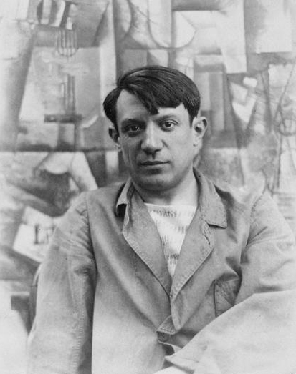
“Every act of creation is first an act of destruction.”
Pablo Picasso
Public domain / Wikimedia Commons

Slide 51
New TRIZ priority
For no improvement projects to have service user and/or carer involvement
Our priority
Notes:
We’ve changed it from 80% to zero.

Slide 52
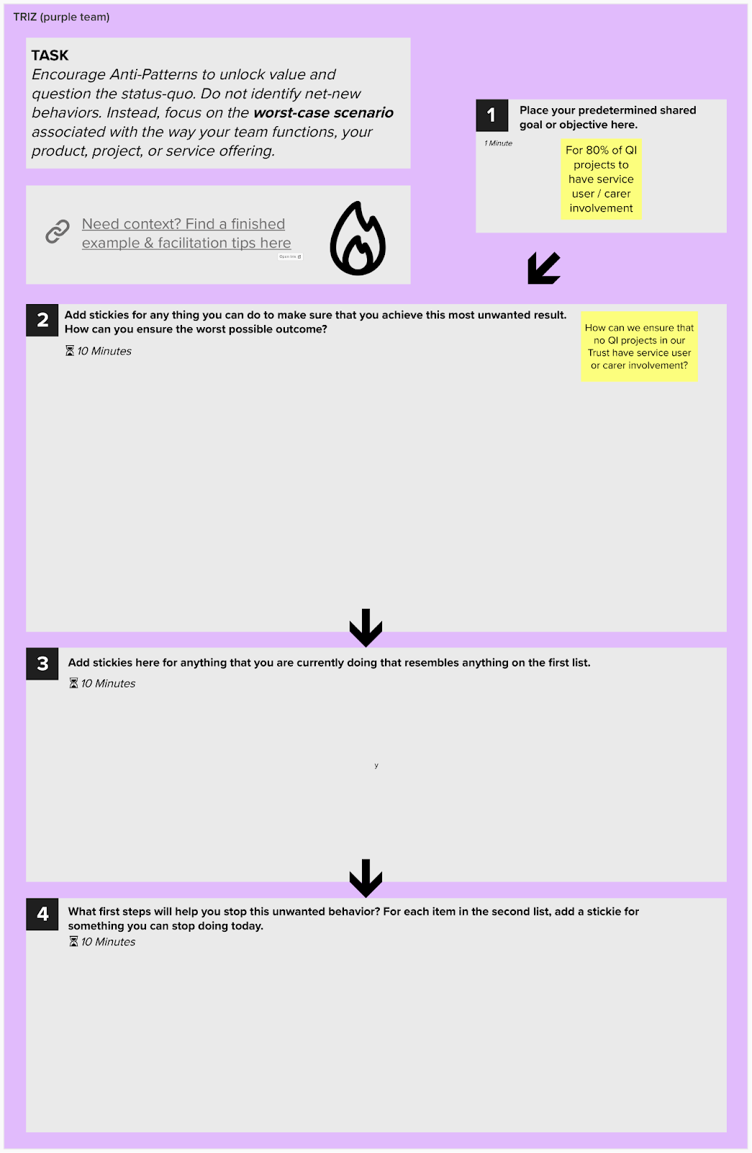
TRIZ is about stopping counterproductive activities and behaviours
Focus
For no improvement work to have service user and/or carer involvement
10 minutes for each box
Activity 3.4
Notes:
See activity 3.4 in the Trainer Guide.
45 mins for activity, 10 mins for reflection.

Slide 53
15% solutions to take forward your TRIZ
15% solutions
Notes:
TRIZ has helped you to consider WHAT to stop in order to improve. However, finishing with a list of things you do that contribute to a problem isn't always helpful – particularly if the list is long.
In the activity we combined TRIZ with a second Liberating Structure, known as 15% solutions. This tool helps you think more about HOW you will improve.

Slide 54
15% solutions
“Even a 100-mile journey starts with a single step”
Any first step or solution that you can do without approval or resources from others and that is entirely within your discretion to act
You might use it:
Closing for meetings
Working with conflict
15% solutions
Notes:
“Even a 100-mile journey starts with a single step”
Any first step or solution that you can do without approval or resources from others and that is entirely within your discretion to act. More succinctly put, it is something that you can start right now if you want to.
Thinking of it like changing the flow of the river by moving a few rocks.
As a simple, short structure, 15% solutions can be used virtually anywhere.
You might use it:
closing for meetings with multiple people to create space for people to identify how they want to contribute and to give and get help
after a team conflict or other incident. You might feel overwhelmed about how to proceed, 15% Solutions helps you focus on setting the first small step in the desired direction.

Slide 55
Conversation café
Engage everyone in making sense of profound challenges
Open space
Liberate inherent action and leadership in large groups
Simple ethnography
Observe and record actual behaviour of users in the field
Impromptu networking
Rapidly share challenges and expectations, building new connections
Min specs
Specify only the absolute ‘must do’s’ and ‘must not do’s’ for achieving a purpose
Discovery and action dialogue
Discover, spark & unleash local solutions to chronic problems
9 Whys
Make the purpose of your work together clear
Wise crowds
Tap the wisdom of whole group in rapid cycles
Integrated autonomy
Move from either-or to robust both-and solutions
Liberating Structures
What, So What, Now What?
Together, look back on progress to-date and decide what adjustments are needed
Wicked questions
Articulate the paradoxical challenges that a group must confront to succeed
Generative relationships
Reveal relationship patterns that create surprising value or dysfunctions
TRIZ
Stop counterproductive activities and behaviours to make space for innovation
Drawing together
Reveal insights & paths forward through non-verbal expression
Critical uncertainties
Develop strategies for operating in a range of plausible yet unpredictable futures
Appreciative interviews
Discover and build on the root causes of success
Improv prototyping
Develop effective solutions to chronic challenges while having serious fun
Purpose to practice
Define the five elements that are essential for a resilient & enduring initiative
1–2–4–All
Engage everyone simultaneously in generating questions/ideas/suggestions
Agreement-certainty matrix
Sort challenges into simple, complicated, complex and chaotic domains
Ecocycle planning
Analyse the full portfolio of activities and relationships to identify obstacles and opportunities for progress
User experience fishbowl
Share know-how gained from experience with a larger community
Shift and share
Spread good ideas and make informal connections with innovators
Panarchy
Understand how embedded systems interact, evolve, spread innovation, and transform
15% solutions
Discover and focus on what each person has the freedom and resources to do now
Heard, seen, respected
Practice deeper listening and empathy with colleagues
What I need from you
Surface essential needs across functions and accept or reject requests for support
25 : 10 crowdsourcing
Rapidly generate and sift a group’s most powerful actionable ideas
Social network webbing
Map informal connections and decide how to strengthen the network to achieve a purpose
Celebrity interview
Reconnect the experience of leaders and experts with people closest to the challenges at hand
Troika consulting
Get practical and imaginative help from colleagues immediately
Design storyboards
Define step-by-step elements for bringing projects to productive endpoints
Helping heuristics
Practice progressive methods for helping others, receiving help, and asking for help
Notes:
If this has sparked your interest in Liberating Structures then you can go to the website for more details.
Reference:
Liberating Structures: https://www.liberatingstructures.com/

Slide 56
Conversation café
Engage everyone in making sense of profound challenges
Open space
Liberate inherent action and leadership in large groups
Simple ethnography
Observe and record actual behaviour of users in the field
Impromptu networking
Rapidly share challenges and expectations, building new connections
Min specs
Specify only the absolute ‘must do’s’ and ‘must not do’s’ for achieving a purpose
Discovery and action dialogue
Discover, spark & unleash local solutions to chronic problems
9 Whys
Make the purpose of your work together clear
Wise crowds
Tap the wisdom of whole group in rapid cycles
Integrated autonomy
Move from either-or to robust both-and solutions
What, So What, Now What?
Together, look back on progress to-date and decide what adjustments are needed
Wicked questions
Articulate the paradoxical challenges that a group must confront to succeed
Generative relationships
Reveal relationship patterns that create surprising value or dysfunctions
TRIZ
Stop counterproductive activities and behaviours to make space for innovation
Drawing together
Reveal insights & paths forward through non-verbal expression
Critical uncertainties
Develop strategies for operating in a range of plausible yet unpredictable futures
Appreciative interviews
Discover and build on the root causes of success
Improv prototyping
Develop effective solutions to chronic challenges while having serious fun
Purpose to practice
Define the five elements that are essential for a resilient & enduring initiative
1–2–4–All
Engage everyone simultaneously in generating questions/ideas/suggestions
Agreement-certainty matrix
Sort challenges into simple, complicated, complex and chaotic domains
Ecocycle planning
Analyse the full portfolio of activities and relationships to identify obstacles and opportunities for progress
User experience fishbowl
Share know-how gained from experience with a larger community
Shift and share
Spread good ideas and make informal connections with innovators
Panarchy
Understand how embedded systems interact, evolve, spread innovation, and transform
15% solutions
Discover and focus on what each person has the freedom and resources to do now
Heard, seen, respected
Practice deeper listening and empathy with colleagues
What I need from you
Surface essential needs across functions and accept or reject requests for support
Liberating Structures
25 : 10 crowdsourcing
Rapidly generate and sift a group’s most powerful actionable ideas
Social network webbing
Map informal connections and decide how to strengthen the network to achieve a purpose
Celebrity interview
Reconnect the experience of leaders and experts with people closest to the challenges at hand
Troika consulting
Get practical and imaginative help from colleagues immediately
Design storyboards
Define step-by-step elements for bringing projects to productive endpoints
Helping heuristics
Practice progressive methods for helping others, receiving help, and asking for help
Notes:
If this has sparked your interest in Liberating Structures then you can go to the website for more details.
Reference:
Liberating Structures: https://www.liberatingstructures.com/

Slide 57
Creating strings
15% solutions
Discover and focus on what each person has the freedom and resources to do now
Impromptu networking
Rapidly share challenges and expectations, building new connections
1–2–4–All
Engage everyone simultaneously in generating questions/ideas/suggestions
Creating strings
TRIZ
Stop counterproductive activities and behaviours to make space for innovation
Notes:
Explain Liberating Structures are often used in a string and give an example of a simple string they may have experienced e.g. 1:2:4:all into TRIZ.
We created a small string using TRIZ and 15% solutions.

Slide 58
Matching Matrix
Microstructure | Discovering everyday solutions | Noticing patterns together | Unleashing local action | Drawing out prototypes | Spreading innovation
1–2–4–All | ⬤ | ⬤ | ⬤ | ⬤
Impromptu networking | ⬤ | ⬤
Nine Whys | ⬤ | ⬤ |  | ⬤ | ⬤
Wicked questions | ⬤ |  |  | ⬤
Appreciative interview | ⬤ | ⬤ | ⬤ | ⬤
TRIZ | ⬤ | ⬤ | ⬤ |  | ⬤
15% solutions | ⬤ | ⬤ | ⬤ | ⬤ | ⬤
Troika consulting | ⬤ |  | ⬤ | ⬤
What, So What, Now What? | ⬤ | ⬤ | ⬤ | ⬤
DAD dialogue | ⬤ | ⬤ | ⬤ | ⬤ | ⬤
25 : 10 crowdsourcing | ⬤ | ⬤ | ⬤ | ⬤
Shift and share | ⬤ | ⬤ |  | ⬤ | ⬤
Wise crowds | ⬤ | ⬤ |  | ⬤ | ⬤
Conversation café | ⬤ | ⬤
Min specs | ⬤ | ⬤ |  | ⬤ | ⬤
Improv prototyping | ⬤ | ⬤ | ⬤ | ⬤ | ⬤
Helping heuristics | ⬤ | ⬤
User experience fishbowl | ⬤ | ⬤ | ⬤ | ⬤ | ⬤
Heard, seen, respected | ⬤ | ⬤
Draw together | ⬤ | ⬤ |  | ⬤
Design storyboards | ⬤ |  |  | ⬤ | ⬤
Celebrity interview | ⬤ | ⬤ |  |  | ⬤
Social network webbing |  | ⬤ | ⬤ |  | ⬤
What I need from you | ⬤ | ⬤ | ⬤
Open space |  | ⬤ | ⬤ | ⬤ | ⬤
Generative relationships |  | ⬤ | ⬤
Agreement–certainty matrix |  | ⬤
Simple ethnography |  | ⬤ |  | ⬤ | ⬤
Integrated autonomy |  |  | ⬤ |  | ⬤
Critical uncertainties |  | ⬤ | ⬤
Ecocycle planning |  | ⬤ | ⬤ |  | ⬤
Panarchy |  | ⬤ | ⬤ |  | ⬤
Purpose-to-practice |  | ⬤ |  |  | ⬤
Matching Matrix
liberatingstructures.com/matching-matrix/
Notes:
This simple matrix indicates which tools you can use for a given situation. E.g. discovering everyday solutions – you can use TRIZ or Draw Together.

Slide 59
Learning from my mistakes
Keep it simple while you’re learning!
Practise in a ‘safe space’
Be clear in your instructions
Always have a clear shared purpose
Learning from my mistakes

Slide 60
Coffee break
Notes:
15 mins

Slide 61
What is an Appreciative Inquiry?
Another useful method for promoting psychological safety
Approach to sustainable change
Focusses on what is already working and how we can build on that to make improvements
“Asset based model, embracing strengths by illuminating existing positive staff practices and qualities”
— IHI
Appreciative Inquiry
Source: Cooperrider (1985).
Notes:
Developed in 1986 by Cooperrider.
Instead of asking what is the problem – ask what works well and how can we do more of that.
References: Scottish Social Services Council. Appreciative Inquiry resource pack. https://lms.learn.sssc.uk.com/course/view.php?id=14#section-0
Institute for Healthcare Improvement (2018). E25 – Learning from Appreciative Inquiry: What Differentiates Leading Organizations? https://www.ihi.org/resources/Pages/AudioandVideo/2018-IHI-National-Forum-Keynotes-and-Spotlight-Sessions.aspx

Slide 62
Improvement: A focus on the problem
Model for Improvement
Define the problem
What are we trying to accomplish?
How will we know that a change is an improvement?
How will we know that a change is an improvement?
Improvement: A focus on the problem
Understand what’s going wrong in order to be able to make any changes.
Act
Plan
Study
Do
Source: Langley et al (2009).
Notes:
This is often how we approach QI using the Model for Improvement. There is a problem that we need to fix. We diagnose the problem in order to better understand it and then put interventions in place aligned to that.
Reference:
Langley, G. J., Moen, R. D., Nolan, K. M., Nolan, T. W., Norman, C. L. and Provost, L. P. (2009). The Improvement Guide: A Practical Approach to Enhancing Organizational Performance.
Jossey-Bass Publishers.

Slide 63
Improvement: Appreciative approach
Model for Improvement
What is the best thing about this?
What has previously gone well here?
What are we trying to accomplish?
How will we know that a change is an improvement?
How will we know that a change is an improvement?
Improvement: Appreciative approach
How can we build on the success?
How can we build on that learning?
Sustainability
Act
Plan
Study
Do
Source: Langley et al (2009).
Notes:
When you frame a question neutrally e.g. how was your day today? You often get back a neutral (it was okay) or a negative response highlighting something that went wrong or wasn’t good (it was rubbish or boring).
If you frame the same topic with an appreciative approach e.g. what was the best part of your day today? Then you will get a more positive response as it often incites emotion and people are more likely to give you a genuine and engaging response.
When using this positive lens, we can see that the Model for Improvement offers us opportunities to build on the good and spend less time using a deficit based approach.
Reference:
Langley, G. J., Moen, R. D., Nolan, K. M., Nolan, T. W., Norman, C. L. and Provost, L. P. (2009). The Improvement Guide: A Practical Approach to Enhancing Organizational Performance.
Jossey-Bass Publishers

Slide 64
Appreciative inquiry vs deficit-based problem solving
Appreciative inquiry | Deficit-based problem solving
Begins with recognising success | Begins with critique or failure
Looking at what works wel (as a frontline service provider) | Diagnosis of the problem (from detached viewpoint)
Focuses on organisations’ performance at the very best | Focuses on the cause of a problem
Aims to move towards the very best | Aims to reduce problems
Encourages openness | Encourages defensive behaviour
Assumes organisations are sources of creativity and innovation | Assumes organisations (and people) are sets of problems to be overcome
Appreciative inquiry
Notes:
Here is a table comparing the appreciative approach vs the deficit-based problem solving.
Does this resonate with you?

Slide 65
5D Model
Definition
What will we focus on?
1
Discover
Appreciating the best of what is
2
5D Model
Dream
Imagining what could be
3
Design
Determining what should be
4
Delivery
Creating what will be (actions)
5
Notes:
One approach to undertaking an appreciative inquiry is to use the 5D model – from Cooperrider et al.
5D Model
1. Define
It is important to define the focus of the inquiry – what the system wants more of.
Define clarifies the purpose, content and what needs to be achieved. Teams should ask themselves “what topic do we want to focus on?”
2. Discovery
Appreciate the best of what is
Discovery is based on open and honest dialogue, where all members of the team discuss the things that work well and the organisation at its best.
3. Dream
Envisioning uses past achievements and successes identified in the discovery phase to imagine new possibilities and envisage a preferred future.
4. Design
Design brings together the stories from discovery with the imagination and creativity from dream
We call it bringing the ‘best of what is’ together with ‘what might be’, to create ‘what should be – the ideal’.
5. Delivery
Creating ‘what will be’ – the fifth stage in the 5Ds process identifies how the design is delivered, and how it’s embedded into groups, communities and organisations.

Slide 66
5D Model
1 Definition
‘What is the focus of inquiry?’ Affirmative topic of choice
Clarifying
2 Discovery
‘What gives life?’ Affirmative topic of choice
Appreciating
5D Model
5 Delivery
‘What will be?’ How to empower, learn, adjust and improvise
Innnovating
3 Dream
'What might be?’ What the world is calling for
Envisioning
Positive Core
4 Design
‘What should be?’ The ideal
Co-constructing
Notes:
Surrounding the positive core – you will clarify, appreciate, envision, co-construct and innovate.

Slide 67
Appreciative Inquiry activity
1 Definition
We’re picking for you: Money management
2 Discovery
Appreciative Inquiry activity
5 Delivery
3 Dream
4 Design
Notes:
See activity 3.5 in the Trainer Guide.
30 mins
You will guide the group collectively through an appreciative inquiry, focusing on the topic of money management (budgeting). You will use the 5D model to facilitate the activity.
Stage 1 Define has already been decided (the topic is money management)
Stage 2 Discover: you should spend 5–10 minutes as a group discussing the things that are already working well re money management. Document the discussion using a template
Stage 3 Dream: spend 5–10 minutes on this stage
Stage 4 Design: spend 5–10 minutes on this stage
Stage 5 Delivery: you may wish to combine 15% solutions into this – ask each individual to consider what small step they can take towards achieving.

Slide 68
Summary
Positive focus to starting a change
Focuses on the best of something, instead of taking a deficit-based approach
A powerful method for quality improvement that is underutilised
5D model can help you structure/facilitate conversations.
Summary
Notes:
There is research evidence to show when you use appreciative inquiry – it brings about positive change.

Slide 69
We need your feedback
Feedback
Notes:
Use your evaluation forms to gather feedback on the day.

Slide 70
Today’s learning outcomes
By the end of the session, you will…
Be able to promote an environment that encourages team members to contribute equally to the development of improvement work
Be able to assimilate QI knowledge and facilitation skills that support teams to progress through the different stages of QI work
Have an awareness of different working styles and how they may interact in a group
Understand the importance of psychological safety in improvement efforts
Be able to apply simple methods to promote psychological safety within groups.
Today’s learning outcomes
Notes:
Each session has its own learning outcomes. Today’s focus is on working with people.
As delegates on the programme, we encourage you to reflect on the learning outcomes at the end of each session. Ask yourself: can I meet the outcomes shown on the screen without guidance from a member of the QI team? If not, then think about what you need to meet these learning outcomes.

Slide 71
All teach, all learn
Prepare a 15 minute presentation for session 5 [date]
Five mins of Q&A after each presentation
Everyone will need to present
You should pick a simple technical concept to teach back to your peers. Examples include:
Fishbone diagrams, process mapping, using charts LIFE QI, pareto charts, funnel plots, creating bar charts on Excel, stakeholder mapping, Big I and Little I, stages of a QI project, nominal group technique, a Liberating structure…
You will present to one another in smaller groups in the afternoon.
Teachback – next time
Notes:
You should decide how participants will select a topic – it is important to avoid duplication.

Slide 72
Self-directed learning
1
2
Read the stakeholder management section of the handbook
page 25
Prepare for the all teach, all learn session
Self-directed learning

Slide 73
References and links
Growth Engineering. Just-in-Time Learning: 8 steps to success.
www.growthengineering.co.uk/what-is-just-in-time-learning/
Bolton, R. and Bolton, D. G. (2009). People Styles at Work and Beyond: Making Bad Relationships Good and Good Relationships Better. Amacom.
Burhouse, A. and Bailey, S. (2019) From super-hero to super-connector, changing the leadership culture in the NHS. Future Healthcare Journal.
Institute for Healthcare Improvement (2019). Applying the Psychology of Change Framework to Quality Improvement. https://chronicdisease.org/resource/resmgr/website-2019/peertopeer2019/alex_anderson_ihi_psych_of_c.pdf
World Economic Forum (2016). Is your team in 'psychological danger’?
https://www.weforum.org/agenda/2016/04/team-psychological-danger-work-performance
Liberating Structures:
https://www.liberatingstructures.com/
Q Community:
https://q.health.org.uk/join-q/
Scottish Social Services Council. Appreciative Inquiry resource pack.
https://lms.learn.sssc.uk.com/course/view.php?id=14#section-0
Institute for Healthcare Improvement (2018). E25 – Learning from Appreciative Inquiry: What Differentiates Leading Organizations?
https://www.ihi.org/resources/Pages/AudioandVideo/2018-IHI-National-Forum-Keynotes-and-Spotlight-Sessions.aspx
Langley, G. J., Moen, R. D., Nolan, K. M., Nolan, T. W., Norman, C. L. and Provost, L. P. (2009). The Improvement Guide: A Practical Approach to Enhancing Organizational Performance. Jossey-Bass Publishers.
References and links

Slide 74
Authors
Bridget Browne Sidney Beech Lucinda Hollinshead Hannah Pearson
Contributors
Jennifer Cotter
Slide design and layout by Studio Quercus

Slide 75
Authors
Bridget Browne Sidney Beech Lucinda Hollinshead Hannah Pearson
Contributors
Jennifer Cotter
Slide design and layout by Studio Quercus

