Slide 2
Coaching and the Foundations of QI
Session 2
Quality Coach Development Programme

Slide 3
Funding Acknowledgement
The Quality Coach Development Programme was partially funded through Q Exchange by the Health Foundation and NHS England and NHS Improvement
For additional information contact
clcht.continuous.improvement@nhs.net or the Q Community
This slide deck and all associated materials of the Quality Coach Development Programme are available under the Creative Commons Attribution-ShareAlike Licence 4.0
This licence permits others to remix, adapt, and build upon this piece of work even for commercial purposes, as long as you credit us and license any and all new creations under the identical terms. (CC-BY-SA)
Notes:
All materials associated with this programme are copyrighted. CC-BY-SA allows anyone to use this slide deck for free, as long as the authors and contributors are credited.
You should not add your own logos to these materials without the express permission of all authors, as this would be a direct infringement on the copyright. We want to ensure all materials associated with this programme remain free-to-access for everyone.
The legal code for CC-BY-SA can be found here: https://creativecommons.org/licenses/by-sa/4.0/legalcode

Slide 4
Coaching and the Foundations of QI
Session 2
Cohort A
Notes:
Hello faculty of the Quality Coach Development Programme.
Welcome to Session 2 of the Quality Coach Development Programme. Please refer to the Trainer Guide for more detailed information on the day, including activity templates for the breakout rooms.
In advance of delivering this day you should work through the slides with any co-presenters and tailor the content to suit your local context. This may include swapping slides out for your own slides, adding different visuals, changing icebreakers or adapting activities to suit the target audience.
Notes in bold are instructions for the faculty. Notes in regular text are notes for delegates, and can be read out during the session or adapted as required.
The working styles questionnaire is included in the QCDP resource pack (available at https://q.health.org.uk/resource/quality-coach-development-programme/)
Please do not delete large sections of content – if significant changes are made to the content then it may no longer meet the learning outcomes. See further explanation in the Programme Leader Guide.
All content is copyrighted by the authors. Please do not remove the © mark from any materials and ensure content is correctly attributed. We have made all materials available for free to the public and just ask that you attribute the content fairly.

Slide 5
Making the most of our virtual environment
We are happy to take questions – raise your hand at any point or ask in your breakout room sessions
When you see this symbol, we recommend you take a photo or screenshot of the task for the breakout room
Indicates page in handbook
Feel free to use the chat box during the session
Making the most of our virtual environment
Indicates activity
We will be using breakout rooms a lot
Top tip: don’t touch anything when you are being moved to rooms
Indicates an independent task for you to complete later
Notes:
You should edit this slide if delivering the content in person. You will only need the icons shown in the right hand box. However you may still wish to explain that you encourage people to ask questions or chat in the breaks, and that the session includes many activities.
If you are using an online whiteboard, ask delegates to open your preferred internet browser. If you are using Mural, we find it works best with Google Chrome.

Slide 6
Housekeeping
Housekeeping
Notes:
Suggested housekeeping – adapt to suit your environment
Technology
Where possible, please turn off emails, websites, mute phones
Mute yourself when you’re not speaking
Use emojis and reactions
Keep cameras on
Movement
Stretch if you need to, move around as desired
Feel free to fidget and doodle
Excuse yourself when you need to (sign off and re-sign on)
Fun
Have fun
Lean in with curiosity

Slide 7
Agenda for today
9.00
Introduction and getting to know one another
Grow coaching practice
Coffee break
Reflection on coaching
Contracting as a coach
Facilitation top tips
Lunch
Coaching circle
Coffee break
Coaching an aim
Comfort break
Coaching the QI process
Close
9.15
10.25
10.35
10.45
Agenda for today
11.30
12.00
12.45
2.10
2.20
2.55
3.00
4.20

Slide 8


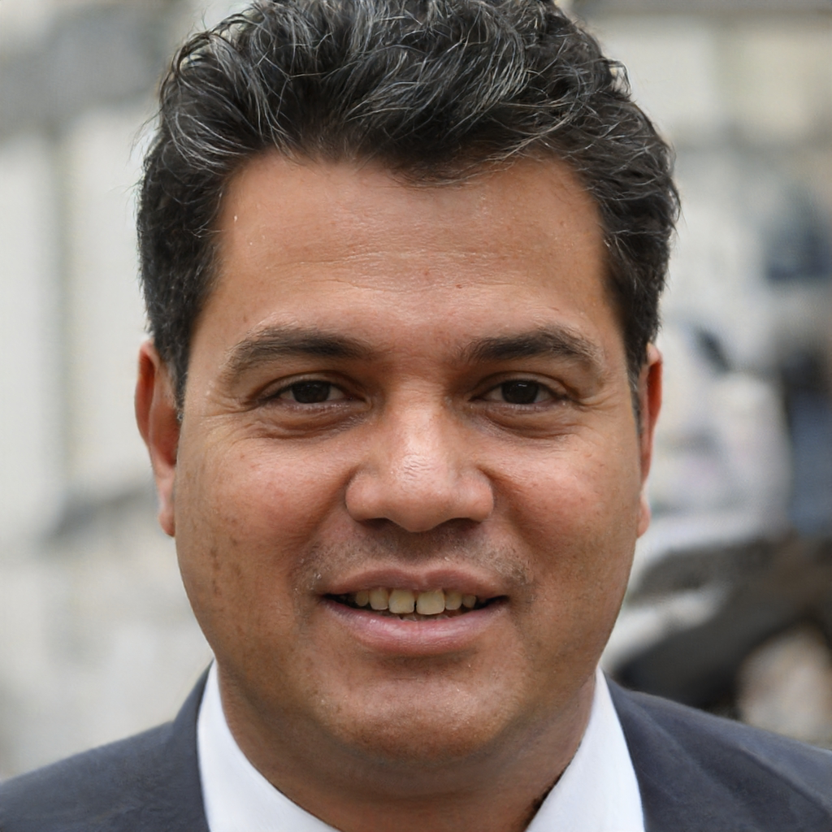
Today’s facilitators
To tint photos:
Format picture > Picture > Picture colour > recolour
Person name
Job title
Email
Mobile
Person name
Job title
Email
Mobile
Person name
Job title
Email
Mobile
Today’s facilitators
Notes:
*Notes for faculty – please add in your own images and contact details here*
This is a good point to properly introduce yourselves and explain your background and experience in QI and coaching improvement.

Slide 9
Programme aim
The aim of this eight week programme is to…
Support individuals to develop the skills and knowledge required to independently and confidently coach a team through improvement work.
Programme aim

Slide 10
Ten learning outcomes of the programme
By the end of the programme delegates will be able to independently:
Coach an improvement team ensuring robust application of QI methods and principles
Help teams to explore barriers and enablers relating to their QI work, in support of the sustainability of interventions
1
6
Understand the concepts of coaching improvement and the difference between coaching and advising
Advocate for meaningful involvement in QI work and advise teams on methods for involvement
2
7
Ten learning outcomes of the programme
Explain their role as a Quality Coach to different stakeholders
Coach a team to identify, collect and interpret data in support of their improvement work
3
8
Promote an environment that encourages team members to contribute equally to the development of improvement work
Apply creative problem-solving methods and behaviour change concepts to support teams to revive a stalled effort
4
9
Assimilate QI knowledge and facilitation skills that support teams to progress through the different stages of QI work
Critically analyse their own limitations and the limitations of coaching
5
10

Slide 11
Coaching and the Foundations of QI
Quality Coach Development Programme
Notes:
Explain that this is the first of four modules of the coach programme.

Slide 12
Self-directed learning
1
2
3
Remove #3 if video was used in the session
Meet with your buddy and reflect on today, using a coaching approach:
What is your key learning from today?
What do you need to focus on/develop?
What opportunities are there for you to practise?
Read the BMJ article and discuss any questions or thoughts with your mentor
www.bmj.com/content/368/bmj.m865
Watch the GROW case study video and discuss with your mentor
Self-directed learning
Notes:
You have hopefully completed these tasks from last time by now. If you haven’t please prioritise them and speak to your mentor if you have any questions.
Reference:
Backhouse, A., Ogunlayi, F. (2020). Quality improvement into practice. BMJ. https://www.bmj.com/content/368/bmj.m865

Slide 13
Today’s learning outcomes
By the end of the session, you will…
Understand the concepts of coaching improvement and the difference between coaching and advising
Be able to explain your role as a Quality Coach to different stakeholders
Be able to effectively contract as a coach with a QI team
Reflect on your role as a coach in relation to the key stages of QI work
Be able to use the coaching circle as a useful method for supporting your Quality Coach peers
Today’s learning outcomes
Notes:
Each session has their own learning outcomes. Today’s focus on coaching and the foundations of improvement.
As delegates on the programme, we encourage you to reflect on the learning outcomes at the end of each session. Ask yourself: can I meet the outcomes shown on the screen without guidance from a member of the QI team? If not, then think about what you need to meet these learning outcomes.

Slide 14
Coaching practice: activity
You will be put into groups of three
One coach, one client, one observer.
Take 15 minutes to work through a real situation using the GROW technique.
Observer to note if advice was given, whether the GROW model was properly followed, what the coach did well and to keep an eye on time
At the end of the session take five minutes to describe how it felt as client or coach and what the observer noted
Repeat so everyone coaches
60 mins total
Activity 2.1
Notes:
See activity 2.1 in Trainer Guide
60 mins
GOAL: What do you want to achieve?
REALITY: Where are you starting from now?
OPPORTUNITY/OPTIONS: What could you do?
WILL/WAY FORWARD: What will you do/what’s next?

Slide 15
Coffee break
Notes:
15 mins

Slide 16
Feedback from breakout room
What questions did you use?
Reflections
What went well?
What didn’t go so well?
What would you change?
Feedback from breakout room
Notes:
Spend 10 minutes asking the group to reflect on the breakout activity. They can do this verbally, in the chat or using a tool such as Mural or Jamboard (you decide).

Slide 17
Getting off to a flying start…
“The responsibility of every relationship is 50/50. There are two sides to every story.”
Getting off to a flying start
Spend some time at the start thinking about how you and the team will work together. Then contract with the team.
Notes:
You need to think about how you will approach your first meeting with a new QI team/project. It’s important to be clear on how you can support them from the offset – you don’t want to become a project manager or the project lead.
Some considerations (feel free to add to these):
You could ask them whether they have any prior experience or knowledge of QI – those with more experience need less support and you want to be sure that everyone is included in any discussion you have so be clear on language and QI phrases from day 1.
Think about their skillset and what they bring to the project…
How the project will run and who is supporting it
Are the decision makers (e.g. the sponsor of the QI work) in the room?

Slide 18
Contracting as a coach
Things I will do:
Things I will not do:
Help you work out the aim of your project
Tell you exactly what to do and when
Activity 2.2
Things I can do:
Things I cannot do:
Share improvement tools
Do all the work for you
Notes:
See activity 2.2
25 mins in breakouts, 15 mins group discussion
They have a template 2x2 grid with the headings shown on the screen. They just need to populate this through group discussion. There is a suggestion included in each box to help get the conversation started.

Slide 19
Contracting as a coach
p97
Things I will do:
Things I will not do:
Meet when we agree.
Do the work for you.
Listen to you.
Talk all the time.
Support you.
Answer all your questions.
Ask challenging questions.
Get involved in operational management.
Give you feedback.
Chase after you.
Contracting as a coach
Provide information as required.
Things I can do:
Things I cannot do:
Help you to identify your aim
Nursemaid you.
Suggest a structure/process/plan to move forward.
Teach you everything.
Bring knowledge of other improvement projects.
Identify your goals for you.
Help with data analysis.
Do the work for you.
Share my experiences.
Take responsibility for the project.
Notes:
An example to help with the previous slide.
What did people have that is not on here? Why?
What did they have that is?
What differences are there between groups? Why?
Your organisation may have a different coaching contract – modify slides to reflect local practice.
There is a contracting template in the handbook.

Slide 20
You will wear many hats…
You will wear many hats…
Teach
Facilitating
Coaching
Advice
Coaching
Notes:
As we mentioned last time, you will assume many different roles as a Quality Coach. Often wearing different hats at different points of one session.
We’re going to give you some pointers on facilitating, before looking in more detail at coaching.

Slide 21
Facilitation – some tips
Set ground rules and be clear on the task of the group before setting off
Learn to be comfortable with silence. Resist the urge to interrupt silence with your thoughts
If you feel the meeting is being derailed at any point, take an impromptu break and refocus on the task at hand after the break.
Facilitation

Slide 22
Common challenging characters in a team
Distractor
It’s important to keep discussions on task. Make use of your “car park” to not lose track. Make use of the agenda and focus of the meeting.
Moaner
Negativity can be a distraction for the rest of the group.
Allow them to share their concerns and ask what they feel they can do about it.
If needed, commit to meeting outside the group to discuss.
The quiet one
Bring into the group by inviting them to contribute.
Avoid surprise, for example you may say “after this discussion, I would like to hear from…”.
If you suspect they are not feeling confident you can ease them into the conversation by providing a start point you feel they could respond to. For example “I am interested in your view with your experience in…”
Common challenging characters in a team
Murmurer
Whispering to someone else. Ask if they would like you to clarify anything. They may be trying to understand without interrupting the group. Invite discussion in the group.
“That won’t work”
Ask them to hold making a decision until the end of the discussion. If the rest of the group believe the idea may work make sure that is clear in discussion.
Joker
It’s good to have a little fun. Try to strike the right balance. If needed, remind the group of the focus and task at hand.
Dominator
Thank them for their contribution and redirect the conversation to the rest of the participants by immediately asking the others in the group for their thoughts.
Notes:
When working with a team it is important to understand the dynamics, you will often come across some very challenging characters
We have highlighted seven – let’s share how we would address each one:
Dominator
Thank them for their contribution and redirect the conversation to the rest of the participants by immediately asking the others in the group to share their thoughts.
“That won’t work”
Ask them to hold making a decision until the end of the discussion. If the rest of the group believe it may work – create space to raise the positive points and make sure it is clear that there is a range of opinions in the room.
The quiet one
Bring into the group by inviting them to contribute.
Avoid surprise, for example you may say “after this discussion, I would like to hear from…”.
If you suspect they are not feeling confident you can ease them into the conversation by providing a starting point you feel they could respond to. For example “I am interested in your view with your experience in...”
Distractor
It’s important to keep discussions on task. Make use of your “car park” to not lose track.
Make use of the agenda and remind the group of the focus of the meeting.
Joker
It’s good to have a little fun. But it is important to strike the right balance.
If needed, remind the group of the focus, deadlines and task at hand.
Murmurer
Whispering to someone else.
Ask if they would like you to clarify anything.
They may be trying to understand without interrupting the group. This is a chance to invite discussion in the group.
Moaner
Negativity can be a distraction for the rest of the group.
Allow them to share their concerns and ask what they feel they can do about it (possible solutions can meet their concerns).
If needed, commit to meeting outside the group to discuss.

Slide 23
Facilitating virtually
p118
Top tips↓
Facilitating virtually
Warm people up
Make it interactive
Agree communication norms at the start of the meeting
Don’t abandon all in-person behaviours
Don’t be afraid of the technology
Focus on the content and have a back up plan
Notes:
Warm people up
Icebreakers or small talk can help with this. Throughout the programme we will show you some quick and more timely icebreakers – you may want to use these.
Make it interactive
Coaching calls are often the highlight of the week for staff – a break from the daily norm. You should try to make the sessions interactive and fun.
Agree communication norms
From the offset the team should set out the expectations for how the meeting will go. You may use the 7 step meeting process (more on the next slides) to help with this.
Don’t abandon all in-person behaviours
Niceties are important – things like welcoming everyone to the session, doing an introduction to new people, having some small talk (chit chat) and not speaking over one another. Just because it is virtual doesn’t mean these should go out of the window.
Giving 100% of your energy and focus to the session is key. Ask others to do so as well – so switch off emails, the phone, Teams etc. as much as possible
Being respectful – camera on is a must – if it needs to be off whilst you pop away, eat etc. then just let people know
Be on time as a coach – you may find you are the spoke that holds the wheel together – at least until the team find their feet.
Don’t be afraid of the technology
As a coach you should be comfortable using, explaining and showing others how to use any piece of technology you use. Think of tools like Jamboard, Mentimeter, Slido, MS Polls, Mural etc.
Ensure you give extra time for sessions that use virtual technology – some won’t pick things up as quickly and shouldn’t be left behind.
Practise using the tech – seek help and invite others to help facilitate if you don’t feel comfortable straight away
ALWAYS have a backup plan if someone goes wrong – like the tech breaks!

Slide 24
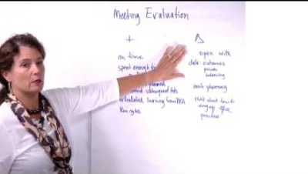
Seven step meeting process
Seven step meeting process
Institute for Healthcare Improvement (2021)
Notes:
The 7 step meeting process was created by the Institute for Healthcare Improvement.
Video link https://youtu.be/Zovb1qpR7Bc
Video is 8mins 20secs long from IHI
Clarify aim/purpose: It is very important, at the beginning of the meeting, to clarify and agree the purpose of the meeting. This promotes focus and clarity in the event of conversation drift, or if members feel lost in the process. There is also an opportunity here for introductions (new members/guest presenters) and for group members to highlight their reason for attendance.
Assign roles: There are four roles to be assigned –
Leader: The team leader role is not intended to be a power position, but rather a functional one. The leader can be the person who called the meeting, or can ask for a volunteer to lead the meeting. It is also appropriate to rotate this role to support development of group members. The leader’s role is to start the meeting, ensure that the agenda is followed with smooth transitions between agenda items and to conclude the meeting.
Recorder: The recorder role is crucial to ensure that key ideas, themes and actions are recorded for all to see. Recording on flip charts around the meeting room is encouraged. This means the notes are there for people to see and review before they add their thoughts. This minimises duplication that often occurs because people are busy thinking and may miss a contribution someone has already made. It is also extremely useful for late arrivals: they can catch up via the notes, thereby avoiding the need for any recap.
Timekeeper: The timekeeper keeps everyone on track with agreed timings for each agenda item, whilst also making appropriate contributions to any discussion. Once timings have been agreed for each agenda item, the time keeper should follow a rule of 50%. If an agenda item has been allocated ten minutes: -the timekeeper will call out “five minutes left” at the halfway point, -then “two and a half minutes left”, -then “one minute left”, -then “time!” It is then the leader’s role to check-in with the group to ensure the agenda item is concluded, or to determine if more time needs to be allocated. Extra time can be borrowed from another item or tabled and discussed at a future meeting. It is important for group members to understand that management of time is not the timekeeper’s responsibility. It is the responsibility of the entire group.
Facilitator: As much as possible the group should identify someone with accomplished facilitation skills for this role. The role of facilitator can be challenging and may not be required for every group situation. The facilitator will observe the meeting progress ensuring that all participants have an opportunity to contribute and that the group remains focussed on the agenda and the process.
Review agenda and times: This should be a quick review of proposed agenda items and clarification of late agenda submissions. Best practice would be to ensure that all group members have an opportunity to contribute and agree agenda items beforehand. Once the agenda items are agreed, a short time should be spent agreeing approximate time slots; this should take no more than a few minutes. The group should avoid over analysis of time slots – these can be renegotiated throughout the meeting depending on progress. You may also wish to agree timings prior to the meeting to save time in the meeting.
Work through agenda: The majority of the meeting should be devoted to working through agenda items. Steps 1–3 and 5–7 should take no longer than five minutes each, enabling an efficient, productive discussion focussed on the agenda items.
Review meeting record: When the agenda items have been discussed, the leader should take the opportunity to quickly review what has been accomplished, the key actions and responsibility for follow-up.
Plan next steps and next agenda: Based on what has been accomplished, the leader should ask the group to determine what the agenda items should be for the next meeting. Consequently, the group should leave the meeting with a clear understanding of the purpose and focus of the next meeting.
Evaluate: This final step supports the group to stay on track and improve future meetings. There are three steps to evaluation. Each group member should allocate a score ranging from 0 (worst meeting ever) to 10 (effective and efficient meeting where expectations were surpassed and progress was made). People should write these down without conferring. The purpose of the scoring is to demonstrate the variation. The next step is to ask each participant for “one thing they liked” about the meeting and “one thing that we could improve”. This last question is extremely useful to support continuous improvement of the meeting process.
Reference:
Institute for Healthcare Improvement (2021). 7 Step Meeting Process (video). https://youtu.be/Zovb1qpR7Bc

Slide 25
Example meeting
Objective
Assign roles
Review agenda
Review actions
Plan next steps and agenda
Evaluate
Review where we are with our QI project since we last met. Review PDSAs.
Bridget (Leader), Dimitrios (Recorder), Lu (Timekeeper) and Sam (Facilitator).
Agree agenda for this meeting? Do we need to discuss anything else?
Agenda item 1 10 mins
Agenda item 2 10 mins
Agenda item 3 5 mins
Agree actions 5 mins
5 mins
5 mins
Example meeting

Slide 26
Lunch break
Notes:
45 mins.

Slide 27
Get to know your faculty quiz!
Get to know your faculty quiz!
Notes:
We advise using a short poll/quiz with some random facts about one or two members of the faculty. It can be helpful in building relationships with the delegates of the programme.
One method we often use is to ask the group if a random fact is about you, or a given celebrity.
E.g.
Who tried to take a bus hostage with a toy gun when they were five years old?
A: Simon Cowell
B: Faculty member

Slide 28
Coaching circle
Activity 2.3
Notes:
Activity 2.3
60 mins
The format and structure of the coaching circle is explained in the next 2 slides. Please teach these before going into the activity.

Slide 29
Coaching circle
p12
1
Select the ‘coachee’ and time-keeper
Intention statement by ‘coachee’. Coaches listen deeply and may ask clarifying questions (don’t give advice!)
Short silence (stillness)
Mirroring
Generative dialogue
Closing remarks
Individual reflection
2 mins
10–15 mins
3 mins
10 mins
20 mins
8 mins
2 mins
2
3
Coaching circle
4
5
6
7
Notes:
Give a detailed overview as this is their first coaching circle.
Select the ‘coachee’ and time-keeper
The ‘coachee’ should be someone with a concrete and current coaching challenge that they would like support with
The time-keeper’s role is to help ensure the meeting stays on track.
Intention statement by ‘coachee’.
Clarify these questions:
Current situation: What key challenge or question are you up against?
Stakeholders: How might others view this situation?
What future are you trying to create?
Threshold: What do you need to let go of – and what do you need to learn?
Help: Where do you need input or help?
Coaches listen deeply and may ask clarifying questions (don’t give advice!)
Short silence (stillness)
Coaches should reflect on what they have just heard from the ‘coachee’.
What feelings, images, gestures and metaphors come to you, based on what you have just heard?
Mirroring
Each coach shares the images/metaphors, feelings and gestures that came up in the silence or while listening to the case story.
Having listened to all coaches, the ‘coachee’ reflects back on what they heard.
Generative dialogue
Reflect together on the remarks of the ‘coachee’, and move into a generative dialogue on how these observations can offer new perspectives on the case.
Go with the flow of the dialogue. Build on each other’s ideas. Stay in service of the ‘coachee’ without pressure to fix or resolve their challenge.
Closing remarks
By coaches
By ‘coachee’: How do I now see my situation and way forward?
Acknowledgment: An expression of genuine appreciation to each other.
Individual reflection.

Slide 30
Coaching circle ground rules
Peer-to-peer coaching in small groups (5–7 people)
Safe space to discuss recent experiences, challenges, approaches, reflections etc.
“A problem shared is a problem halved”
Opportunity to gain insights from others experiences
Good practice for coaching conversations
Space for micro-learning
Coaching circle ground rules
Notes:
Before you go into the circle I just want to give you some key highlights of coaching circles…
Peer-to-peer coaching in small groups (5–7 people)
Instead of one coach you get five!
The idea of a coaching circle involves meeting with your peers to discuss a defined challenge or topic that one (or more) of you is facing.
Safe space to discuss recent experiences, challenges, approaches, reflections etc.
You should use the concept of ‘Chatham House rules’.
When a meeting, or part thereof, is held under the Chatham House Rule, participants are free to use the information received, but neither the identity nor the affiliation of the speaker(s), nor that of any other participant, may be revealed.
This will create a safer space for the coachee to be more open and honest in their reflection and disclosure of information.
“A problem shared is a problem halved”
This saying could not be more true – through experience of being part of a coaching circle (both as a coach and a coachee), I’ve come out of the other side with a better way forward, and others to support me with that journey.
Opportunity to gain insights from others experiences
We all have our experiences – that is what makes us as a collective so powerful.
QI is a very multidisciplinary field by its nature.
We can all learn a lot from one another's experiences and this makes us all better coaches.
Good practice for coaching conversations
This may still be quite new to you. Using a structure like GROW can be helpful but practice and experience are key to becoming a good quality coach.
You will also get to observe other coaching styles from your peers – which may help shape what you do and don’t do going forward.
Space for micro-learning
QI is about learning. Use this time to seek new insights and pick up new tips, tricks, tools and techniques. If you see something you like, ‘pinch with pride’.

Slide 31
Coffee break
Notes:
10 mins

Slide 32
Coaching a QI aim statement
Questions to ask:
What is the problem we are trying to solve?
What is the crux of the issue?
What do you mean?
Can you give an example of the issue?
What might good look like?
What is that in service of?
Coaching a QI aim statement
Notes:
As a Quality Coach, one of the key tasks you will undertake is supporting improvement teams to set a SMART aim statement.
Teams do not always get this right the first time, and so you may need to use coaching techniques to help them strengthen their aim statement. Example questions that can be useful are shown on the screen.

Slide 33
Coaching a QI aim statement
Keep it small and grow the scope later if needs be
Avoid management jargon and ‘weasel words’
Keep it simple – if you don’t understand it, the chances are others won’t get it
Reassure that this is a difficult part to get right
The aim will probably change.
Coaching a QI aim statement
Notes:
Read the slide.

Slide 34
Beware ‘weasel words’
Beware ‘weasel words’
best practice
effective
evidence-based
excellence
high quality
high value
responsive
streamline
value
value-added
world class
…and many more!
Notes:
‘Weasel words’ are words that have no specific, obvious and singular meaning.
They bring no clear images to mind of what is meant.
Their use in an aim makes objective measurement difficult so it’s best to avoid them and help teams move away from weasel words to something more quantifiable.
Examples are shown on the screen.

Slide 35
Pebbles and boulders
p30
Respond/accept
Pebbles and boulders
Influence
Control
Notes:
The root causes to a problem can be categorised as boulders or pebbles and we can map them onto this bullseye which shows there are some things in our day-to-day work that we can control (centre), there are some things we can influence (middle circle) and there are some things we can only respond to (outer circle).
Boulders: These are the things that are out of your control or influence. You can only respond or adapt to these challenges. A common example of this is the financial constraints on the service.
Pebbles: These are the things that you are able to change – either because they are directly under your control, or because you hold influence over changing them.
See also the CIA model on p63 of the handbook.

Slide 36
Coaching a QI aim statement
Context
You have just completed your contracting with a QI project team
Your task is now to coach the project lead to identify a SMART aim for their project
Using a coaching approach, what questions could you ask to help the team leader to identify their aim statement and consider how to engage the team in improvement work?
Background
“My friend has recently lost over 10kg by cycling to work instead of driving. So my SMART aim is to cycle to work 100% of the time over the next four months and to lose weight so I can fit into my summer outfits.
I weigh 80kg at the moment and eat and drink a normal amount for a person of my age.”
Coaching a QI aim statement
Notes:
You should role-play this particular aim statement. Circa 5 mins (no more than this).
One of you will take on the role of the coachee – someone keen to lose weight with a defined intervention.
Another will take on the role of the coach (if there is one faculty member then you can invite a delegate or two to take on this role). Their role in this short role play is to use GROW coaching and coaching questions to help the coachee shift from a narrow solution-based approach to a more QI approach.
Others should observe the process and take notes – they will have a go next in small groups.

Slide 37
Coaching a QI aim statement
Activity
In groups of three (coach, project member, observer)
Using the project brief, role play the development of a SMART aim for the project
Activity 2.4
Notes:
See Trainer Guide 2.4
20 mins with 10 mins group reflection/feedback.

Slide 38
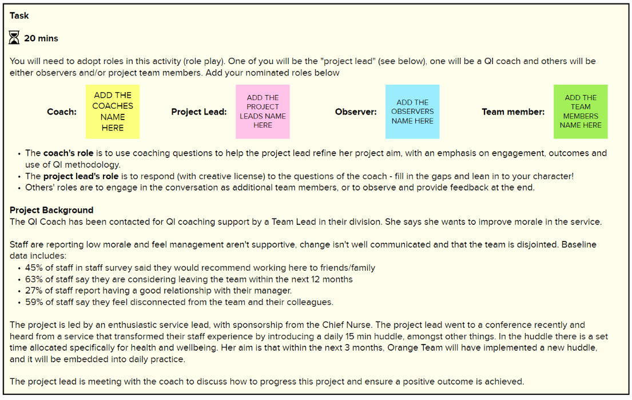
Coaching a QI aim statement
Coaching a QI aim statement
Notes:
See Trainer Guide 2.4
20 mins with 10 mins group reflection/feedback

Slide 39
Comfort break
Notes:
5 mins

Slide 40
Pitfalls and challenges of new coaches
We know 80% of change is about people (adaptive).
Identify common pitfalls of engaging and working with teams as a QI coach.
How could you avoid these or fix them?
Notes:
Discussion in room – what are their experiences and thoughts on the pitfalls and challenges a new coach faces?
Encourage delegates to come up with as many common pitfalls as they can.

Slide 41
Possible pitfalls
p103
Expected to fix everything | Unrealistic time frame | Sent to coach a team who don’t want you | Getting too involved/ taking over
Coach linked to the success/failure of the project | Unrealistic scope (solve world peace) | You are a part of the management
Possible pitfalls
Notes:
Ask the group what we can do to overcome or prevent these. Open discussion
See the handbook for some possible solutions.

Slide 42
Alignment of your development and the work
First meeting with improvement team
Completion of improvement work
Coaching and the Foundations of QI
Working with People
Coaching Measurement
Human Side of Change
Alignment of your development and the work
Stage 1
Identification of a quality issue
Stage 2
Understand the current situation/ problem
Stage 3
Measure for improvement
Stage 4
Develop a strategy and change ideas
Stage 5
Small-scale testing
Stage 6
Sustain improvement
Notes:
Shown on the screen is the archetype of a QI improvement effort.
This is aligned to the coach programme, with your first contact with the improvement team after we finish today’s taught content.
You may wish to update the graphic of the 6 stages of improvement with your local one or one from another programme (e.g. QSIR, NHS Scotland or similar) if this is more useful to you. The Six Stages have been designed by CLCH NHS Trust – they are generalizable to all health setting but local adaptation is encouraged.

Slide 43
Six stages of QI work
Stage 1
Identification of a quality issue
Stage 2
Understand the current situation/ problem
Stage 3
Measure for improvement
Stage 4
Develop a strategy and change ideas
Stage 5
Small-scale testing
Stage 6
Sustain improvement
Forming the QI team
Creating conditions for the QI work
Get commitment and organisational support
Analysing the context and culture
Scoping the problem or opportunity
Collecting user experience
Cause-and-effect analysis
Stakeholder management
Appreciative inquiry
Selecting measures
Setting aims
Collecting and analysing data
Presenting data
Plotting the theory of change
Prioritising ideas
Designing sustainable change and being creative
Factoring in behaviour change
PDSA
Evaluation
Working with resistance
Implementation and spread
Sustaining change
Six stages of QI work
Notes:
You may wish to update the graphic of the 6 stages of improvement with your local one or one from another programme (e.g. QSIR, NHS Scotland or similar) if this is more useful to you. The Six Stages have been designed by CLCH NHS Trust – they are generalizable to all health setting but local adaptation is encouraged.

Slide 44
Six stages of QI work
Stage 1
Identification of a quality issue
Stage 2
Understand the current situation/ problem
Stage 3
Measure for improvement
Stage 4
Develop a strategy and change ideas
Stage 5
Small-scale testing
Stage 6
Sustain improvement
Forming the QI team
Creating conditions for the QI work
Get commitment and organisational support
Analysing the context and culture
Scoping the problem or opportunity
Collecting user experience
Cause-and-effect analysis
Stakeholder management
Appreciative inquiry
Selecting measures
Setting aims
Collecting and analysing data
Presenting data
Plotting the theory of change
Prioritising ideas
Designing sustainable change and being creative
Factoring in behaviour change
PDSA
Evaluation
Working with resistance
Implementation and spread
Sustaining change
Activity 2.5
Notes:
You may wish to change the heading to reflect your own approach i.e. do you use 6 stages of QI work or something else?
Activity 2.5 – 40 mins breakouts, 10 mins group discussion.
The template has a space to note down some thoughts around key questions
Consider your role as a coach in the stages of any given QI work:
what you'd do to support the tasks/stages of the work
what you wouldn't do
what the challenges/pitfalls might be for each stage
what questions you might ask
what tools could be used.

Slide 45
Six stages of QI work – Reflection
Six stages of QI work – reflection
Notes:
You may wish to change the heading to reflect your own approach i.e. do you use 6 stages of QI work or something else?
Useful prompting questions
Do you like the 6 stages of QI work?
What questions do you have around the stages of QI that you do not feel confident in?
What was reassuring for you, if anything?
How might you use this going forward?

Slide 46
Today’s learning outcomes
By the end of the session, you will…
Understand the concepts of coaching improvement and the difference between coaching and advising
Be able to explain your role as a Quality Coach to different stakeholders
Be able to effectively contract as a coach with a QI team
Reflect on your role as a coach in relation to the key stages of QI work
Be able to use the coaching circle as a useful method for supporting your Quality Coach peers
Today’s learning outcomes
Notes:
Each session has its own learning outcomes. Today’s focus on coaching and the foundations of improvement.
As delegates on the programme, we encourage you to reflect on the learning outcomes at the end of each session. Ask yourself: can I meet the outcomes shown on the screen without guidance from a member of the QI team? If not, then think about what you need to meet these learning outcomes.

Slide 47
We need your feedback
Feedback
Notes:
Use your evaluation forms to gather feedback on the day.

Slide 48
Just-in-Time learning (JIT)
What
A targeted approach providing people with the information they need, when they need it.
Typically attributed to Toyota.
Why
Good to respond to demands.
Expect information to be readily available when we need it.
How
Bite-sized information or training that can be delivered on the spot so learners can absorb the information when they need it.
Just-in-Time learning (JIT)
Source: Growth Engineering
Notes:
Just-in-Time approaches have their origins in the world of manufacturing. In fact, the origin is typically attributed to the car manufacturer Toyota, as they created a production system where parts arrive at their warehouse only when they are ready to be distributed.
Example – give an example of Just-in-Time learning used by Facilitator. E.g. when coaching a team, googling a PDSA and talking them through how it works, or finding a trusted video to play. Everyone will have ways that works best for them, and that’s fine!
Reference:
Growth Engineering. Just-in-Time Learning: 8 steps to success. www.growthengineering.co.uk/what-is-just-in-time-learning/

Slide 49
Teachback – next time
Read up on the follow subjects:
Run charts
PDSA
SMART aims
Family of measures
Driver diagrams
The QI Refresher in your handbook may be a helpful resource
Teachback – next time
Notes:
Next time you will be practising Just-in-Time learning through a teachback activity. This will be a safe space for this.
There will not be a coaching circle next time. Instead, you will split into small groups (3–4 people) and will be asked to quickly prepare a short (five min) presentation to ‘teach back’ a simple QI concept. You do not need to prepare the materials in advance as you will be randomly assigned a topic on the day.
Please read up on the above concepts (note to faculty to add or remove topics based on number of delegates in your group) – the QI refresher in the handbook may be useful to read up if you are not 100% confident in the subjects.

Slide 50
Self-directed learning
1
2
3
Complete the Working Styles questionnaire. This will help us with an activity next time
Read the Pitfalls of Coaching section of the handbook
page 101
Read the Group Dynamics section of the handbook
page 133
Self-directed learning
Notes:
The working styles questionnaire is included in the QCDP resource pack (available at https://q.health.org.uk/resource/quality-coach-development-programme/).

Slide 51
References and links
Backhouse, A., Ogunlayi, F. (2020). Quality improvement into practice. BMJ.
https://www.bmj.com/content/368/bmj.m865
Institute for Healthcare Improvement (2021). 7 Step Meeting Process (video).
https://youtu.be/Zovb1qpR7Bc
Growth Engineering. Just-in-Time Learning: 8 steps to success.
www.growthengineering.co.uk/what-is-just-in-time-learning/
References and links

Slide 52
Authors
Sidney Beech Bridget Browne Robin Davis Samantha Machen
Contributors
Jennifer Cotter Hannah Pearson
Slide design and layout by Studio Quercus

Slide 53
Authors
Sidney Beech Bridget Browne Robin Davis Samantha Machen
Contributors
Jennifer Cotter Hannah Pearson
Slide design and layout by Studio Quercus

