Slide 1







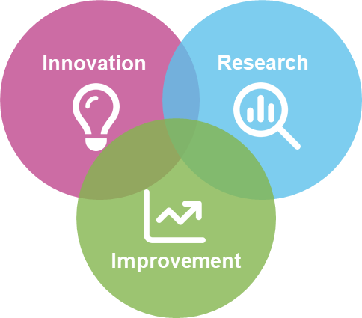
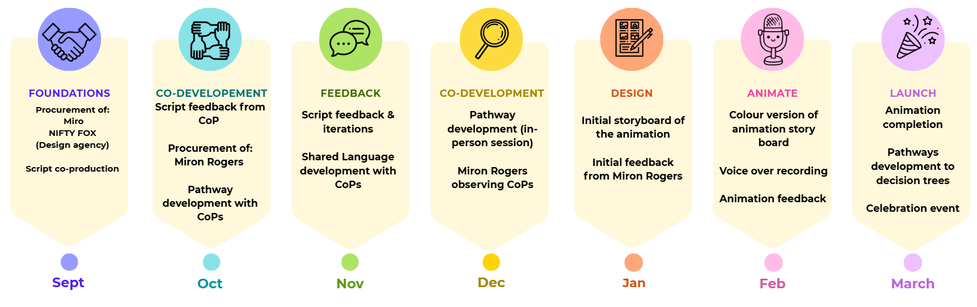
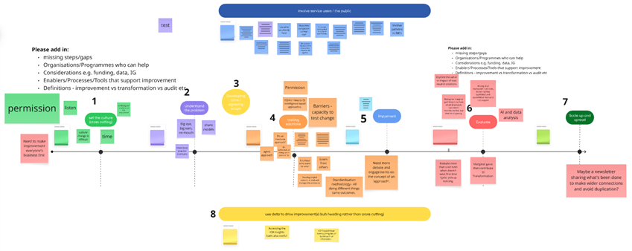
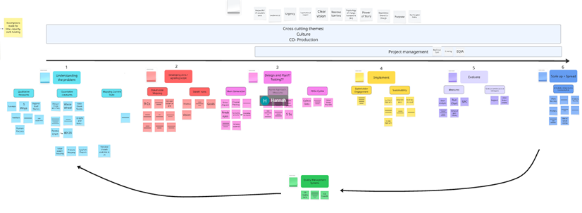
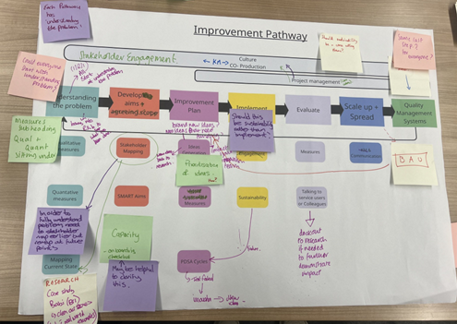
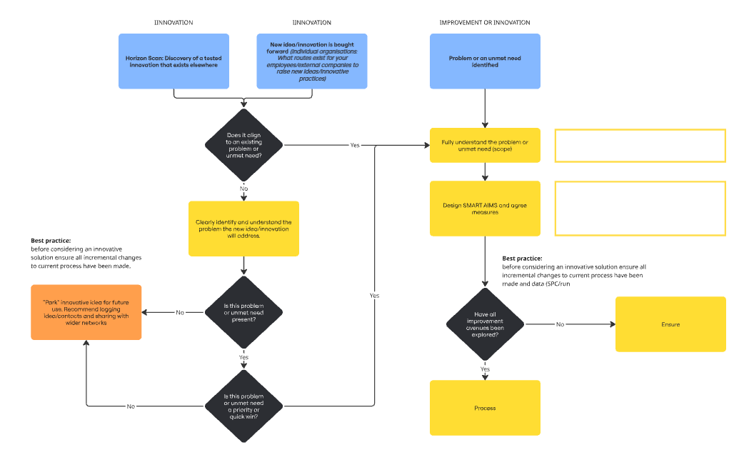
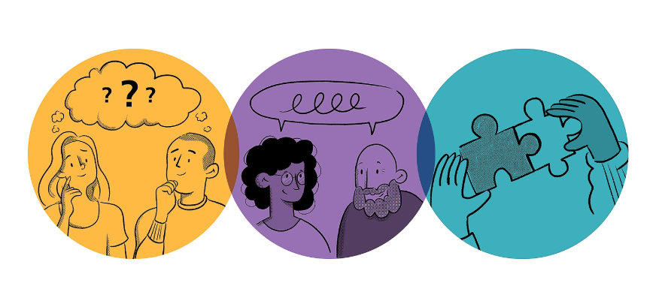
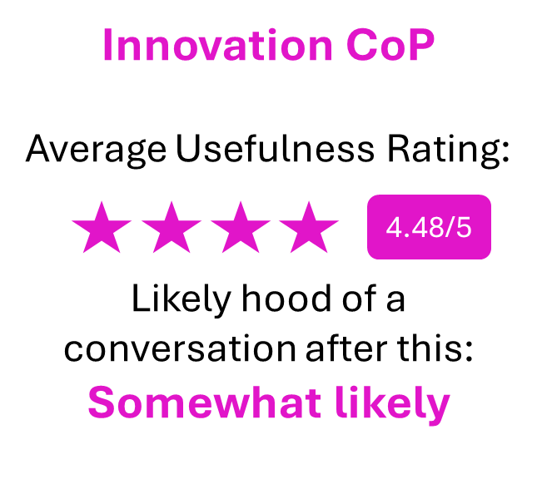
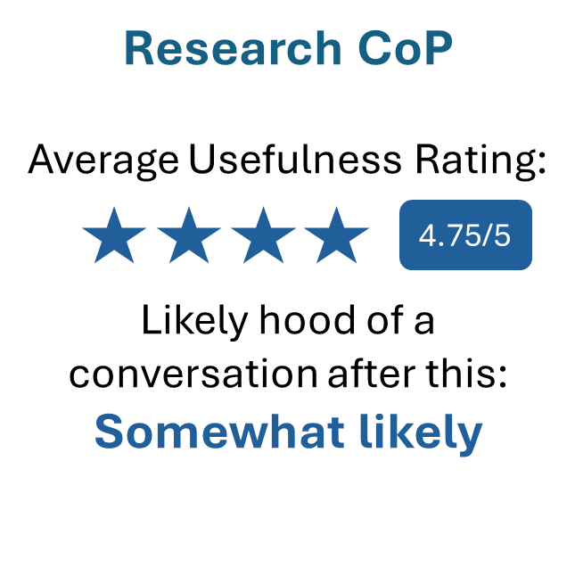
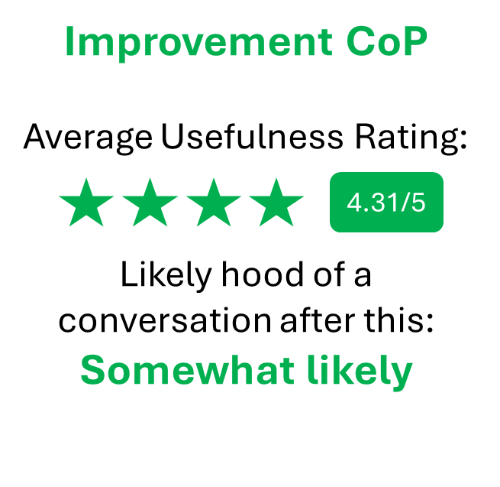
Connecting Innovation, Research and Improvement
across Humber and North Yorkshire
Global aim
To better connect Innovation, Research, and Improvement across our HNY system, to support the development of a unified culture that enables accelerated change to happen.
...
To co-produce an explainer animation
To co-design practical pathways
To co-design a
shared language
To grow and develop
Communities of Practice
Introduction
Across health and care systems, Innovation, Research, and Improvement (IRI) activities are often undertaken in parallel but remain largely siloed. Despite shared aims and overlapping personnel, each domain typically operates with distinct processes, terminology, and entry points. This fragmentation limits collaboration and creates barriers when initiatives move between domains.
Demand for IRI activity continues to grow while resources remain constrained. Expectations of what can be achieved with those resources are increasing, and the consequences of inaction are substantial. These challenges highlight the need for stronger integration and alignment across IRI domains.
This project is funded through the Q community’s Supporting Q Connections programme.
Find out more here:
hnyicb-ery.iris@nhs.net
Timeline
cv
Improvement Methods
The work so far has used a mix of the Model for Improvement (PDSA cycles) along with the Double Diamond Design model: Discover, Design, Develop and Deliver taking complex ideas, language and pathways and simplifying with stakeholders from across Health and Care organisations in Humber and North Yorkshire (both within and external to the NHS). This process has taken place across three CoPs
with a collective membership of over 300colleagues, building relationships and trust across Organisational boundaries as the work progresses.
Progression of the pathways
cv
At each stage, further detail was added including examples of tools, measures and support services within HNY.
We linked with external partners: the Q Community, Health Foundation and NEY Network.
​
Each CoP co-produced an initial pathway; a high-level attempt at explaining the steps we go through when completing a IRI project.
An in-person session made further iterations on the pathways and was used to understand where IRI interconnect.
The pathway is being developed into practical decision trees, which a design agency will be working on.
Measuring Success
As this work is about building and changing culture which takes time; our measures are mainly qualitative through questionnaires, please see below for some measures: (as we are yet to launch our co-produced tools, we are unable to share data at this point)
Increase in Research, Innovation, and Improvement work shared across organisational boundaries
Increase in Communities of Practice membership and participation
Increase in the number of cross organisation/ joint work in Innovation, Research, and Improvement
Decrease in the number of "stuck" pieces of work
Feedback from the CoPs
The Animation
An amination is currently being created by a design agency it has been voiced by members of the design group who represent members of our system. It demonstrates how curiosity, openness and collaboration are essential foundations of working together to make a lasting, positive impact on lived in Humber and North Yorkshire.
'A great opportunity to connect and learn from each other'
'I value meeting new people and potential stakeholders for future projects'
Impact
Through the work we have done so far, we have seen colleagues come together from and build new trusting relationships with one another. We know that building stronger connections across IRI as well as across organisational boundaries will help to change the dial in the way we work together and help to accelerate more transformational change. This work is about building and fostering these strong connections. In the words of Margaret Wheatly we know that creative solutions come from new connections and that to save a failing system we must connect it with more of itself. We hope to demonstrate more of the Impact as our co-produced products launch and we progress with the work.
Anja Jensen, Hannah Parker, Becky Bibby, Callum Schofield, Amanda Lilley –Kelly, Juan Winter, Karen Lucas, Tracey Daniels, Gemma Kierczuk, Tracey Wartnaby, Marie Girdham

